Slide 1


1. Fluency
2. Reasoning and Problem Solving
3. Resources
4. KS2 Assessment

Slide 2
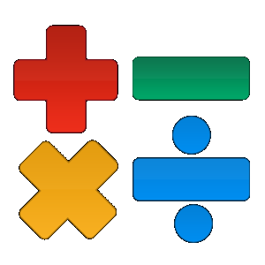
What is fluency?
One of the three aims of the new curriculum states that pupils (of all ages, not just primary children) will: become fluent in the fundamentals of mathematics.
Children will be able to use the four operations to answer number problems. This includes:
percentages, fractions and decimals.

Slide 3
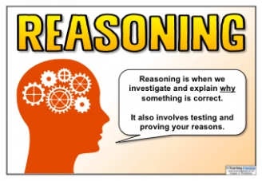
Reasoning and Problem Solving
Reasoning and problem solving is about knowing when to apply the fluency skills in order to provide a reason and overcome a problem.

Slide 4
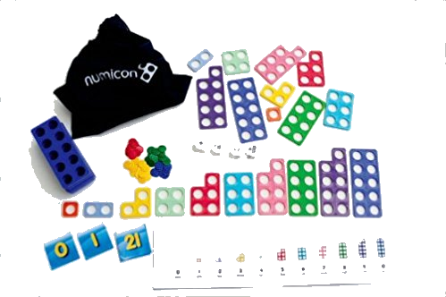
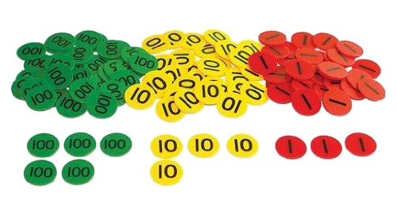
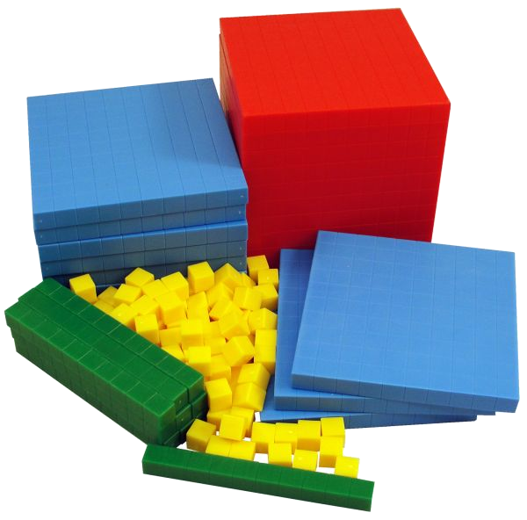
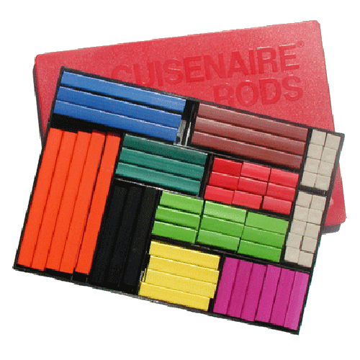
Resources
All classes now have a vast range of resources to support the teaching of fluency, reasoning and problem solving!

Slide 5

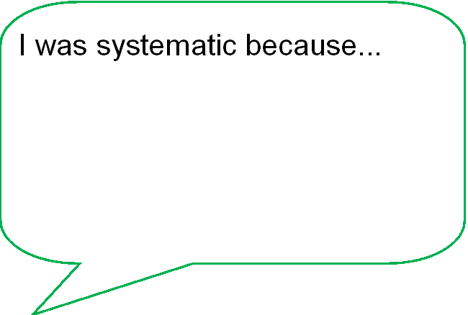
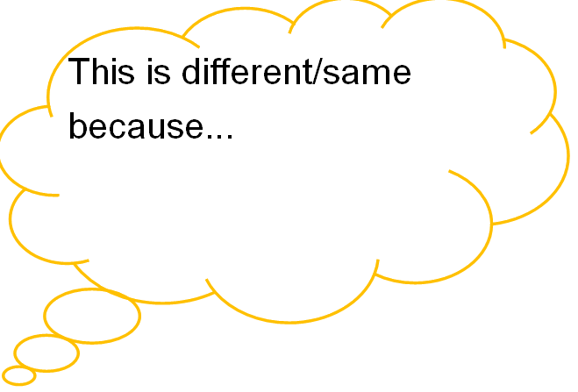
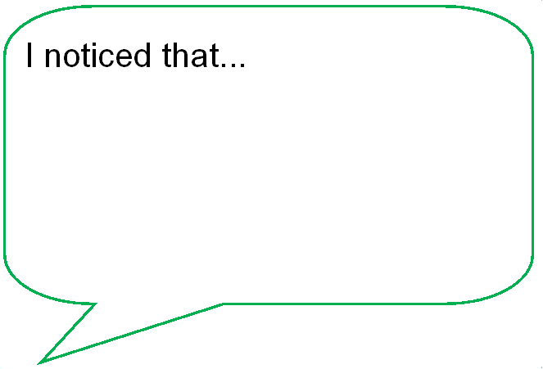
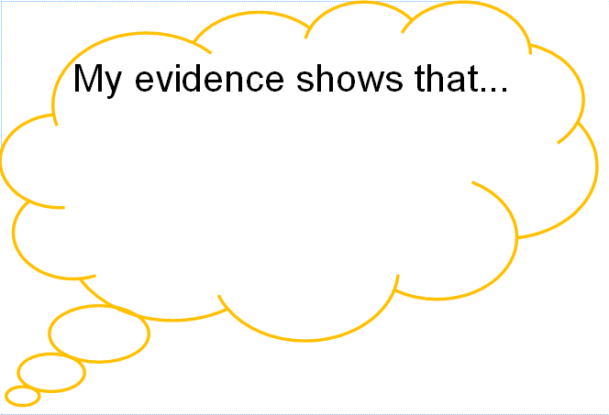
Mathematical Vocabulary

Slide 6
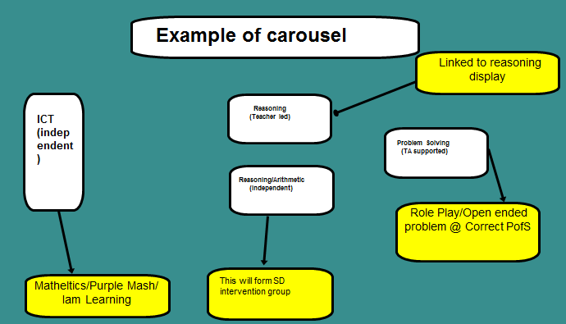
Lesson Set Up

Slide 7
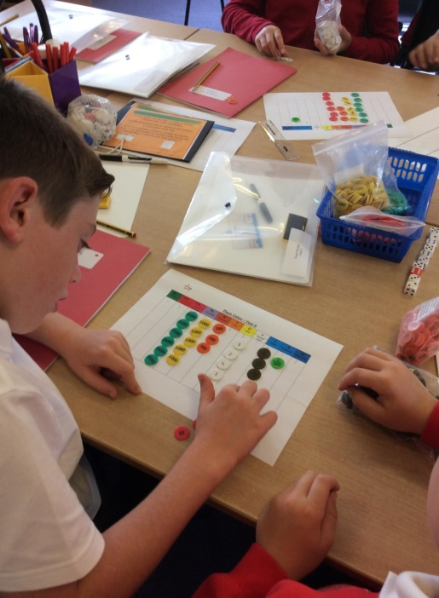
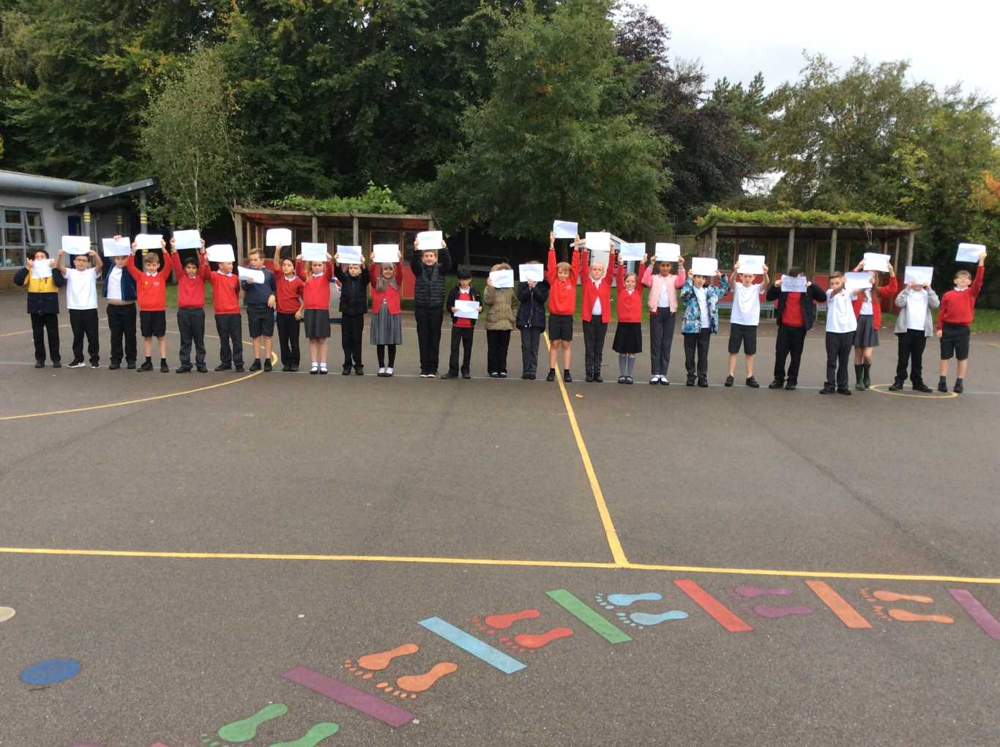
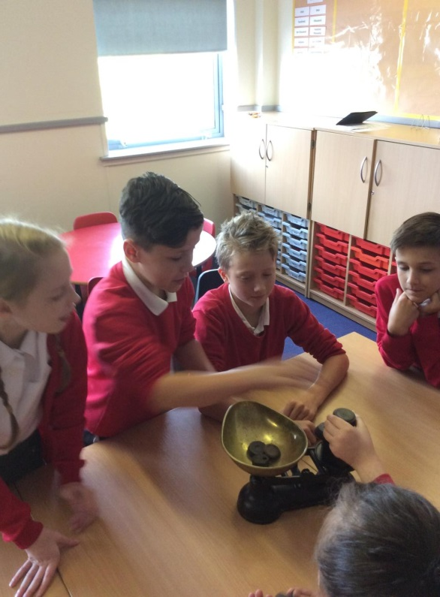
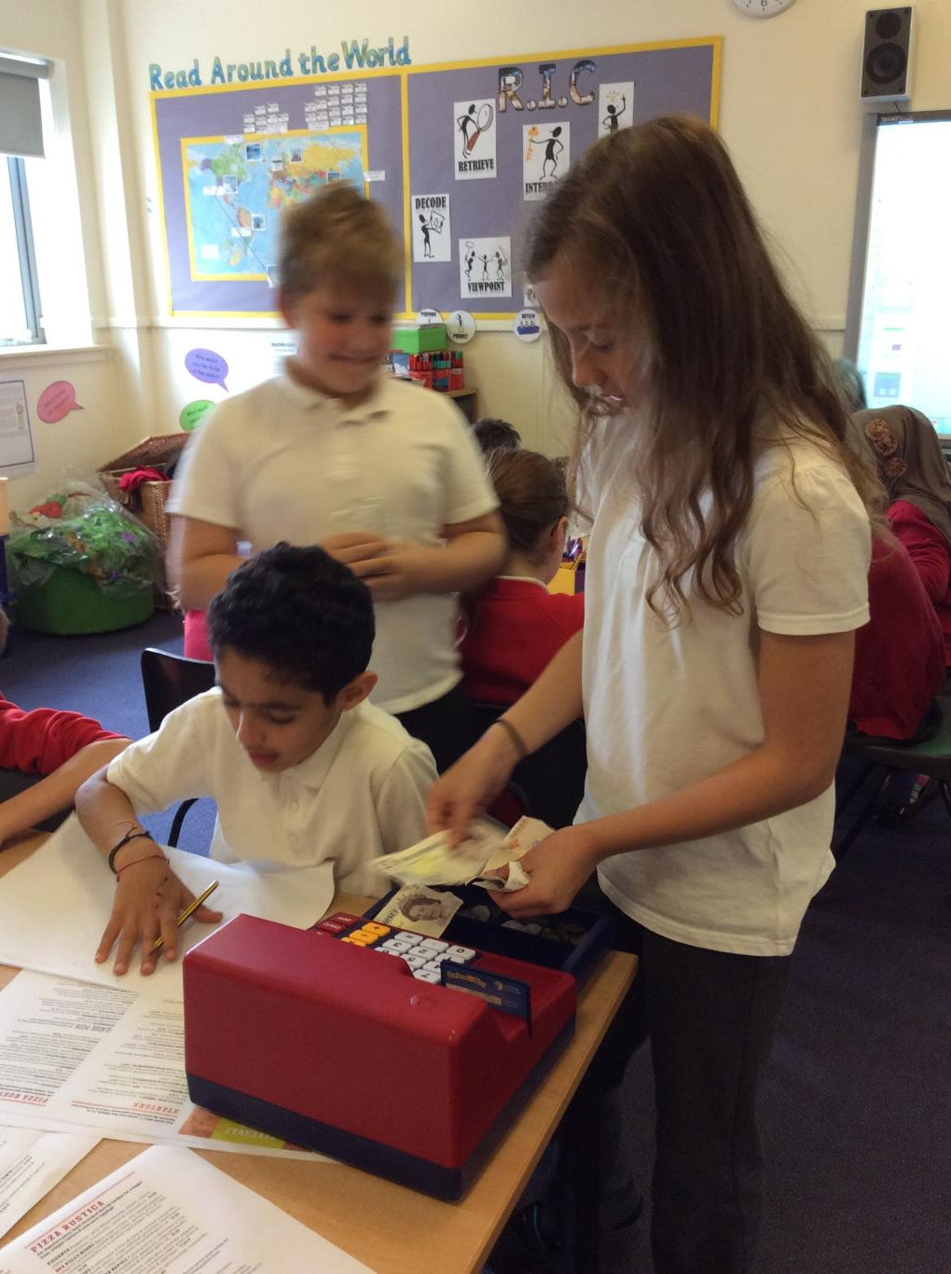
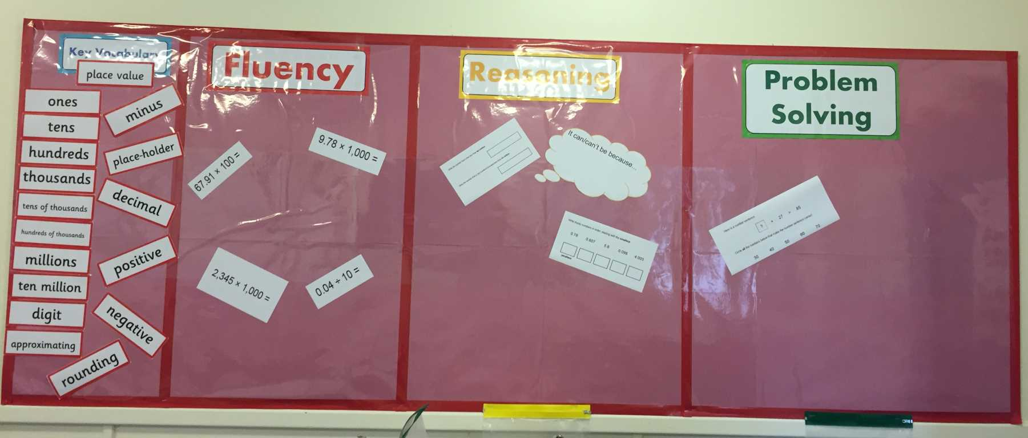
Here's a look at the year so far!

Slide 8

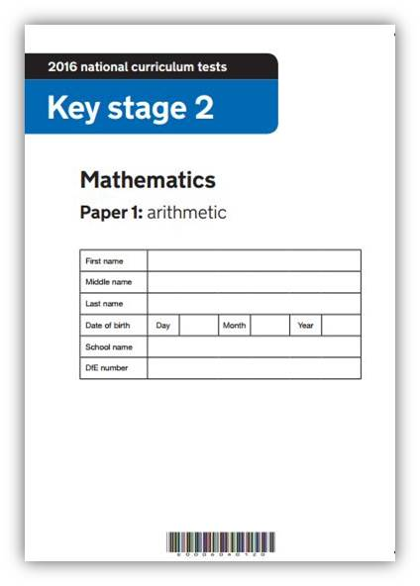

End of Key Stage 2 Assessment
Paper 2:
Reasoning
Paper 1:
Arithmetic
Paper 3:
Reasoning
Year 4 times tables test!

