Slide 1

We could be Heroes…
KS2 Football Heroes Competition
Teacher’s Powerpoint
T: 020 7587 1842
W: literacytrust.org.uk
Twitter: @Literacy_Trust
Facebook: nationalliteracytrust
Notes:
A short class / KS2 assembly to introduce the Football Heroes competition to children.

Slide 2
Quick Quiz … Whose profile?
Name: _____________
Date of Birth: 28 July 1993
Place of Birth: London
Nationality: English
Current Club: _________
Height: 1.88m
Position: Centre Forward
International Appearances: 39
?
International Goals: 22
Club appearance this year:28
Awards:
World Cup ____ Top Goal Scorer
Notes:
Talk to the person next to you – whose profile could this be?
Extra Clues on the next slide!

Slide 3
Quick Quiz … Whose profile?
Name: _____________
Date of Birth: 28 July 1993
Place of Birth: London
Nationality: English
Current Club: Spurs
Height: 1.88m
Position: Centre Forward
International Appearances: 39
?
International Goals: 22
Club appearance this year:28
Awards:
World Cup 2018 Top Goal Scorer
Notes:
Now with the most obvious clues…
Answer on the next slide!

Slide 4
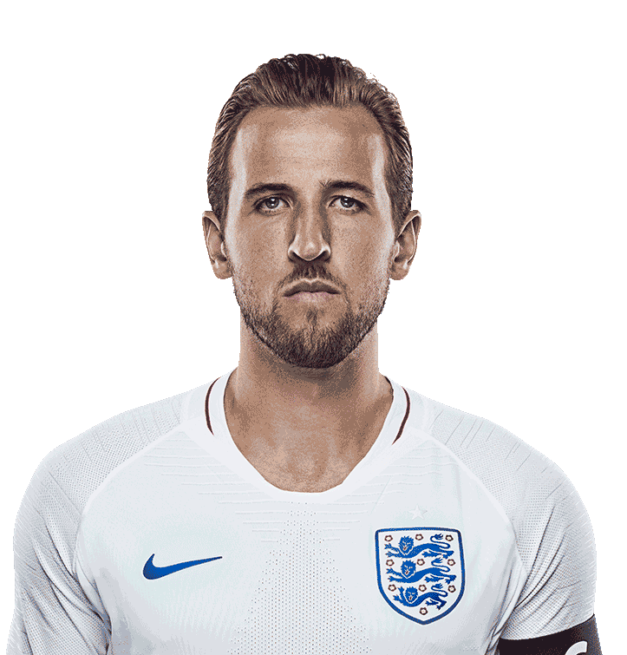
Quick Quiz … Whose profile?
Name: Harry Kane!
Date of Birth: 28 July 1993
Place of Birth: London
Nationality: English
Current Club: Spurs
Height: 1.88m
Position: Centre Forward
International Appearances: 39
?
International Goals: 22
Club appearance this year:28
Awards:
World Cup 2018 Top Goal Scorer
Copyright: Ian Walton
Notes:
Explain that over the next few weeks the school will be challenging pupils to create a hero profile to enter an exciting competition.
If parents have been invited, explain there will be opportunities for them to get involved throughout.

Slide 5
Zero to Hero
Who was your hero from last year ?
Football Hero?
Other Sporting Hero?
Friend?
Family Member?
Someone else?
+ Why?
Notes:
Talking partners – 1 minute monologue then swop.
Select a few from the audience, feedback and ask them to explain their choices. Share your very own hero as an example.

Slide 6
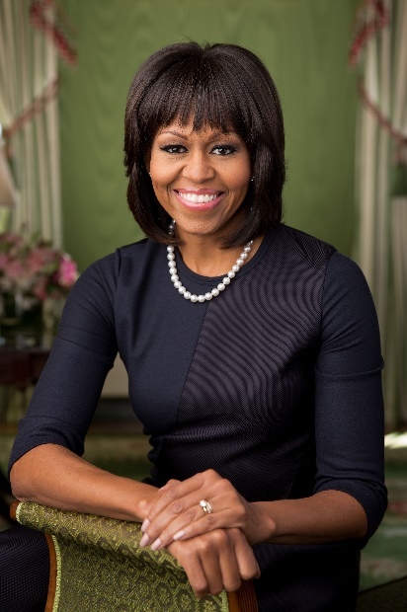
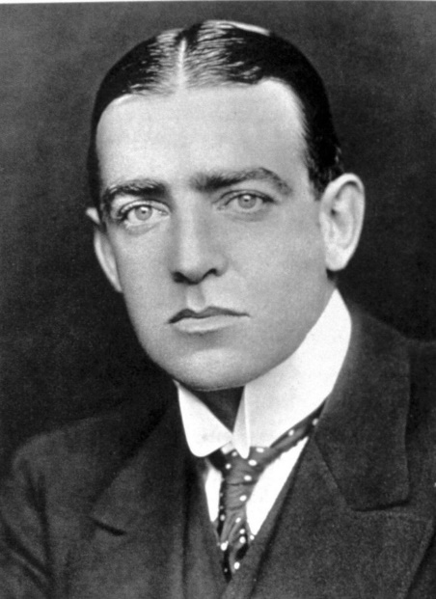
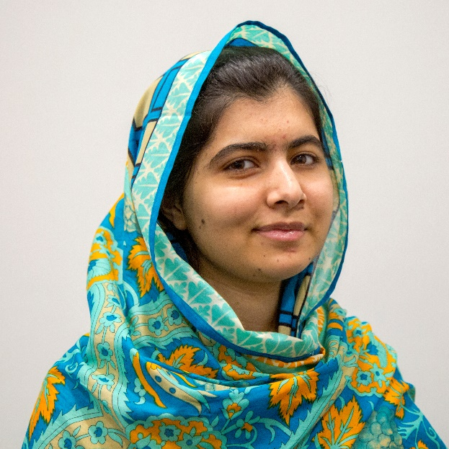
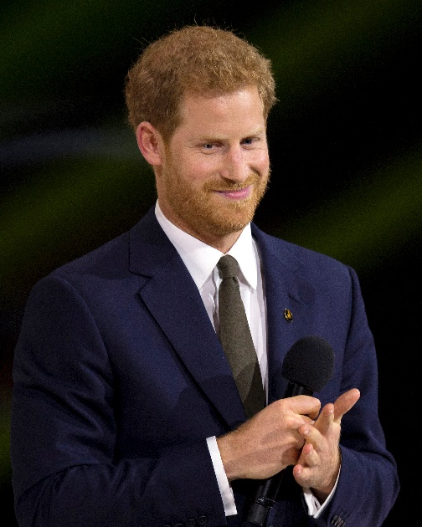
Heroes can be male or female!
Notes:
Explain that a hero can be male or female. Does anyone know what we call a female hero? Hero is the masculine. Heroine is the feminine.
Michelle Obama – the US President’s wife and a active supporter of young people
Sir Ernest Henry Shackleton CVO OBE FRGS was a British polar explorer
Malala Yousafzai is the youngest Nobel Prize Laureate and an activist for female education
Prince Harry founded the Invictus Games for wounded serviceman to compete in sports.

Slide 7
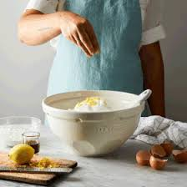
What makes a hero ?
What are the qualities of a hero?
Notes:
We all have heroes – but what are the qualities of a hero? How do we know someone is a hero?
Encourage discussion.

Slide 8
Ingredients?
Courage?
Determination?
Leadership?
Overcoming adversity?
Generosity?
Achievement?
Notes:
Collate answers and add to the slide / flipchart where available.

Slide 9
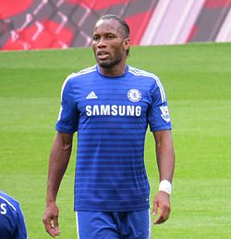
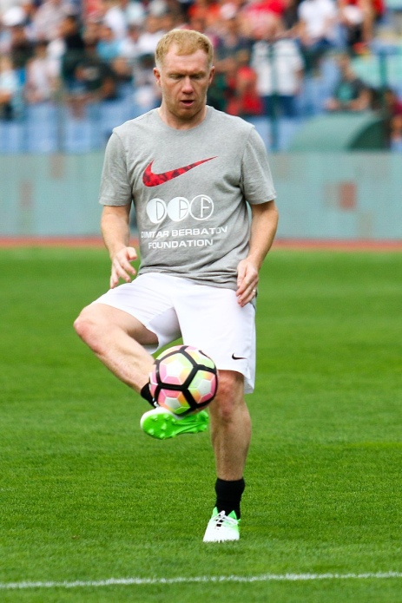
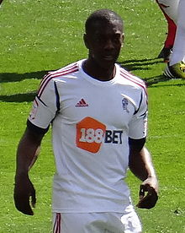
Did you know?
DIDIER DROGBA
PAUL SCHOLES
MARVIN SORDELL
CC BY-SA 4.0
CC BY 4.0
CC BY-SA 2.0
Notes:
We all have sporting heroes but what makes them heroes is not just what they do on the pitch but also their personality and what they do off the pitch. Share these 3 inspirational examples using the information below.
Didier Drogba Chelsea and Ivory Coast striker
1998-present
But for all his achievements on the pitch, it is away from football that has made him a role model to millions of children in his home country – and is even credited with playing a vital role in bringing peace to the Ivory Coast.
When the Ivorians qualified for the 2006 World Cup, they were embroiled in a civil war that had plagued the country for five years.
Didier made a desperate appeal for his countrymen to end the war, and his people listened.
A year later, he was appointed by the United Nations Development Programme as a Goodwill Ambassador.
In 2009, he donated a $3 million to the construction of a hospital in his hometown of Abidjan and a year later his peace and charity work led him to being named one of the world's 100 most influential people by Time Magazine.
MARVIN SORDELL
Back in 2012, Sordell was seen as England’s next big striker, but like so many, the teenager struggled to live up to the great expectations. He now plays his football for Burton Albion in the Championship, where he’s happier and free to work on his important off-the-pitch interests. These include poetry and writing and campaigning for better mental health support in football.
PAUL SCHOLES
Manchester United and England midfielder
1993-2004
He made 718 appearances for United and earned 66 caps for England and in that illustrious career he won the Treble, 11 Premier League titles, three FA Cups and two UEFA Champions League medals.
However, after every football match, he returned home to his family, avoiding nightclubs and the paparazzi, to be with his wife Claire and three children – the youngest of whom is autistic.
In his autobiography Scholes: My Story, Paul wrote:"Aiden suffers from autismand has quite severe learning difficulties, so he can't take part in most sports at the moment, though he does absolutely love his swimming.
"He seems in his element when he is in the pool, he's a real water baby and it's wonderful that he's got that to enjoy.
"We hope his condition improves but we're not banking on it, just doing everything we can to make sure he has a happy life. He has a load of people trying to help him, speech and play therapists for example.
"Aiden's in his own little world, and it is some consolation that he does seem content with it."
One of the greatest footballers of his generation – and a brilliant dad.

Slide 10
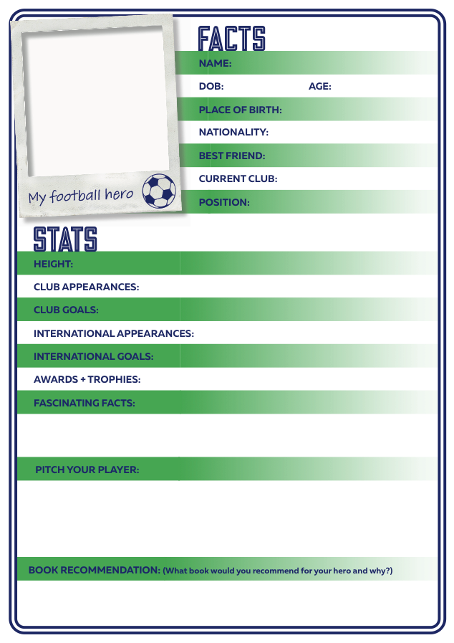
The Challenge
Create your own hero profile
> Research
> Facts & Stats
> Fascinating Facts
Pitch your Player …
or
Let’s Hear it for your Hero
Notes:
Introduce the competition. Explain that whilst is inspired by the Football Heroes series, they are not limited to choosing a footballer – they can choose anyone as long as they can demonstrate that they deserve to be a hero ( and as long as it’s a real person and not fictional).
If parents are present this could be a great opportunity to talk about how the partnership between parents pupils and schools is key as a reminder at the start of term and of course for new parents. Explain that the first activity looks at Family Heroes and children will be tasked with finding out about family heroes – footballers, family members and other aspirational figures.

Slide 11

Use your powers of persuasion
5 Points why YOUR hero
should be the ULTIMATE hero
Notes:
The Facts and Stats are relatively easy – the tricky bit will trying to persuade us that your hero is the ‘Ultimate Hero’ and has the top hero rating. Activities will help children write a persuasive pitch

Slide 12
Your own personal challenge…
What about you?
How could YOU be a hero this new school year?
Notes:
Finally at the start of the year – concentrating on the qualities of a hero and what our heroes mean to us is a great opportunity. Encourage pupils to set themselves a challenge for the new academic year – how can they be heroes in this schools year? You could even give the post it notes or luggage tags and encourage them to make a classmates’ pledge of the personal qualities they’d like to develop in their new year group.

