Slide 1
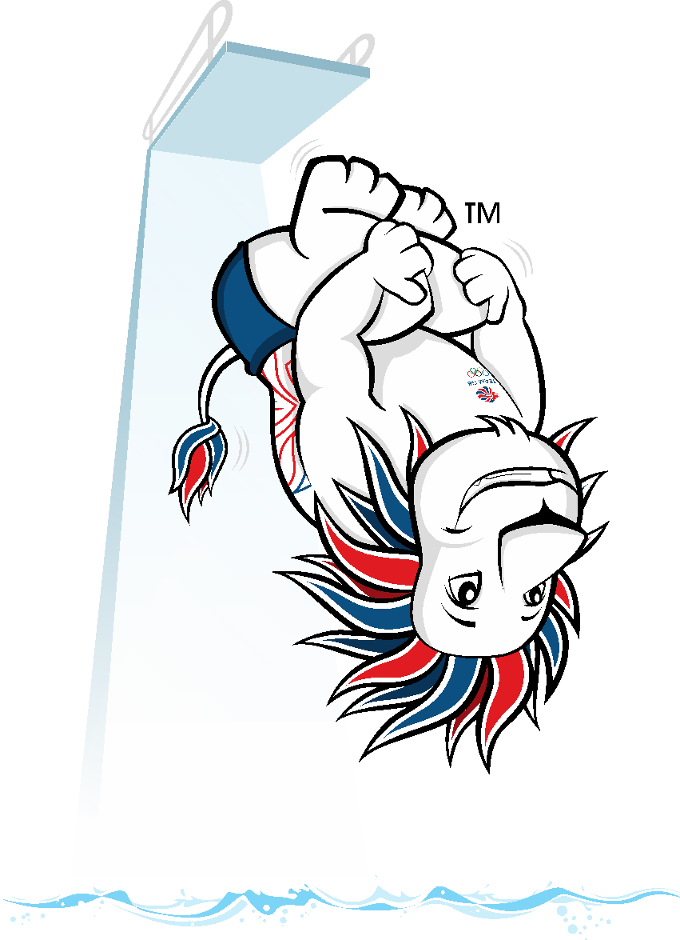
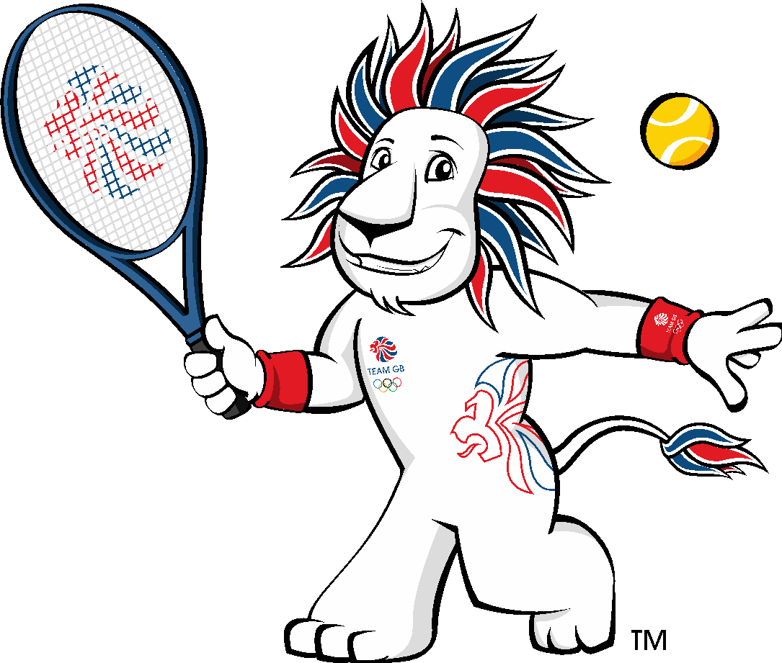
THE MASCOT CHALLENGE
Design a mascot for ParalympicsGB and their supporters

Slide 2
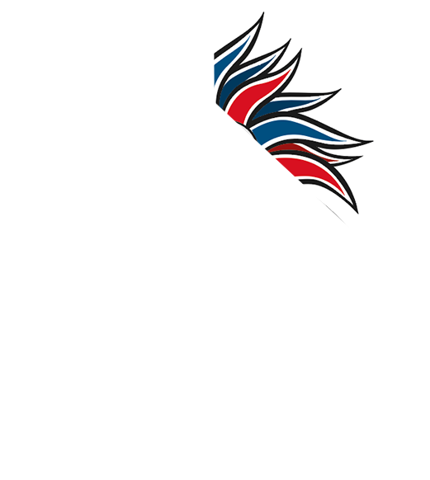
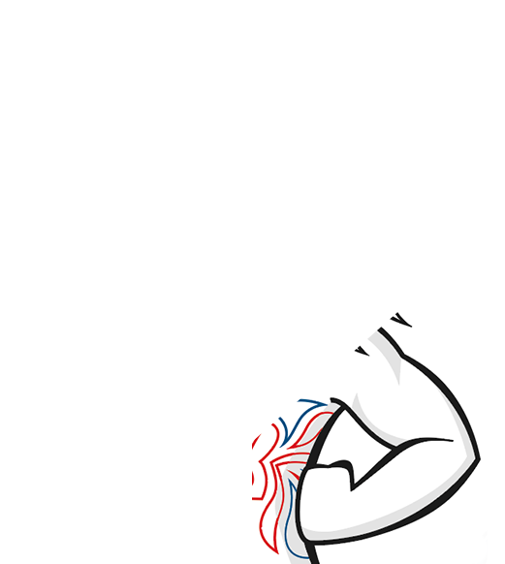
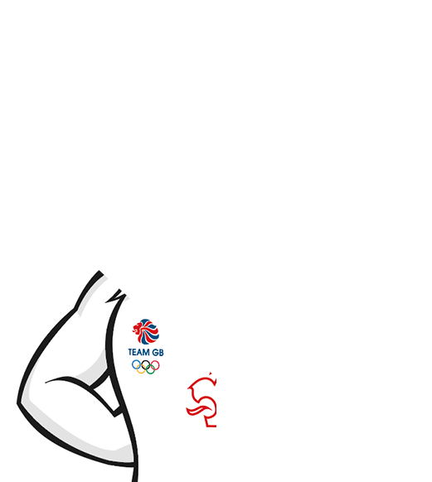
What’s in the picture?
Click to reveal the picture and answer!
Pride, Team GB’s mascot
Notes:
What’s in the picture?
Guess what’s in guess the picture, clicking to reveal square by square. As soon as you think you have the answer, jump up!

Slide 3
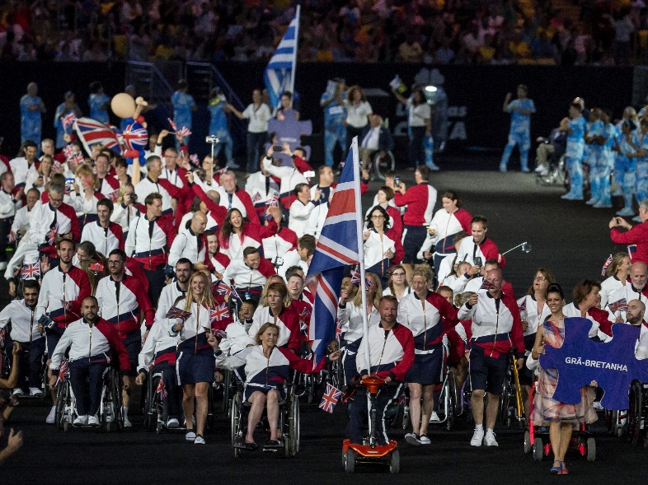
Design a mascot
Team GB has a mascot, but ParalympicsGB do not. Can you design a mascot for ParalympicsGB?
Notes:
Set the challenge
Can you design a mascot for ParalympicsGB?

Slide 4
Who are ParalympicsGB?
Watch the video.
What different sports can you see?
How do you feel watching the video?
What words do you think describe ParalympicsGB?
Notes:
Watch the video
Watch the video and think about:
What sports do you see?
How do you feel watching the video?
What words do you think describe ParalympicsGB?
ParalympicsGB is made up of elite athletes selected to represent Great Britain and Northern Ireland at Paralympic Summer and Winter Games. They are amazing athletes who thrill us with their extraordinary performances. They have often overcome immense hurdles to represent their country and ParalympicsGB. They will be seen in action at the Tokyo 2020 Paralympic Games.

Slide 5
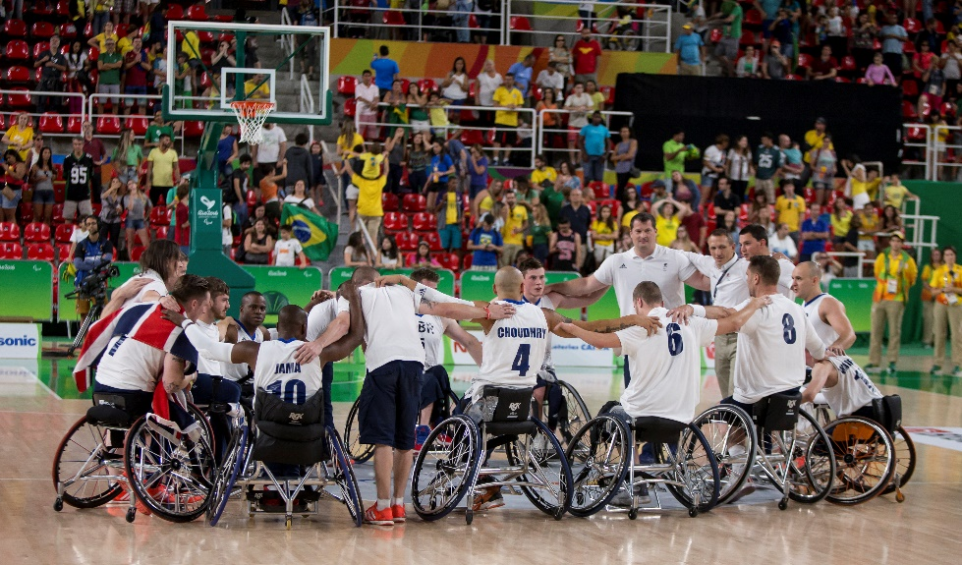
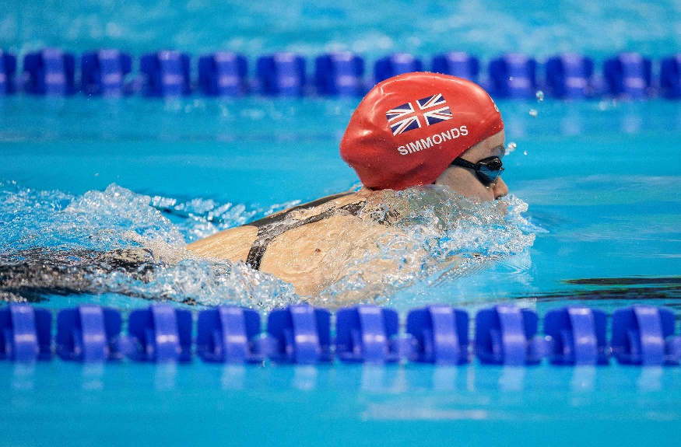
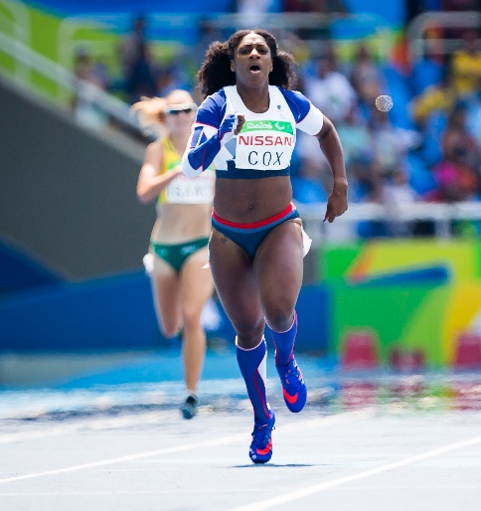
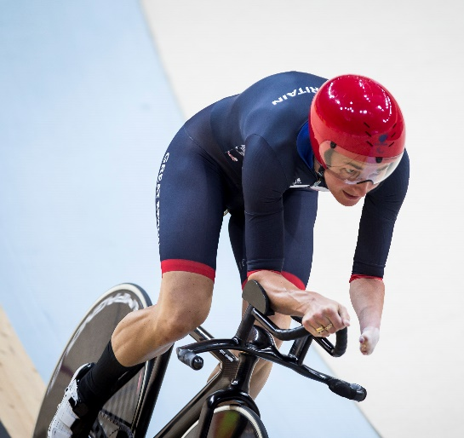
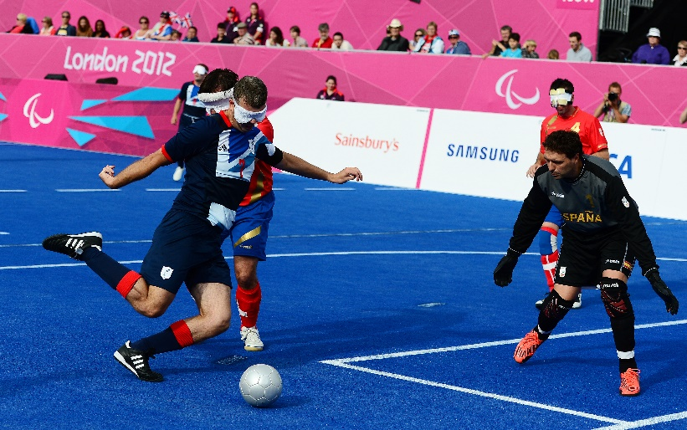
Who are ParalympicsGB?
ParalympicsGB is made up of a range of athletes with different physical impairments, who compete in a wide range of different sports, in different sports classes.
Notes:
Who are ParalympicsGB?
Think about the range of different sports and athletes you saw in the film. ParalympicsGB is made up of a range of athletes with different impairments, who compete in a wide range of different sports.
Support: Paralympic athletes have a range of physical impairments, such as lower and upper limb amputations, poor muscle control leading to loss of leg/arm and/or body control, difficulties walking and balancing, and vision impairments.

Slide 6
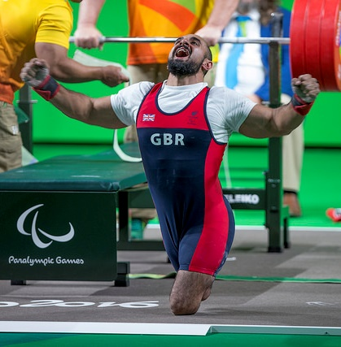
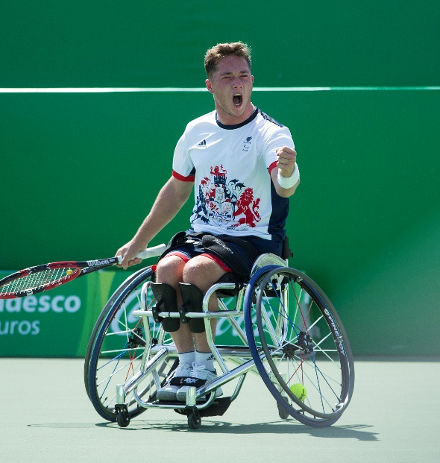
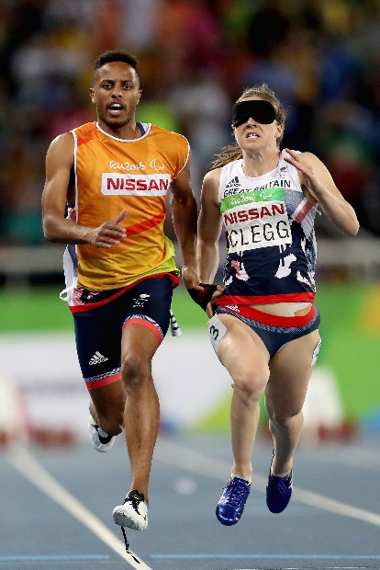
What are sport classes?
Athletes from ParalympicsGB, like all Paralympians, compete in sport classes.
Sports classes are set according to what kind of impairment an athlete has (for instance, prosthetic limb user, difficulty walking, short stature, or a visual impairment) and how much the impairment affects performance in their sport.
Dividing Paralympic Sport into sports classes makes sure competition is fair. It means athletes whose impairment has a similar effect on sports performance compete against each other, and that the best performing athlete wins on the day.
Notes:
What are sports classes?
Read about Paralympic sports classes, finding out how they allow athletes with different impairments to compete fairly.
In Paralympic Sport, athletes compete in sport classes based on the type and degree of their impairment and how much it affects their ability to carry out all the skills and movements required for the different Paralympic events.
Paralympic Sport has ten eligible impairment types. These are: impaired muscle power, impaired passive range of movement, limb deficiency (e.g. upper or lower limb amputees), leg length difference, short stature, hypertonia (abnormal muscle tension, and reduced ability to stretch), ataxia (lack of coordination of muscles), athetosis (generally characterised by unbalanced, involuntary movements and a difficulty in maintaining a symmetrical posture, due to a neurological condition, such as cerebral palsy, brain injury or multiple sclerosis), vision impairment, and intellectual impairment.
Each sport has its own rules for determining which athletes compete together. Some sports only permit specific groups of athletes to compete. For example, the Paralympic Sports of Goalball and Football 5-a-side are played by those with a vision impairment and Boccia is a competitive game for those with impairments that affect motor skill and coordination.
Further information about sport classes can be found at: https://www.Paralympic.Org/classification

Slide 7
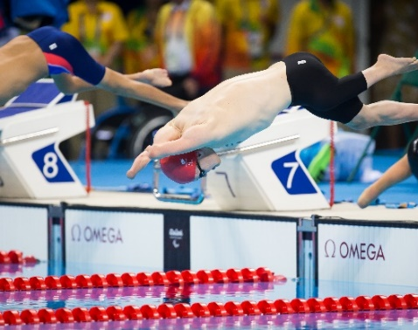
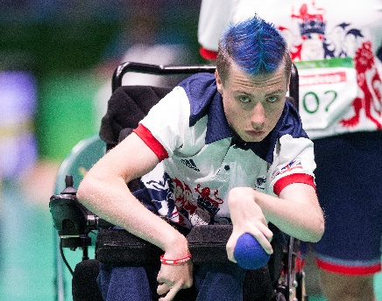
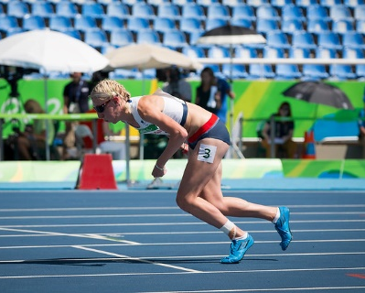
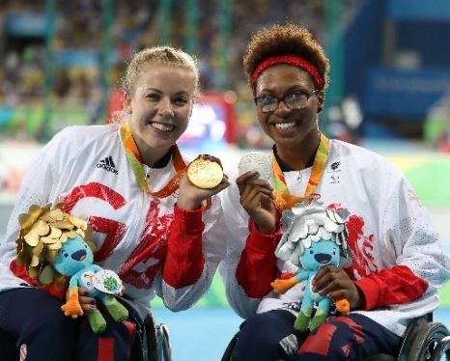
GET
ACTIVE
The athletes of ParalympicsGB demonstrate the Paralympic Values in their sporting and daily lives.
What are the Paralympic Values?
What do ParalympicsGB represent?
Click to reveal the answer!
Courage
Equality
Determination
Inspiration
Which Value do you think is the most important for you? How about for a Paralympian?
Notes:
Discuss the Paralympic Values
Which Value do you think is most important for you or for a Paralympian? Did you pick the same Value, or different Values? Why did you pick each Value?
Support: Look up any words you do not understand in a dictionary. Use the following slide to see examples of different animals/objects/expressions that might show these qualities.

Slide 8
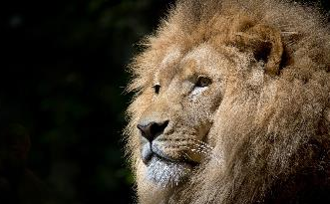
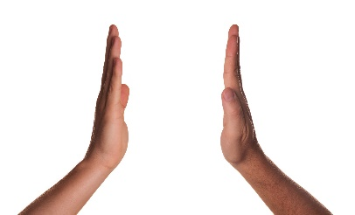
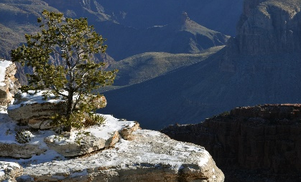
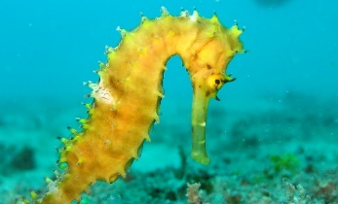
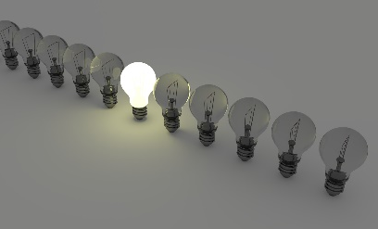
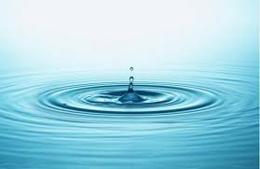
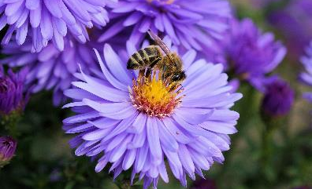
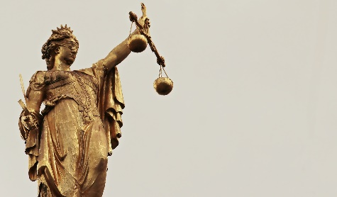
What Paralympic Value could these pictures represent? Think and choose a Value for each.
What could represent the Paralympic Values?
Equality
Determination
Courage
Inspiration
Once you’ve matched the pictures, ask another member of your household to pick a word for each picture. Did you choose the same words for each image?
Notes:
What could represent the Values?
What Value might each picture represent? Explain your answer. (Don’t worry – there is no right or wrong answer!)
Think: How could you design a mascot that portrays one or more of these great values?

Slide 9
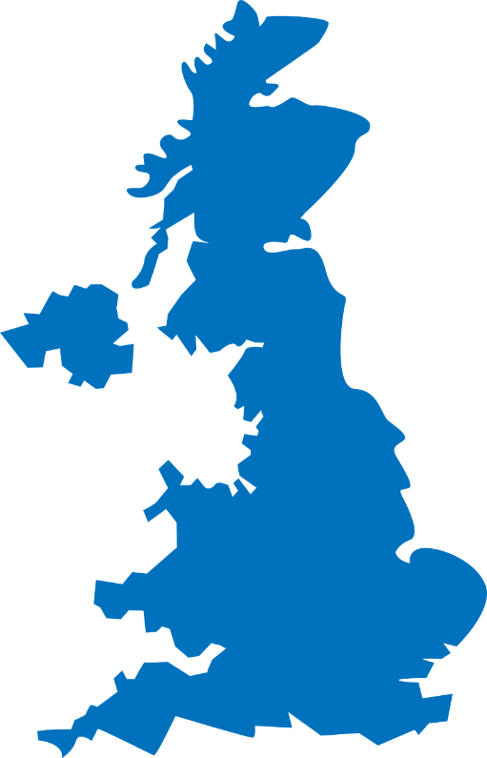
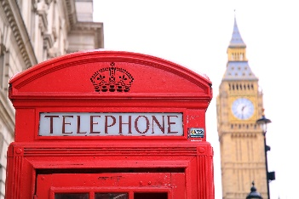
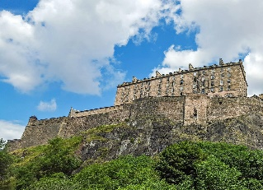
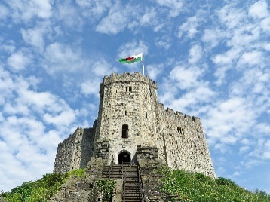
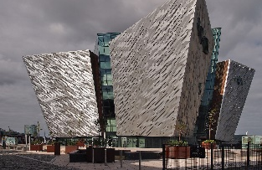
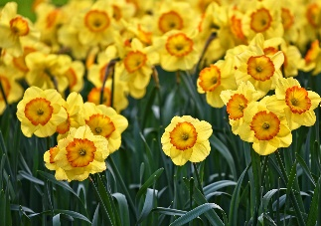
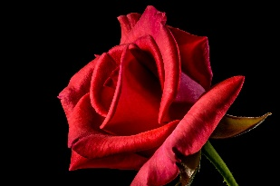
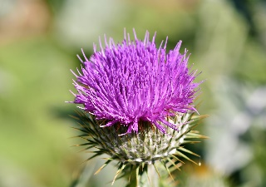
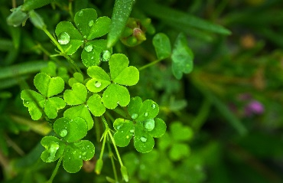
ParalympicsGB represents Great Britain and Northern Ireland.
Which countries does this include?
What represents the United Kingdom?
Click to reveal the answers!
Can you match the symbols and landmarks to the correct countries?
England
Scotland
Wales
Northern Ireland
England
Scotland
Wales
Northern Ireland
Notes:
What represents the UK?
ParalympicsGB is also a national team, it represents Great Britain and Northern Ireland. Can you match the symbol and famous landmark to the correct country?
Think: How will you portray your ParalympicsGB mascot representing Great Britain and Northern Ireland?

Slide 10
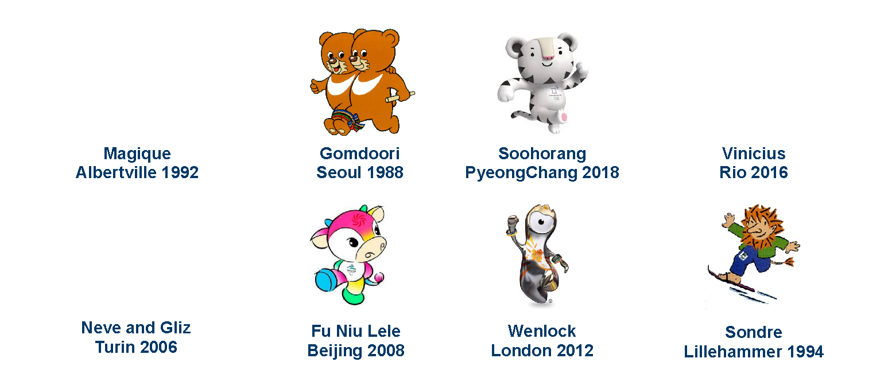
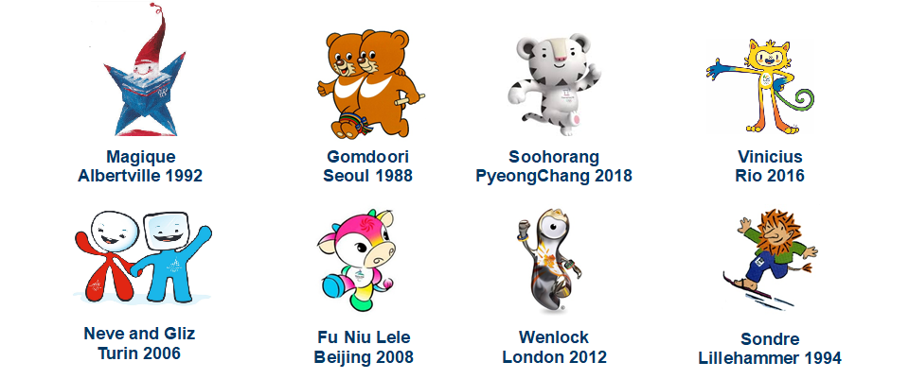
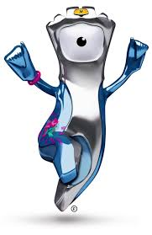
Look at these Olympic and Paralympic Mascots from past Games. What do you like about each mascot design?
What makes a good mascot? The design
Notes:
What makes a good mascot?
What do you like about each design? (Think about the colours, the shapes, the expressions, anything you know about their story.)
What would you change?
Which is/are your favourite mascot(s)?
About the mascots
Magique, Olympic Winter Games, Albertville 1992. The star stands for dreams and imagination and uses the French flag colours.
Gomdoori, Paralympic Summer Games, Seoul 1988. ‘Gomdoori’, which means ‘teddy bear’ in Korean, are two Asian black bears, each representing wisdom and courage. They are running a three-legged race with legs tied together, symbolizing the power of cooperation, of mutual encouragement, and of the ability to create peace and harmony together.
Soohorang, Olympic Winter Games, PyeongChang 2018. In Korean folklore, the white tiger was viewed as a guardian that helped protect the country and its people. ‘Shooho’ means ‘protection’, the tiger helping to ‘protect’ the athletes and visitors at the games, and ‘Rang’ is from the Korean word ‘ho-rang-I’ which means ‘tiger’.
Vinicius, Olympic Summer Games, Rio 2016. Vinicius is made up of different Brazilian animals: the bird, the cat and the monkey, and the name was chosen in honour of the famous Brazilian musician, Vinicius de Moraes. He can stretch his arms and legs as much as he wants. This allows him to jump higher, run faster, and become stronger.
Neve and Gliz, Olympic Winter Games, Turin 2006. ‘Neve’ is the Italian for snow; her fluid, red design embodies elegance of motion and harmony. Gliz is derived from ‘ghiaccio’, meaning ice. He's all compact and blue, as powerful as any Olympic athlete.
Fu Niu Lele, Paralympic Summer Games, Beijing 2008. The cow mascot features colours used in traditional Chinese New Year’s paintings and gifts. The name relates to characters meaning luck and happiness.
Mandeville, Paralympic Summer Games, London 2012. Mandeville, the Paralympic mascot, was named after the Stoke Mandeville Hospital in Buckinghamshire, the birthplace of the Stoke Mandeville Games, the predecessor of today’s Paralympic Games. The three spikes on its helmet symbolise the three Agitos of the Paralympic logo.
Sondre, Paralympic Winter Games, Lillehammer 1994. Sondre is a friendly troll, a creation with origins in Norse mythology. His impairment is a lower leg amputation.

Slide 11
Pride
Team GB mascot
What makes a good mascot? Personality and story
How can you make your character:
fun-loving, playful
friendly-faced and welcoming
appeal to younger children
represent and spread the message and Values of ParalympicsGB?
Notes:
What makes a good mascot? Personality!
Think about your mascot’s personality. You need to bring life to your character and make sure it appeals to younger children as well as the athletes and spectators.

Slide 12
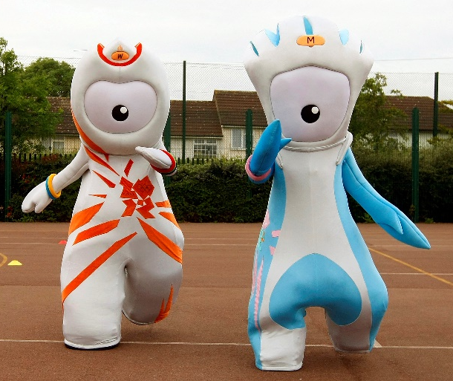
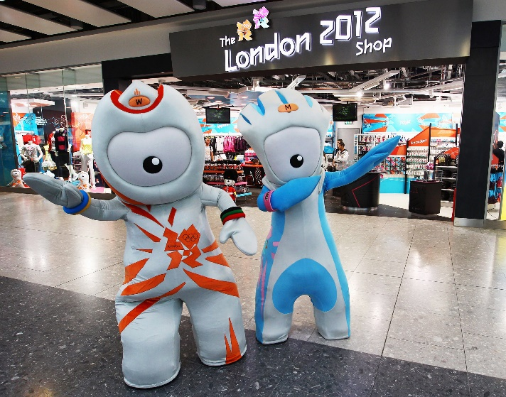
What makes a good mascot? Movement and mime
Remember. Mascots can’t speak. Think carefully about:
facial expressions
mannerisms
gesture
colour
pose
Wenlock and Mandeville
London 2012 mascots
Notes:
How do mascots move?
How can/should a mascot designer consider movement in their design?

Slide 13
The design brief
Your challenge is to design a mascot for ParalympicsGB.
Your mascot could be anything – an animal, an object, or something completely imaginary! Whatever it is, it should celebrate ParalympicsGB and encourage everyone to get behind the team.
Your mascot should:
represent a physical or sensory impairment in some way
celebrate Paralympic athletes and the Paralympic Values
be suitable for use long term (so not Tokyo 2020* themed!)
have a great name!
Think about the colours for your mascot – could you use some of the colours from the ParalympicsGB logo?
*Although the Games will now be held in 2021, they will still be called Tokyo 2020!
Notes:
Read the design brief
Your mascot could be anything (an animal, an object, something more abstract like a flame, or something imaginary). Whatever you design, remember to think about how your mascot could:
represent a physical or sensory impairment (remember to look at slide 6–7 to think about different kinds of impairments)
celebrate the Paralympic Values (determination, inspiration, courage and equality)
be non-games specific (so not Tokyo or Japan themed) so ParalympicsGB could use it long term
have a great name!
Think about the colours of the ParalympicsGB logo – red, white and blue, representing the flag of Great Britain and Northern Ireland, and red, blue and green, the colours of the Agitos, the symbol of the Paralympic Games. How might you use these to colour their mascot?

Slide 14
Develop your design
Pick your favourite design idea to develop. (Or mix the ideas!)
Top tips
What character, animal or thing will you use to represent the Paralympic athletes?
Use pencil to sketch an outline of your mascot.
How will your mascot represent a physical or sensory impairment?
How about giving it a running blade, wheelchair, blindfold or similar?
Give your mascot a great expression.
Wide-eyed, smiley, grinning, happy, cheeky, spiked hair, coloured hair.
Show your mascot to others. What changes do they suggest you make?
Fill in the detail of your mascot.
What colours will you use to make it fun and appealing to younger children?
Remember: this must be your own work.
Notes:
Design your mascot – developing the design
Develop your design. Jot down, sketch or computer-generate ideas. Designs can be hand drawn, produced using computer-aided design or modelled in 3D (with a photograph of the model affixed to the design sheet).

Slide 15
Finalise your design
Use this checklist to make sure your mascot is the best it can be!
Have you given your mascot a great name?
Have you marked where will you put the ParalympicsGB logo?
Does your design represent an impairment?
Can your design be used in the long term, at both the Paralympic Summer and Winter Games?
How does your mascot show the Paralympic Values?
What’s the story behind your mascot?
Notes:
Finalise your design
Think about the names of past mascots, e.g. Pride (named after a pride of lions and the pride we should all feel in Team GB) or Mandeville (named after the Stoke Mandeville Hospital which organised the first Stoke Mandeville Games, considered to be the precursor to the Paralympic Games).
Please note: The ParalympicsGB logo should appear somewhere on the mascot. It is not necessary to draw the logo, although you can if you wish. Use a * to indicate its position. Think about how you can make sure the logo is visible most of the time – including when the mascot is active.

Slide 16
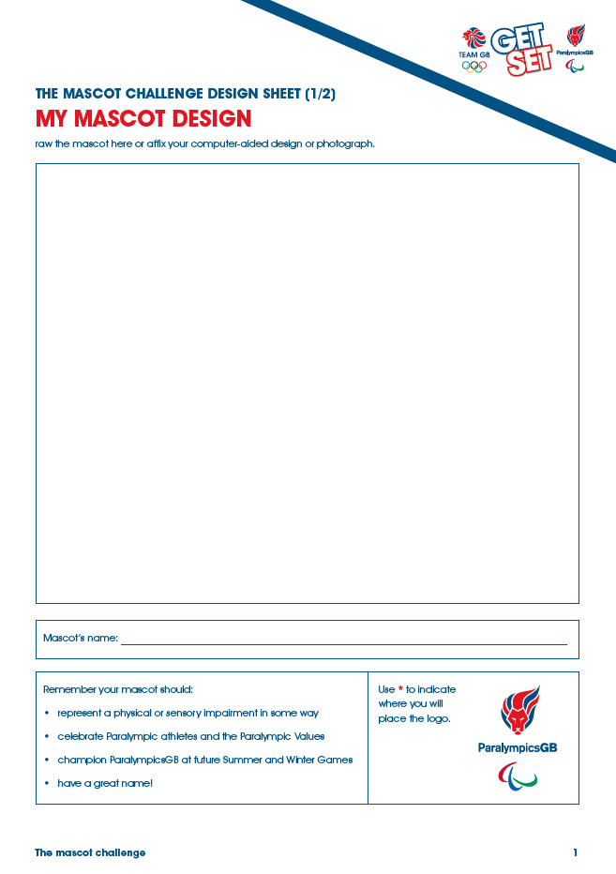
Have you finished your mascot idea? It’s time to complete your design sheet! Be careful, take your time. This is what the judges will see.
Are you ready?
Remember your mascot should:
represent a physical or sensory impairment in some way
celebrate Paralympic athletes and the Paralympic Values
be suitable for use long term (so not Tokyo 2020 themed!)
have a great name!
Send in your design by the extended deadline of 31 May 2020 for the chance to have it displayed at ParalympicsGB team base in the athletes’ village at the Tokyo 2020 Paralympic Games!
Notes:
Complete your design sheet
Draw/add a picture and write a description of the mascot to complete your design. If the mascot has been created using computer-aided design or modelling, it print/photograph the design and stick in to the sheet.
Send your designs to ParalympicsGB!
Send in your designs by 31 May 2020 for the chance to be selected for display at ParalympicsGB team base in the athletes’ village at the Tokyo 2020 Paralympic Games!
Email your mascot designs to: getset@getset.co.uk
Share your designs: @GetSetCommunity (Share contact and entry details through direct message function only. Feel free to share designs publicly!)

Slide 17
Once you’re happy with your mascot, how about making it?
Extension Mascot modelling
Art straws
Plasticine
Paper mâché
Junk materials
Knitted
Dough
Make a costume
Notes:
Optional
Making your model
If you want to go further you could bring your mascot to life by modelling them in 3D. A photograph of the model can be included in the design sheet. (Please do not send in 3D models as these will not be selected to take to Tokyo 2020 – only photographs affixed to a design sheet.)
Think about recycling! Make sure you don’t construct a junk model that you can’t take apart to recycle once you’ve finished with it!

Slide 18
The Mascot challenge
Thank you from
ParalympicsGB

