Slide 1
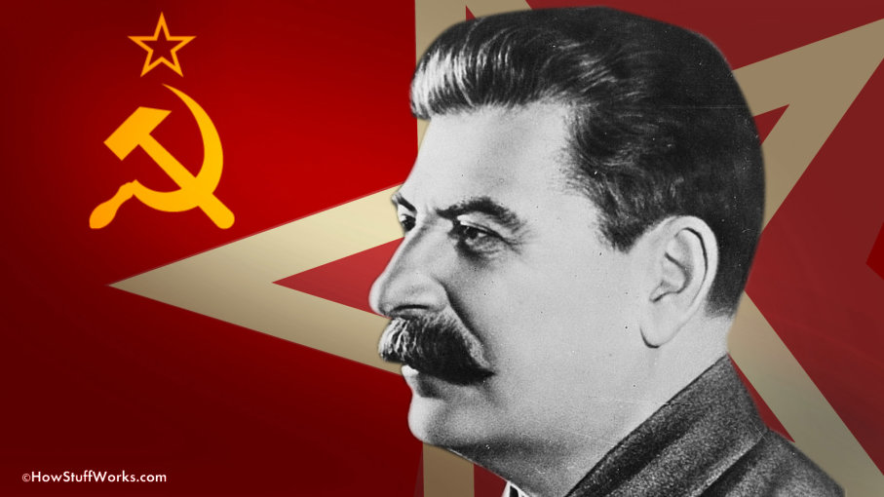
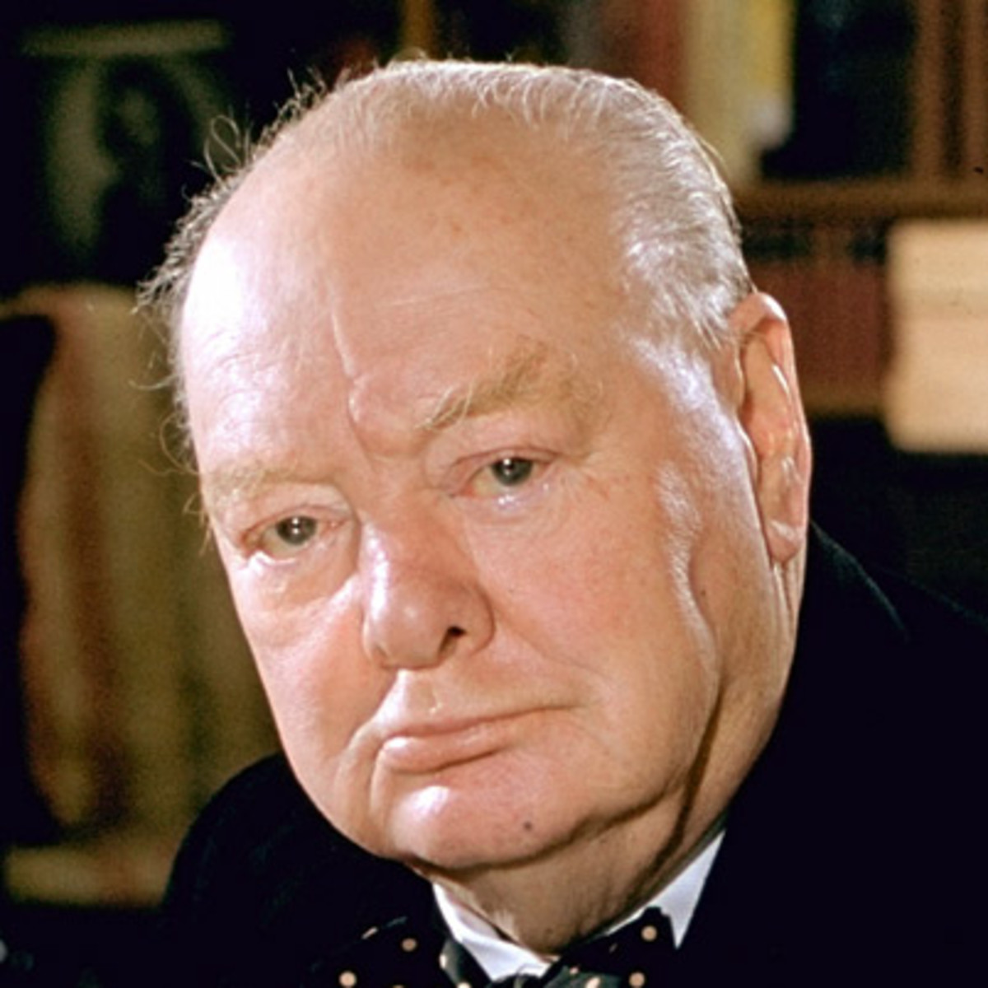
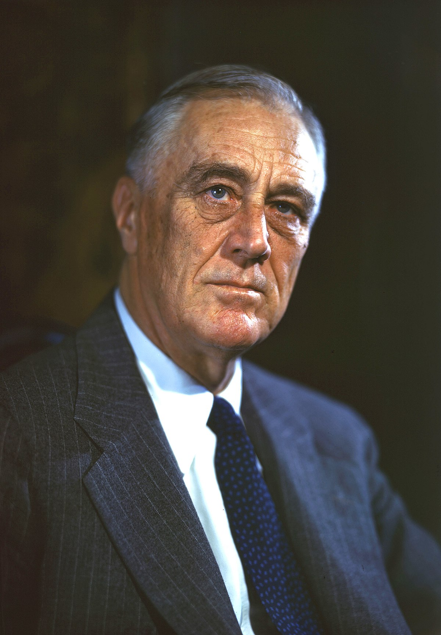
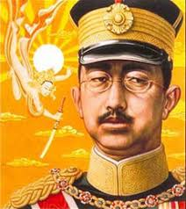
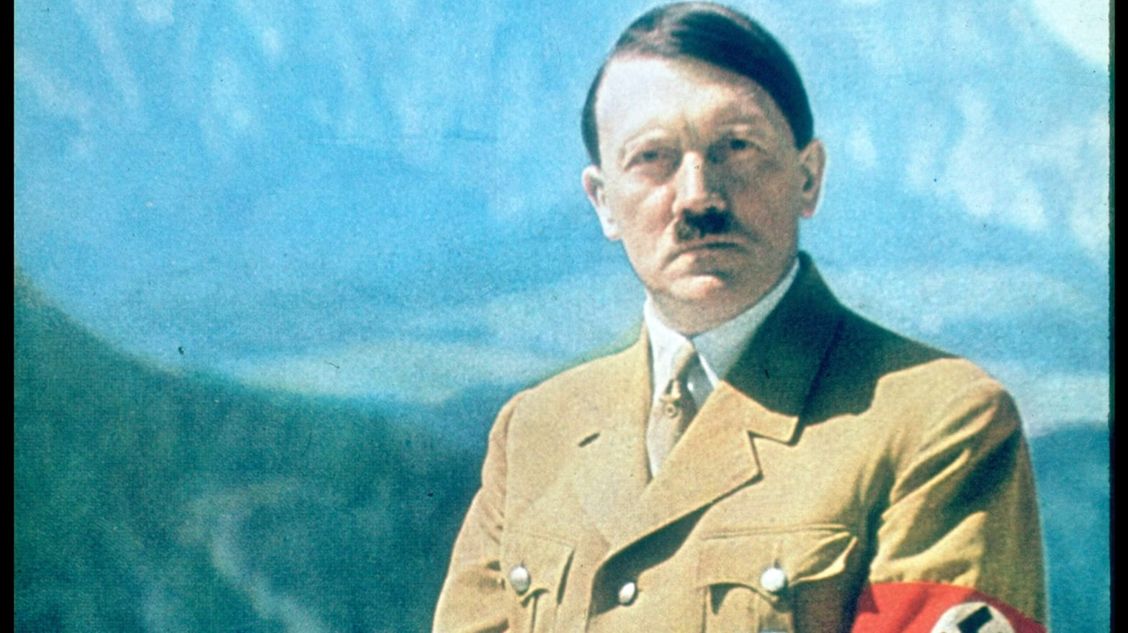
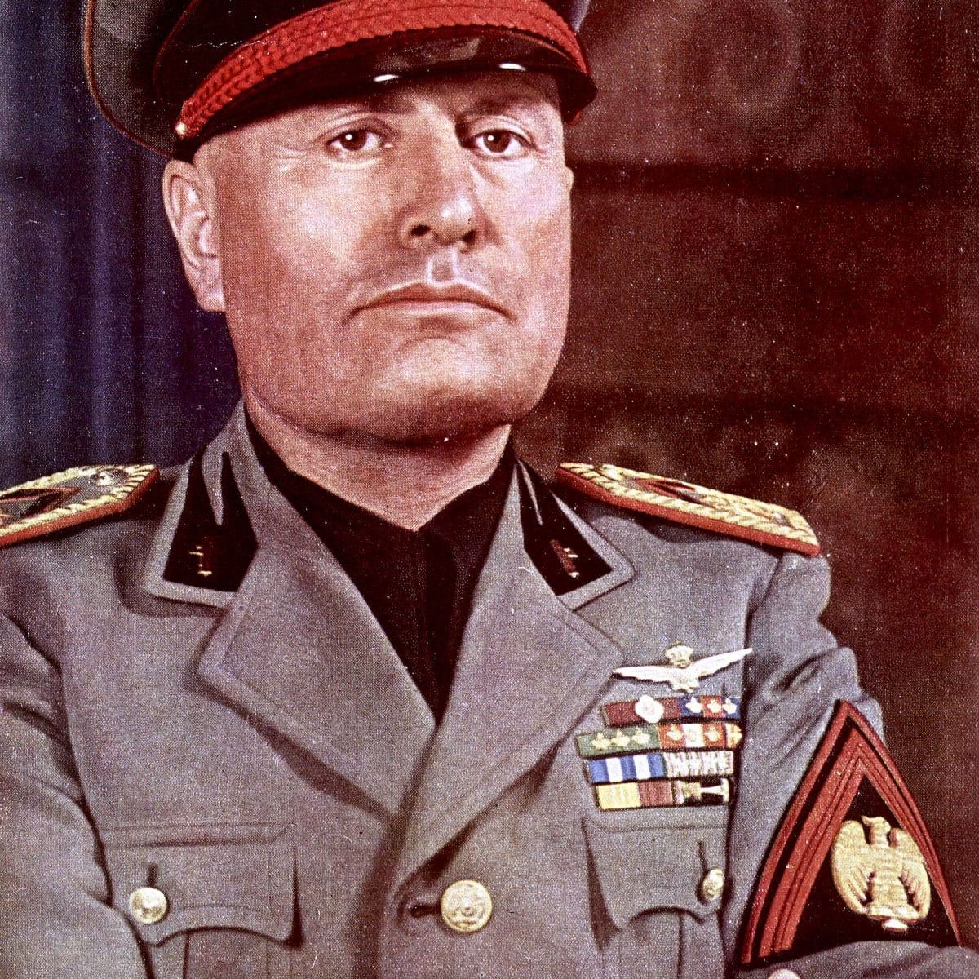
WW2
The great war (also known as World War Two) is know around the globe to be the worst war in history taking approximately 50 million lives.
Find out more in the below.

Slide 2
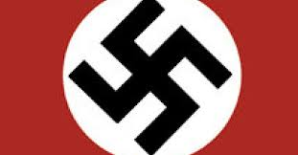
Adolf Hitler
Adolf Hitler was a kind boy to start of with, he loved to read cowboys and Indians, he was a brilliant learner and his grades were good. Until his brother (Edmund) died of measles. His Father soon died followed by his Mother. He found a party called Nazis. And then he won an election and became Canceler of Germany. Hitler hated Jews. He believed that Aryans were the better people and communist and Jews were the worst. When Hitler captured Poland, he used it as a concentration camp as millions of Jews went and died.

Slide 3
Dunkirk
Dunkirk was a desperate last-minute get away for the English. It started when Germany sent a ground invasion to take France and Belgium. The Allies charged forward to meet the Germans head on. This time, Hitler had a trick. Blitzkrieg. He would send thousands of refugees to slow down the Allied forces. When Britain and France charged at the Germans, the French had left an area full of trees and thick forests because they thought it was naturally impenetrable. But Hitler was about to petrate it with everything he had. They smashed thousands of men through the forests and encircled the Allies. The best of the Allied forces were now trapped. The Germans easily took out the French forces and now focused on the English. As spy planes flew over Dunkirk, they noticed a few ships there and immediately informed Hitler. The Germans knew an evacuation was coming, so they gathered up their troops and got ready for an attack. One last spy plane went over Dunkirk to see what they were doing and seen millions of ships there. They were civilian ships. When the attack came most of the ships were gone, meaning most of the British would survive. Suddenly, bombs flew down on to the sand, attempting to hit ships or hospitals.

Slide 4
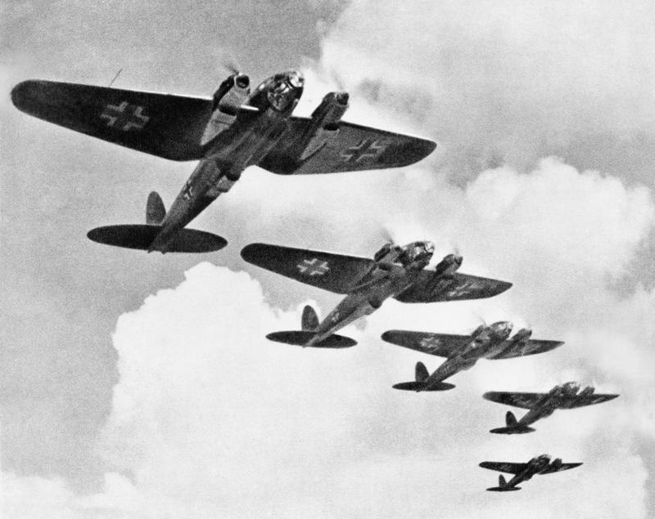
The Blitz
The Blitz was in 1940 till 1941. A lot of people were wounded or killed during the Blitz. All of the children were evacuated to the countryside where people would adopt them. The bombing started on the 7th of September 1940 and the RAF were far from ready. The Luftwaffe bombing sequence went on for hours nearly every day. But when the RAF planes were fixed, they started to repel their attacks. On the 11th of May 1941, German planes did one last all out attack on London which the RAF successfully repelled it putting air superiority in British hands.

Slide 5
Soviet Union
The Soviet Union was once with Nazi Germany, until Germany turned on them in 1941, where they made staggering progress to Moscow. Unfortunately for the Nazis the winter came, and Russia started to push back the Nazis because off special equipped, and well trained Russians. Another reason why the Germans was getting pushed out was because, Hitler had a plan, cut of the Russians flank so that they could have the Caucuses which is an area full of oil. Hitler got over confident and left the 6th army alone because he sent troops in to the Caucuses. It’s 1942, and Russia is slowly pushing Germany out. The year before Nazis attacked, Russia had put it’s factory’s further to the East and they had been producing a ton of tanks and aircraft, and they were now ready. Using Germanys own encircling movement, the Russians encircled the 6th army and they eventually surrendered. The Russians had pushed the Nazis out of the Caucuses and out of Stalingrad, their next goal was to get to Berlin. But suddenly they were in a stalemate.

Slide 6
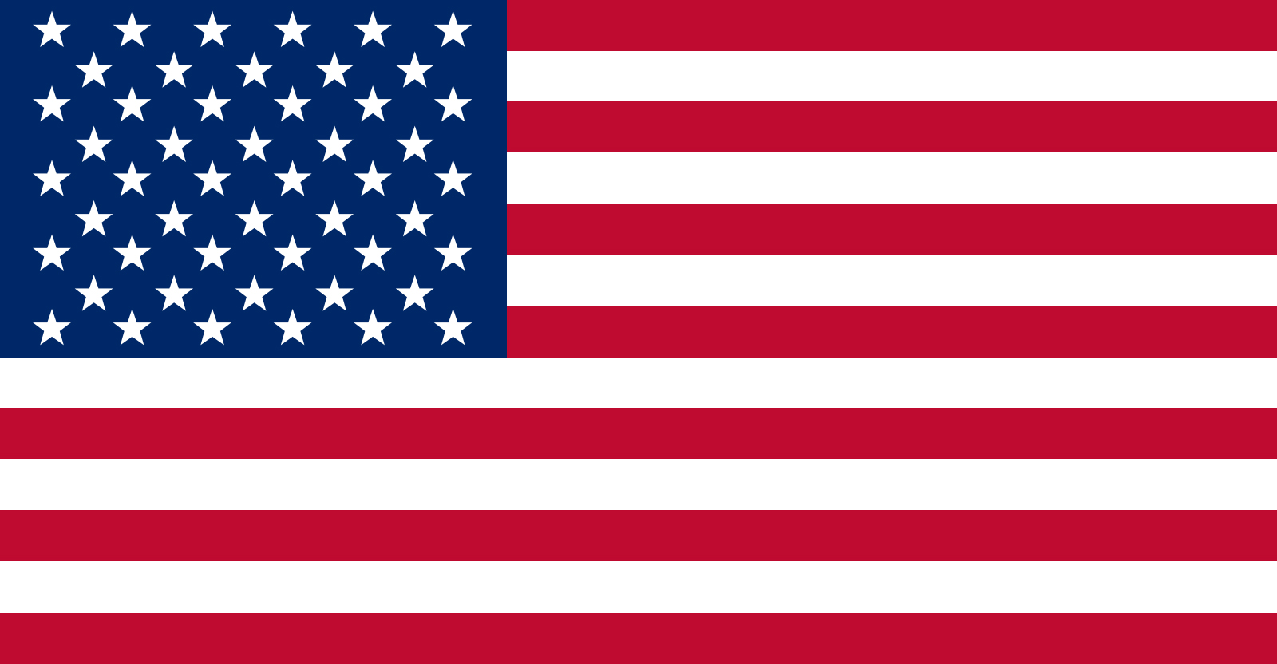
America
America before the war America during the war
In 1940, America held an election. Wendell Willkie saying, "I will not send any Americans to die in Europe.” and Franklin D Roosevelt said, “I will not let any Americans to die in Europe but I might if I have to.” And Roosevelt won. America started to supply England with food, guns and ammunition. But there was one problem, German U-boats were sinking thousands of American ships including civilian ships which got more and more increasing to join the war. In 1941 Japanese planes dropped bombs on Pearl Harbour where some Americans were killed. And in 1941 America declared war on Japan.
Now that America was in the war, they not only started shipping food and guns to the Allies but started shipping men. When the Americans arrived in Europe they stationed at England before making a move. In 1944, when D-day was launched, American troops landed at Omaha and Utah where both were complex. Omaha nearly failed and thousands of people died there. Utah was the wrong landing and had to start the fight there with no enemies. When Germany surrendered, they launched the first ever nuclear weapon on Japan destroying entire city's.

Slide 7
D-Day Sword
In 1944, D-day or decision day, was put in action. American troops would go Utah and Omaha, the English at Sword and Gold, and Canadian soldiers at Juno. It was a disaster at Omaha beach, the Germans were ready there. As men from the landing craft parachuted down upon the Germans, it went horribly wrong. You would either jump to high and land in the enemies bases, or, you would drop to far down and brake some of your bones. Utah beach was the wrong beach and had to open up a new front. Juno, Gold and Sword were going great. Like Omaha, all of the bombing raids were useless until dawn broke. The landing craft was a success and the bombardment was brilliant. Although machine guns rained down on them they were able to take key positions. After British troops took Gold, they went to important bridges to stop reinforcements to get to Omaha beach.

Slide 8
VE-day
VE-day or victory in Europe, was the best day ever for many nations. Bells were ringing, crowds were cheering, people at the pubs were laughing. It was a brilliant day as well as a reembrace day. The Germans had to pay 280 million to all allies and all of it’s territory was gone. The Soviet Union got East Germany, (including Berlin) America had the South, England had North East and France had the East. All Jews were released from concentration camps and could come out of hiding. But tragedy struck as a British submarine sunk a ship with some German commanders on it, but it had a lot of Jews on it as well killing everyone on board. The British conference said, “ If we had know there were Jews aboard then the submarine would have escorted the boat to land and arrested the commanders.

