Slide 2
Block Graphs
What does a block graph show?
A block graph is a collection of discrete data (values that have no in-between data) that has been input into a visual graph, represented in blocks.
What must a block graph have?
A block graph must always have a title explaining what it shows.
Blocks must be carefully drawn to show the data.
There must be no gap between each bar.
Each bar must be the same width.

Slide 3
Block Graphs
How do you represent the data in a block graph?
A number line is marked on the vertical axis (y). The scale of this number line is chosen based on the data range.
The data categories are organised on the horizontal axis (x).
Each axis must have a label explaining what it shows.

Slide 4
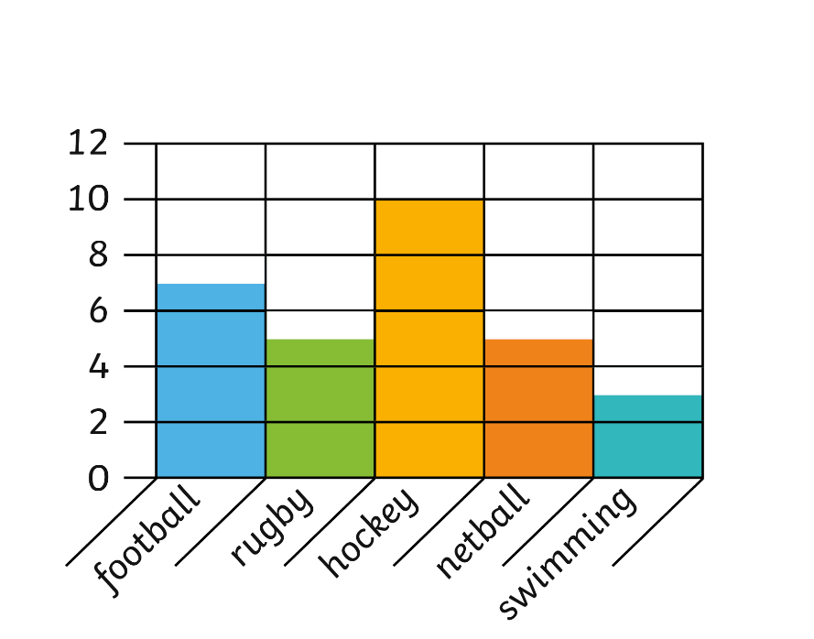
Block Graphs
Class A carried out a survey about their favourite activities. They recorded the data in this block graph.
Which was the most popular activity?
Hockey was the most popular activity
How many more children like hockey than netball?
5 children
How many fewer children prefer swimming than football?
4 children
True or false? Class A has 32 children in total. Explain how you know.
False. 7 + 5 + 10 + 5 + 3 = 30.
Class A’s Favourite Activities
Which was the most popular activity?
How many more children like hockey than netball?
How many fewer children prefer swimming than football?
True or false? Class A has 32 children in total. Explain how you know.
Children
Activities
Notes:
Teacher notes:
What is the scale of the block graph? How do you know?
What does one block represent?
How many of each sport did the children choose?
Explain how you can work out the difference of two blocks.
How will you find out how many children in total?

Slide 5
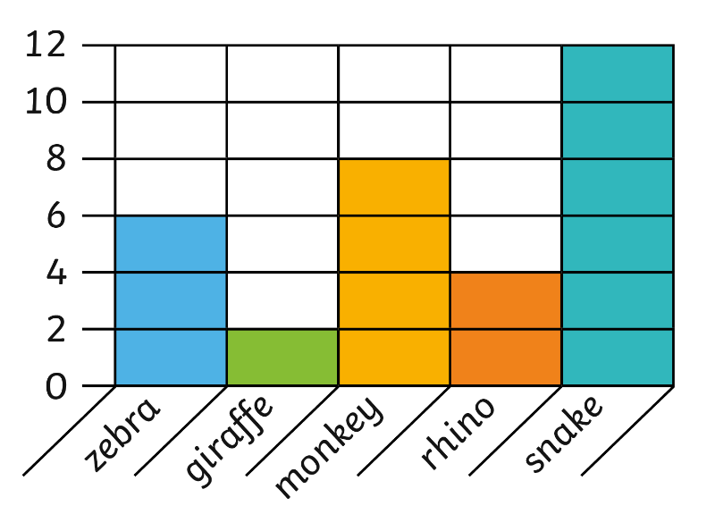
Block Graphs
Class B went to the zoo. They recorded how many zoo animals they saw using a block graph.
Which was the most common animal?
snake
How many more snakes than giraffes were there?
10 more snakes than giraffes
How many fewer zebras than snakes were there?
6 fewer zebras than snakes.
True or false? Class B’s most common animal was the snake and the least common was the rhino. Explain your answer.
False. The most common animal was the snake but the least common was the giraffe as they saw 4 rhinos and 2 giraffes.
Which was the most common animal?
How many more snakes than giraffes were there?
How many fewer zebras than snakes were there?
True or false? Class B’s most common animal was the snake and the least common was the rhino. Explain your answer.
Zoo Animals
Number of Animals Seen
Animals
Notes:
Teacher notes:
What is the scale of the block graph? How do you know?
What does one block represent?
How many of each animal did the children see?
Explain how you can work out the difference of two blocks.
How will you find out how many animals in total?

Slide 6
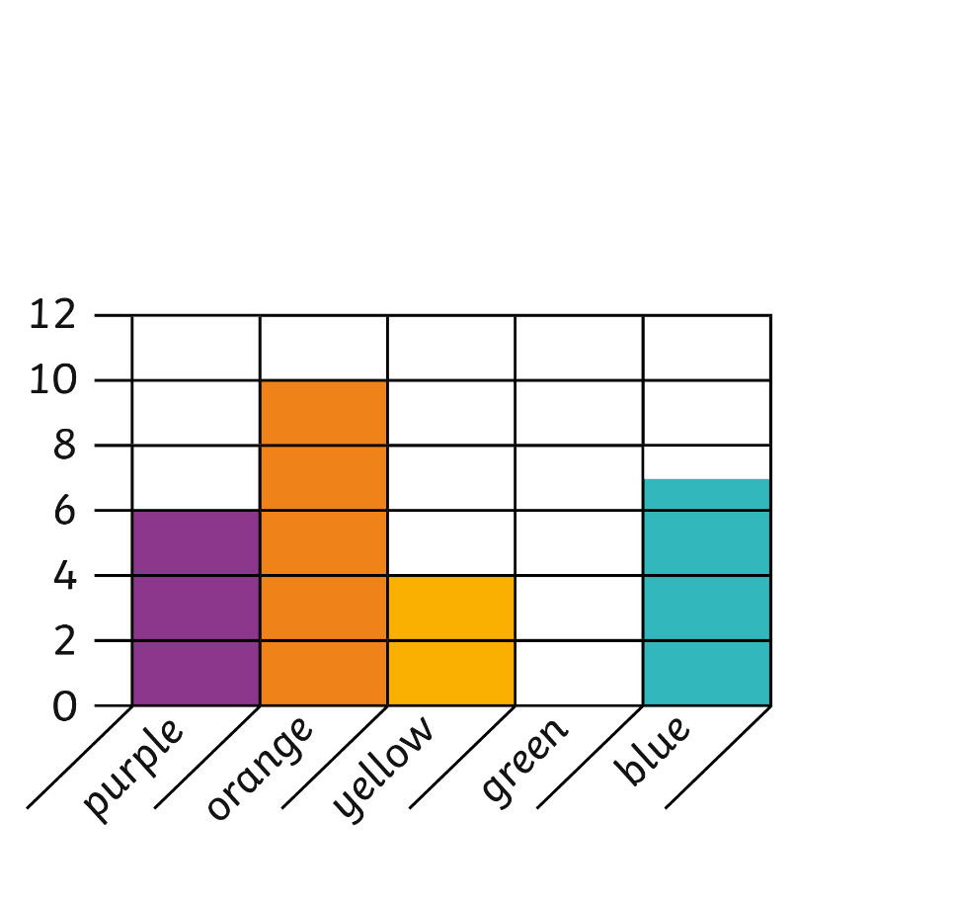
Block Graphs
Sam had a box of chocolates. She recorded the chocolate wrapper colours in a table and created a block graph of her data.
Which was the most common chocolate wrapper colour?
Orange
How many more orange wrappers than green wrappers were in the box?
10 more orange wrappers than green wrappers.
How many fewer yellow wrappers than blue wrappers were in the box?
3 fewer yellow wrappers than blue wrappers.
True or false? If Sam gave half her orange chocolate wrappers to her brother she would have 22 wrappers left. Explain your reason.
True. If she gives half the orange wrappers to her brother, she would have 5 left and 5 + 6 + 4 + 7 = 22.
Which was the most common chocolate wrapper colour?
How many more orange wrappers than green wrappers were in the box?
How many fewer yellow wrappers than blue wrappers were in the box?
True or false? If Sam gave half her orange chocolate wrappers to her brother she would have 22 wrappers left. Explain your reason.
Sorting Chocolate
Number of Chocolate Wrappers in the Box
Chocolate Wrapper Colours
Notes:
Teacher notes:
What is the scale of the block graph? How do you know?
What does one block represent?
How many of each chocolate wrapper did Sam sort?
Explain how you can work out the difference of two blocks.
How will you find out how many chocolates in total?

Slide 7
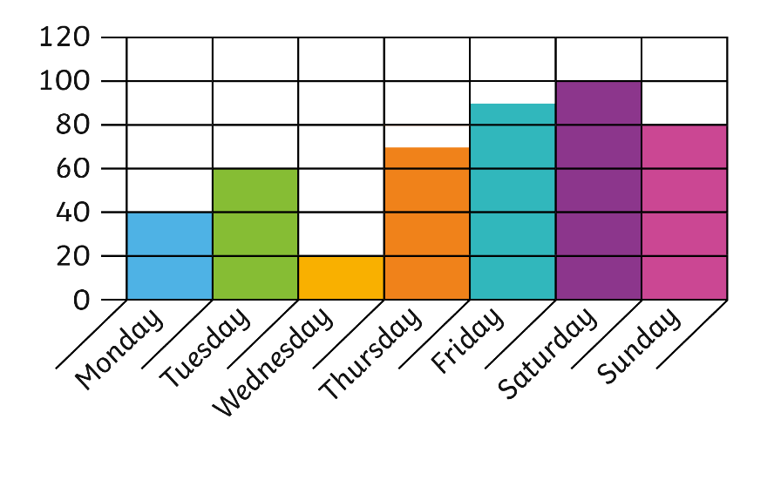
Block Graphs
Mark likes to play video games. He recorded the time he spent playing video games at home last week.
On which day did Mark play video games the most?
Saturday
How many more minutes did Mark play video games on Saturday than on Tuesday?
40 minutes more on Saturday than Tuesday
How many fewer minutes did Mark play video games on Wednesday than on Friday?
70 minutes fewer on Wednesday than Friday
True or false? Mark played video games twice as long on Monday than Wednesday. Explain your reason.
True. He played for 40 minutes on Monday and 20 minutes on Wednesday. 40 is double 20.
On which day did Mark play video games the most?
How many more minutes did Mark play video games on Saturday than on Tuesday?
How many fewer minutes did Mark play video games on Wednesday than on Friday?
True or false? Mark played video games twice as long on Monday than Wednesday. Explain your reason.
Playing Video Games
Time (minutes)
Day of the Week
Notes:
Teacher notes:
What is the scale of the block graph? How do you know?
What does one block represent?
How long did Mark play video games each day?
Explain how you can work out the difference of two blocks.
How will you find out how long Mark played in total?

