Slide 1
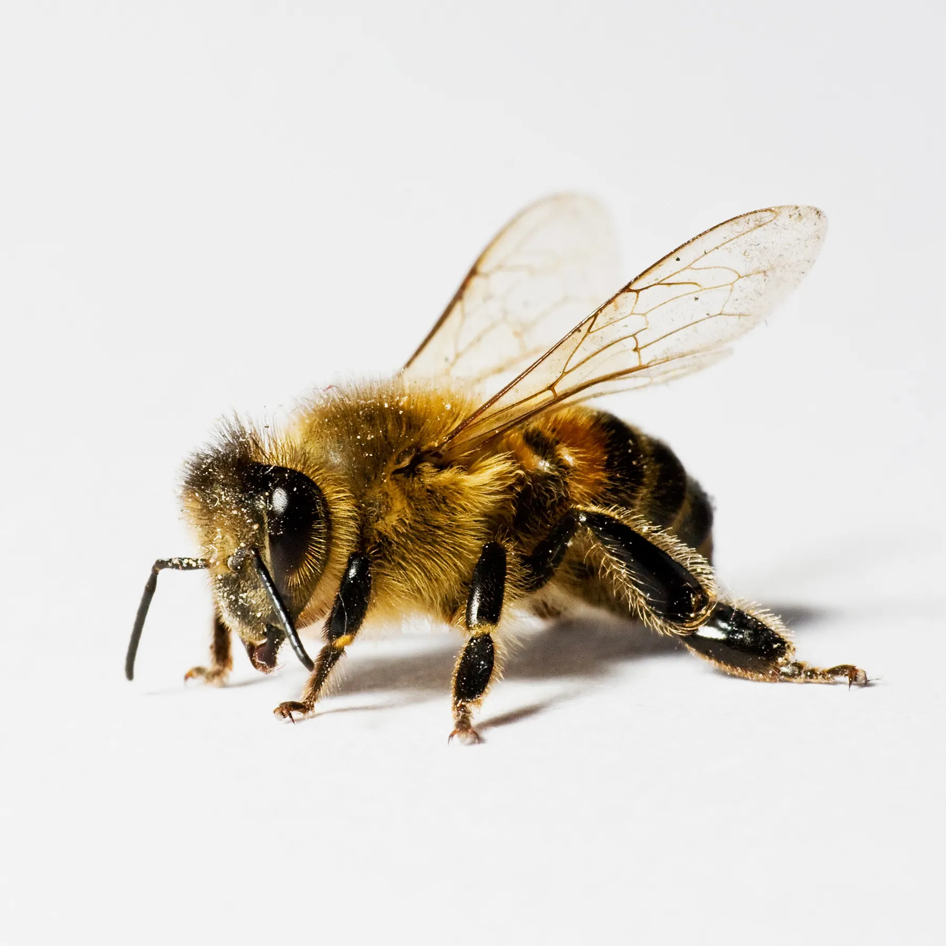
All about the Bees

Slide 2
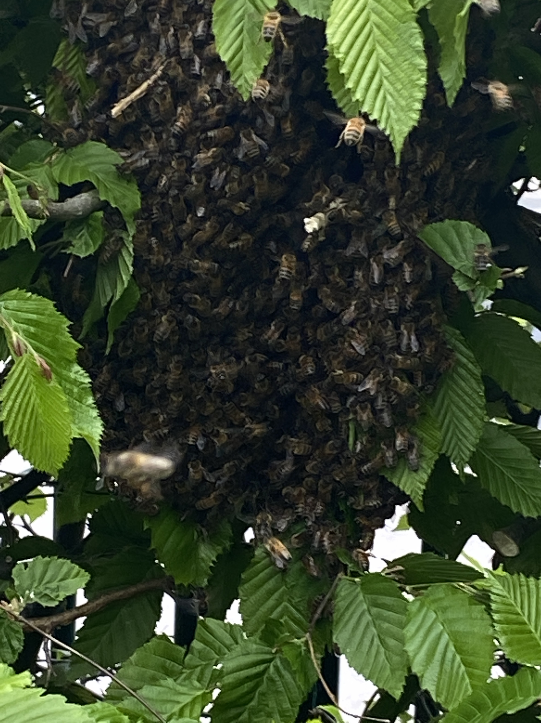
On Monday school was visited by a swarm of bees. They decided to settle in the hedge by the playground gate and form a cluster.
Why did we have a swarm of bees?
When the weather gets warmer the colony of bees living in a hive/nest grows and new queen bees are made. The old queen leaves the hive/nest to set up a new one. She takes with her some of the colony.

Slide 3
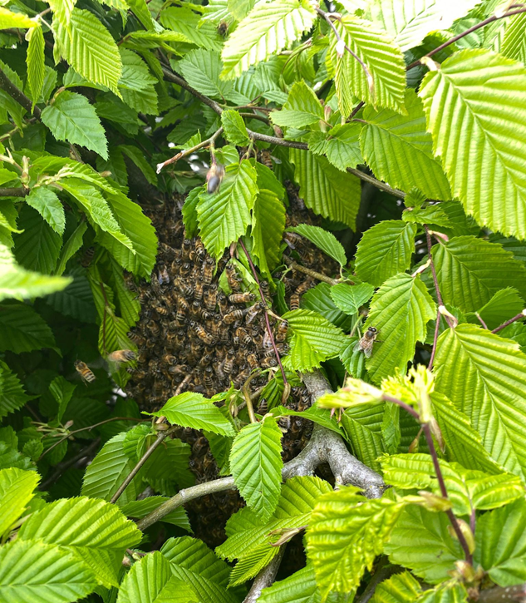
The Queen bee is in the middle of this cluster surrounded by all the worker bees.
Did you know that all the worker bees are female?
Queens are not very good flyers and need to rest regularly. Whilst the queen is resting, some bees called scouts are sent out to look for a new place to live. If they find one they come back and perform a waggle dance to tell all the other bees,

Slide 4
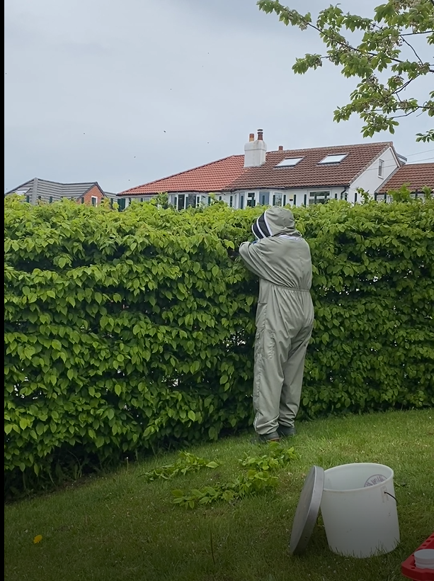
Mr Galek one of our neighbours keeps bees. He came over to help us rehome them.
Why do you think he is wearing this suit?

Slide 5
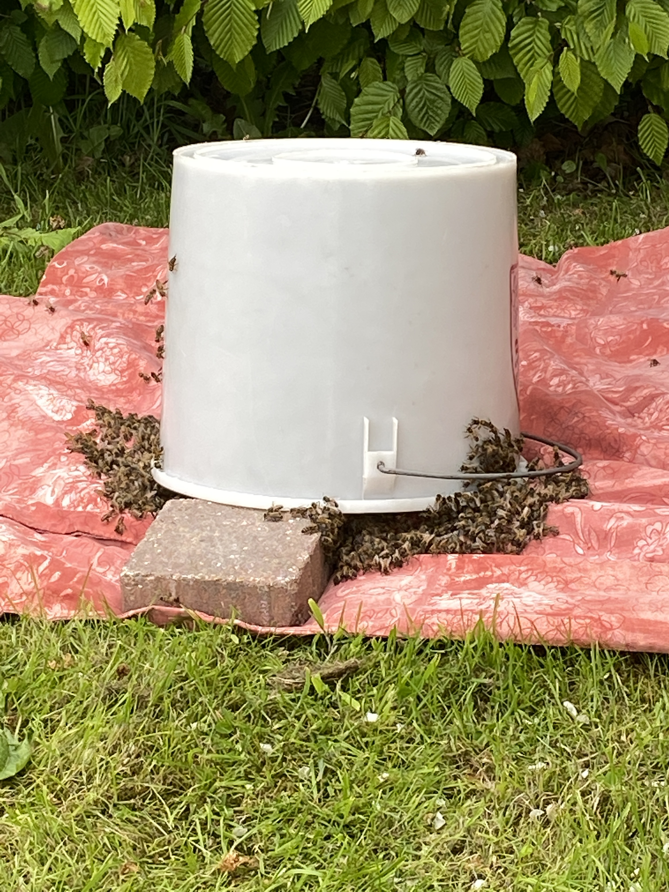
Mr Galek knocked the colony into a bucket which he turned upside down and propped it up with a brick.
Why do you think he did that?
He left the bucket like this for a couple of hours. Once all the bees were inside he wrapped up the bucket.

Slide 6
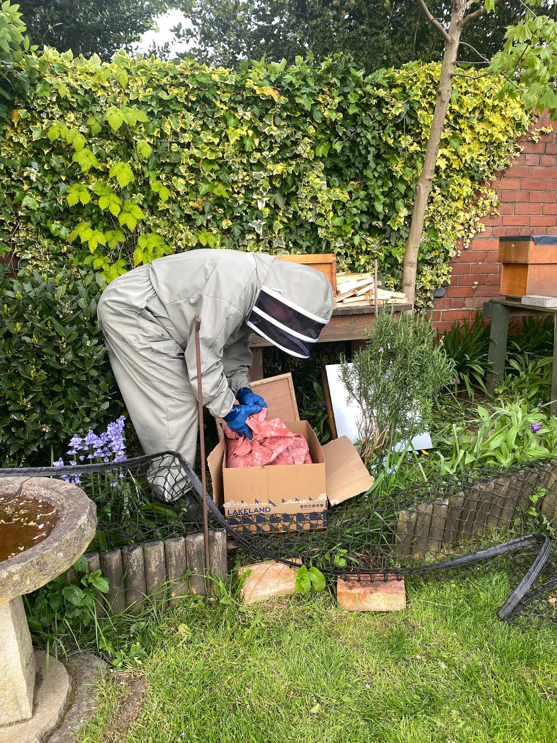
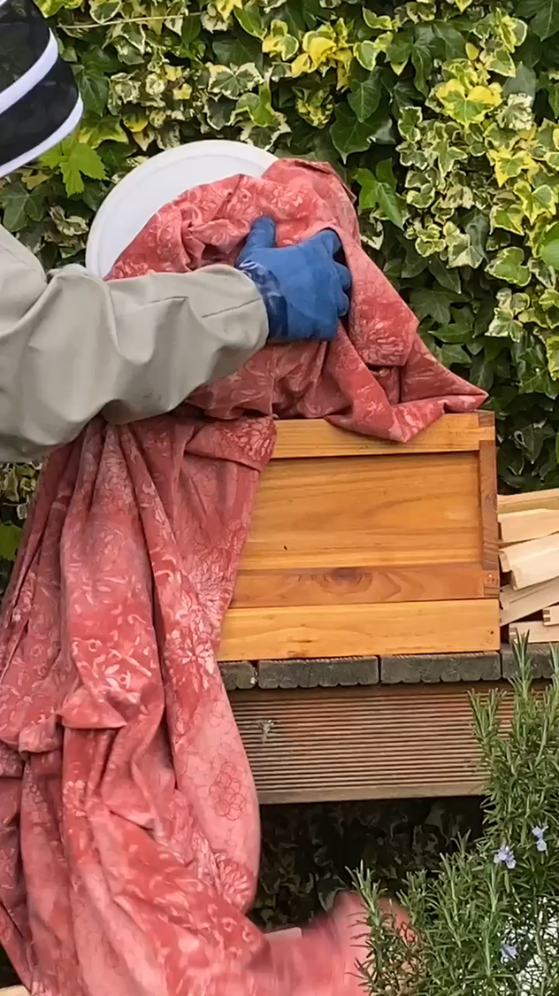
Mr Galek then took the bees to his garden to put into a hive.

Slide 7
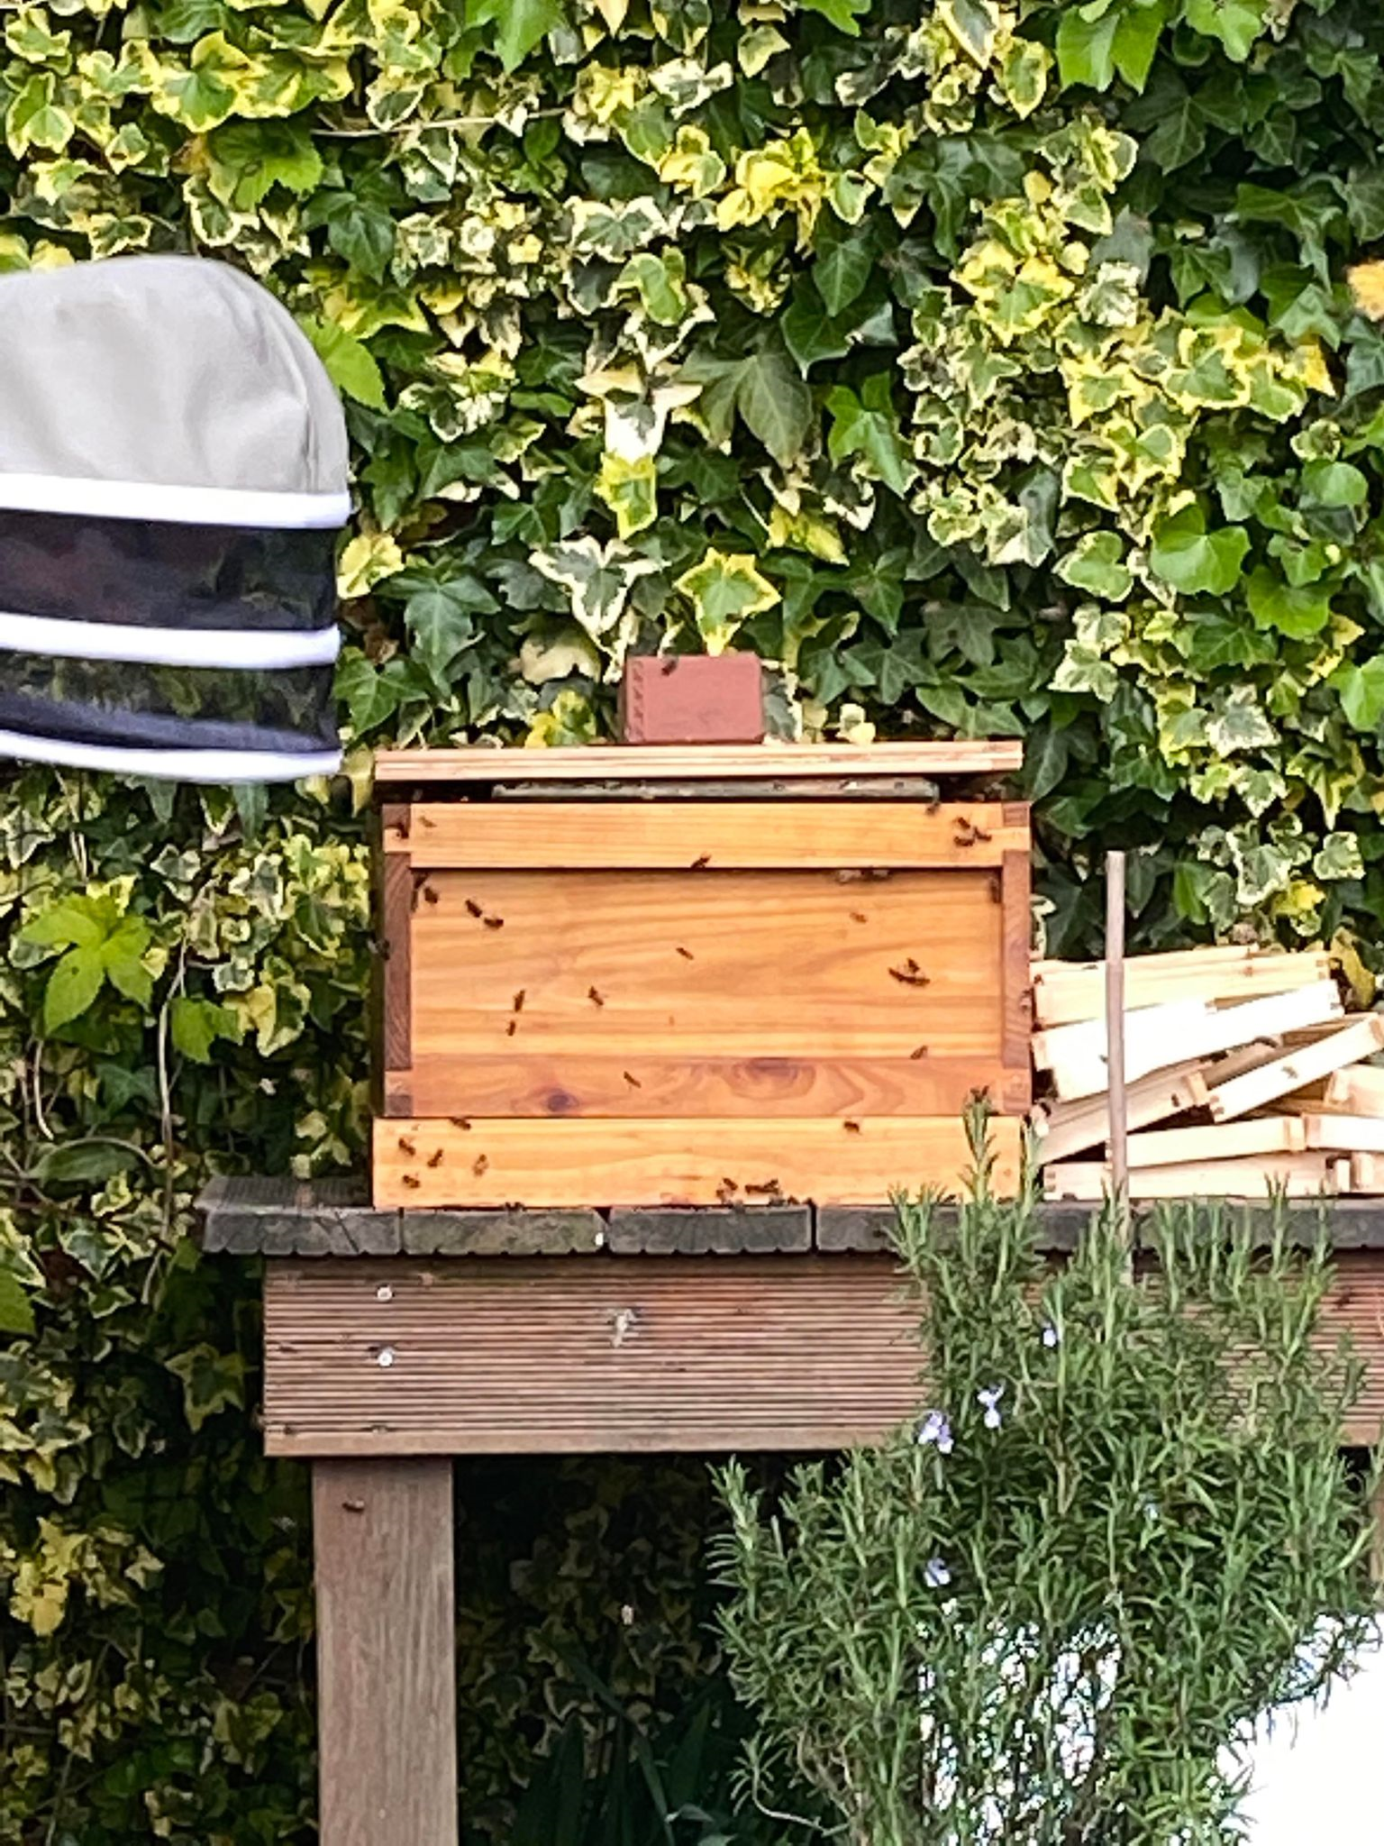
Hopefully the bees will settle, like their new home and start to produce honey.
Did you know…
Honey bees may typically fly between 1 – 6 km on a foraging trip
Honey bees fly up to 15 mph and beat their wings 200 times per second or 12,000 beats per minute!
Each honey bee makes about 1 twelfth of a teaspoon of honey in its life time.
The honey bee is the only insect that produces a food eaten by man.
Honey bees use their front feet, tongue, jaw and antennae to taste with!

Slide 8
How awesome are bees?

