Slide 1
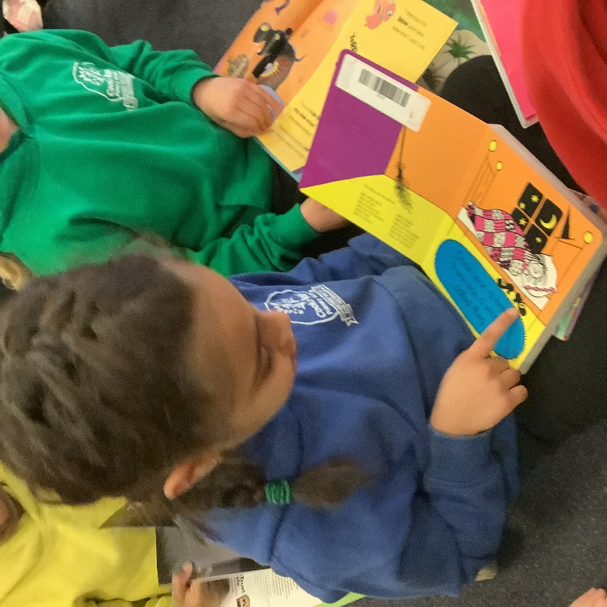
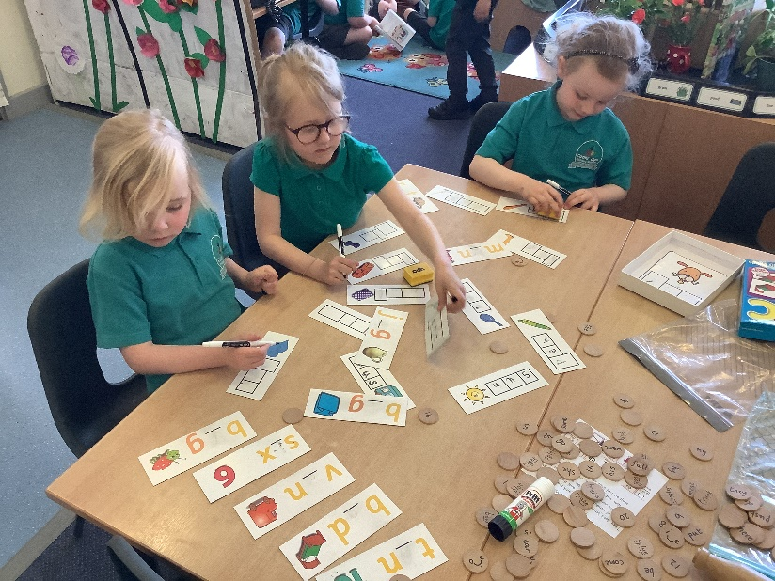
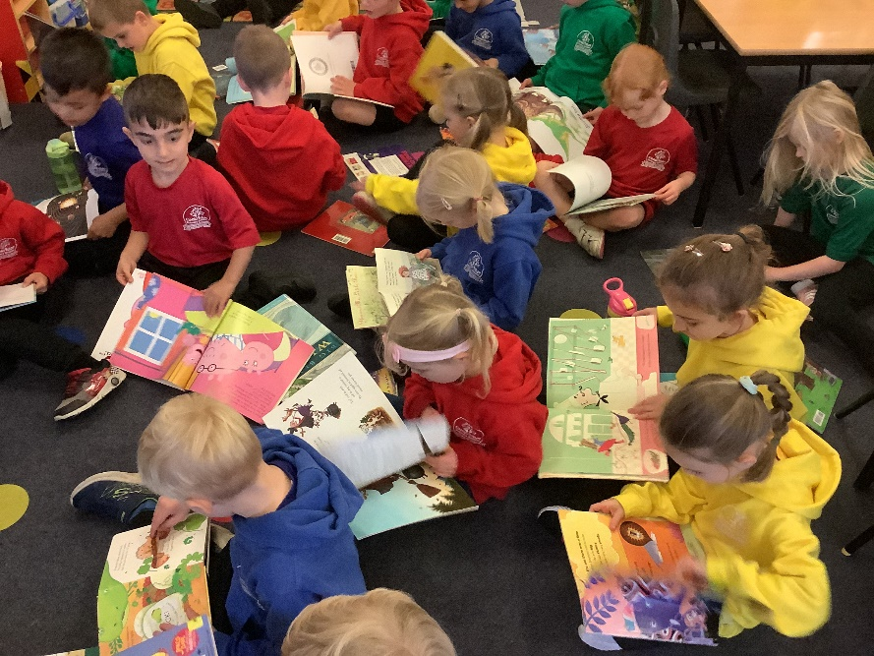
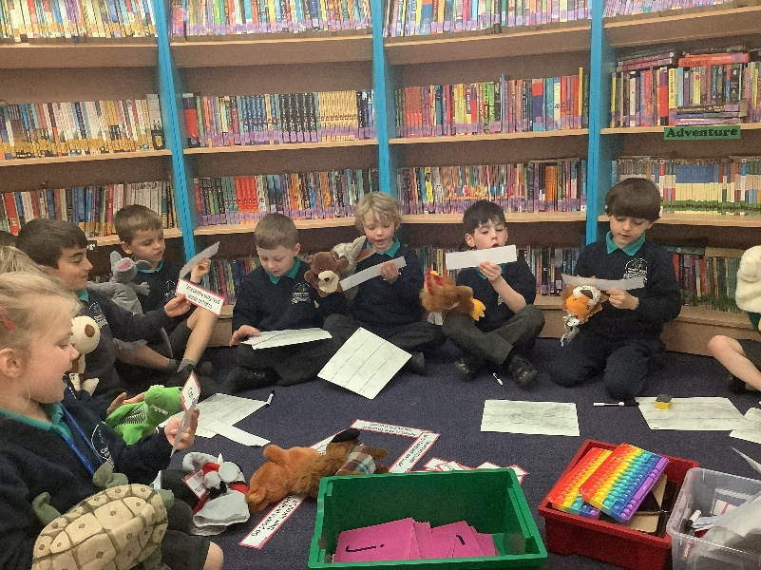
PHONICS

Slide 2
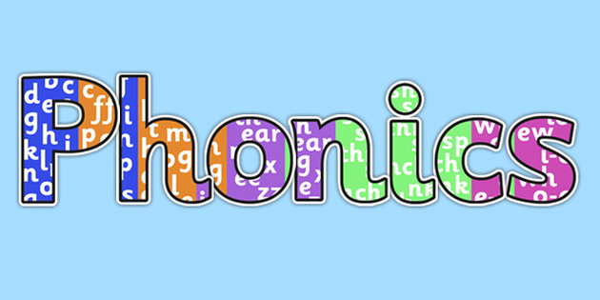
What is Phonics?
Why do we teach it?

Slide 3
Teaching phonics is all part of holistic literacy. It’s repetitive, which helps those that struggle with a short term memory. It can be fun and differentiated and over it all it will give the child the confidence to grow and develop a love of reading.

Slide 4
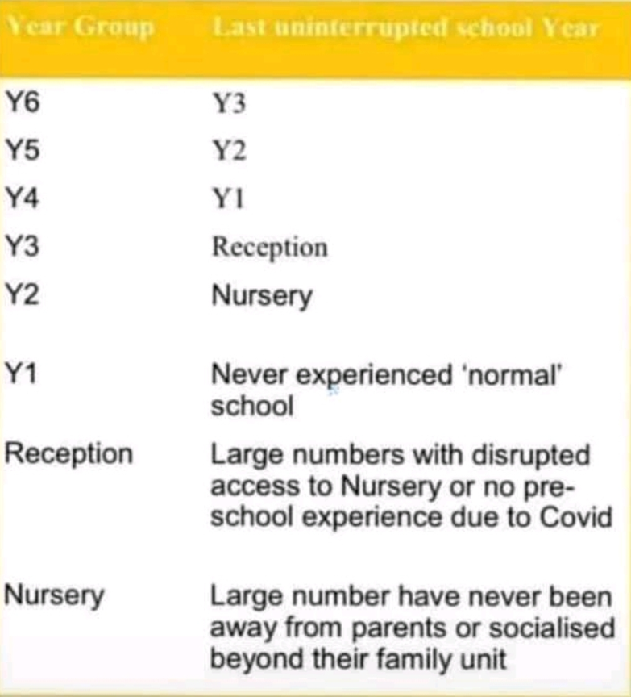
Phonics and Covid
Year 1 children to complete phonics screening wk commencing 6th June 2022

Slide 5
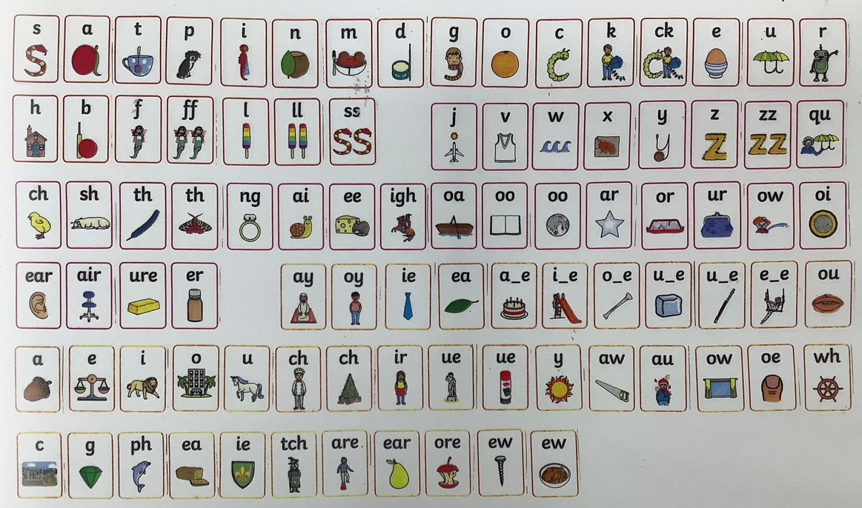
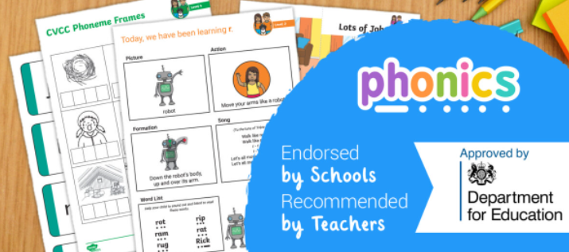
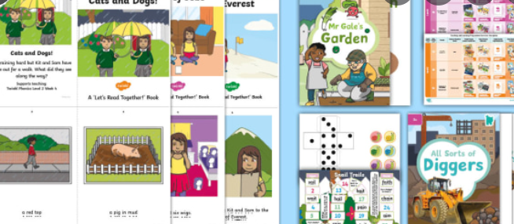

Slide 6
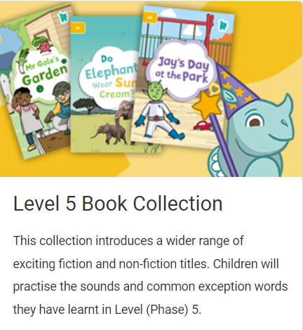
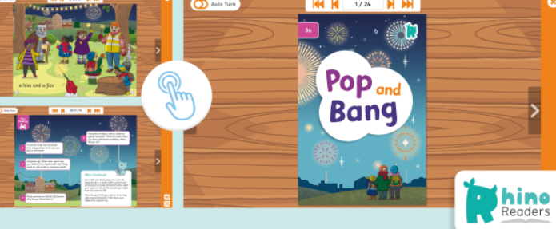

Slide 7
What Is Taught and When?
Twinkl Phonics Level | Number of Teaching Weeks | Recommended Year Group (UK schools) | Age of Children
Level 1 | 36 | Nursery/Preschool | 3-4 years
Level 2 | 6 | Reception | 4-5 years
Level 3 | 12 | Reception | 4-5 years
Level 4 | 4 | Reception | 4-5 years
Level 5 | 30 | Year 1 | 5-6 years
Level 6 | 30 | Year 2 | 6-7 years
Level 1 continues to be taught alongside the other levels.
This is just an overview. We understand that every child progresses at their own pace.

Slide 8
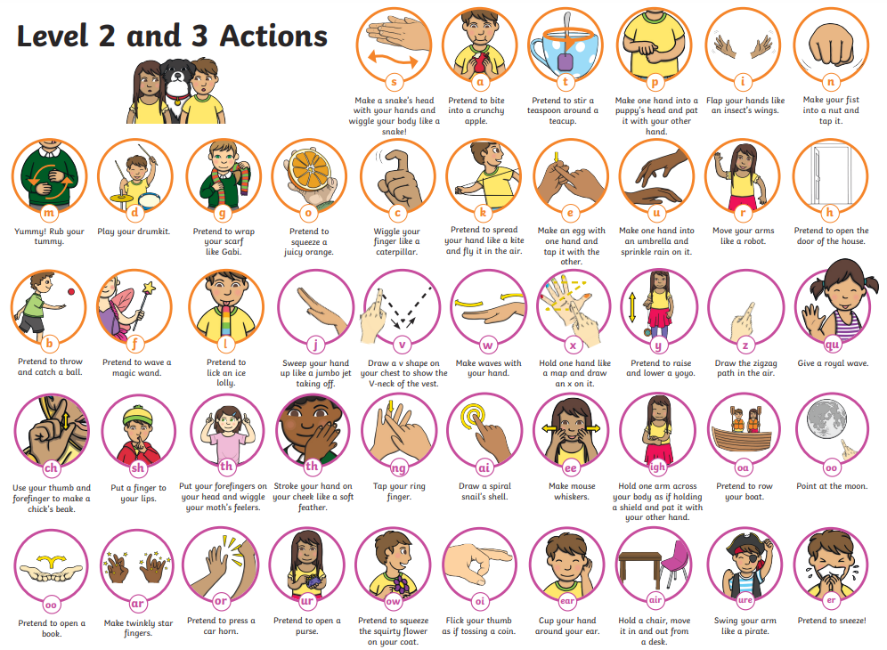
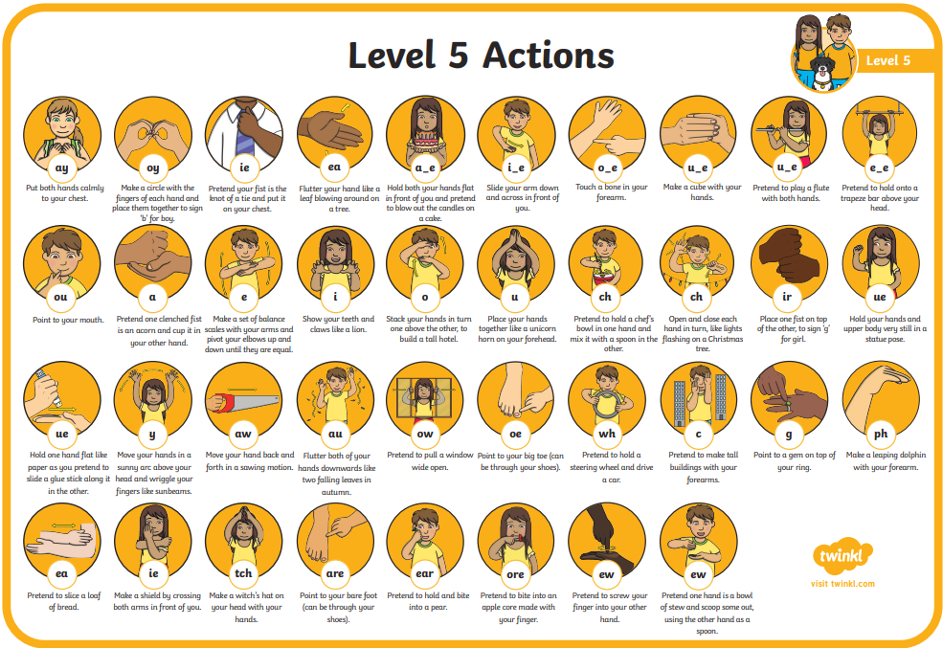

Slide 9
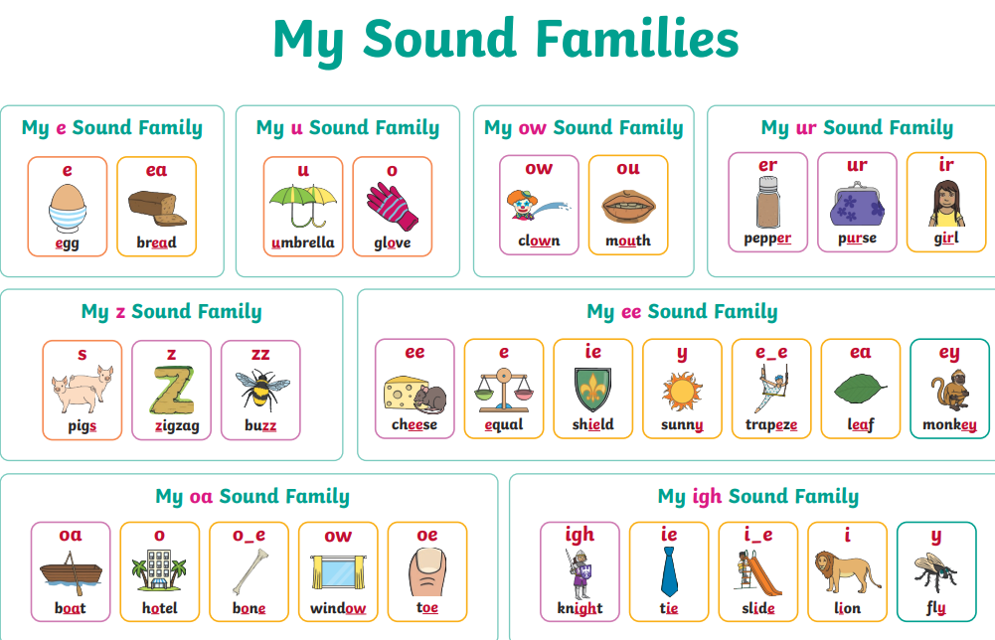

Slide 11
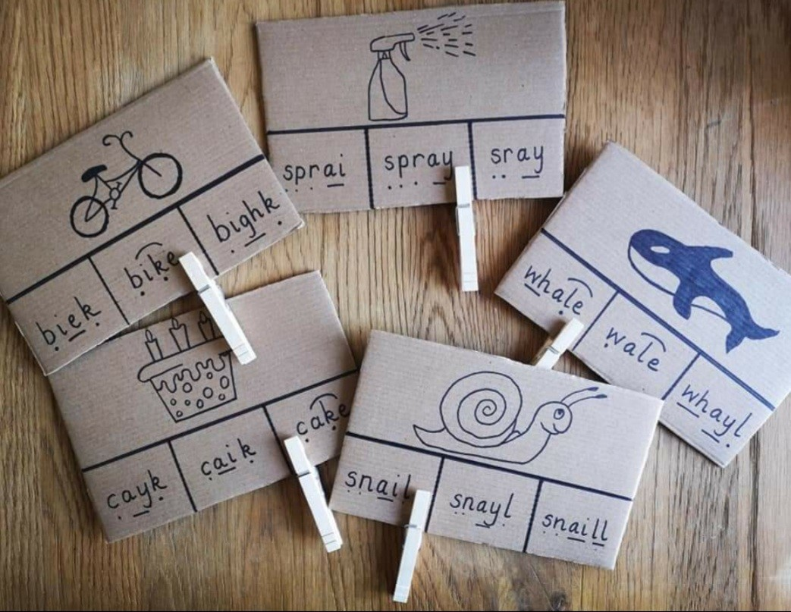
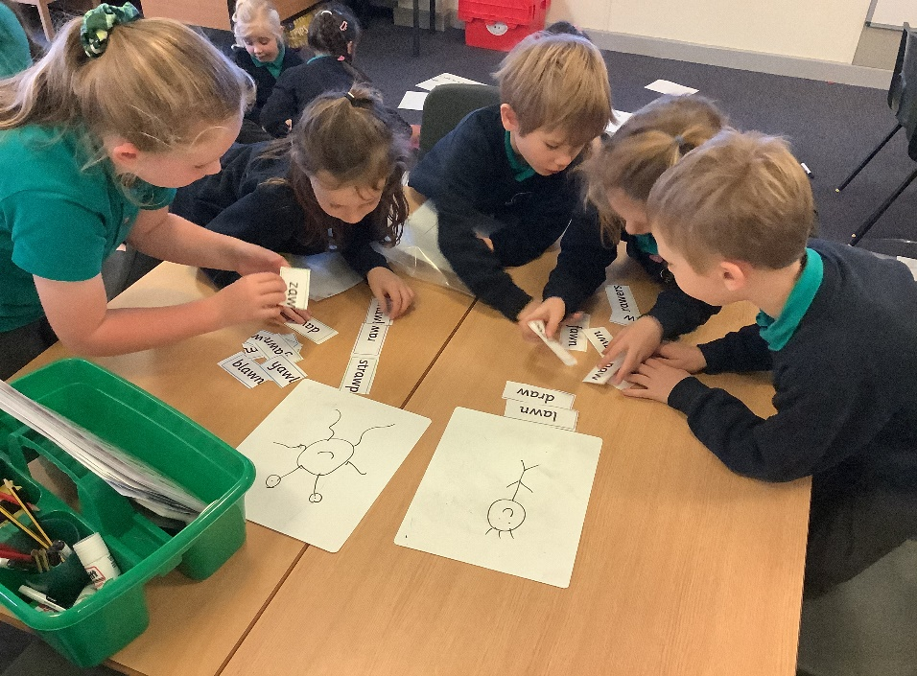
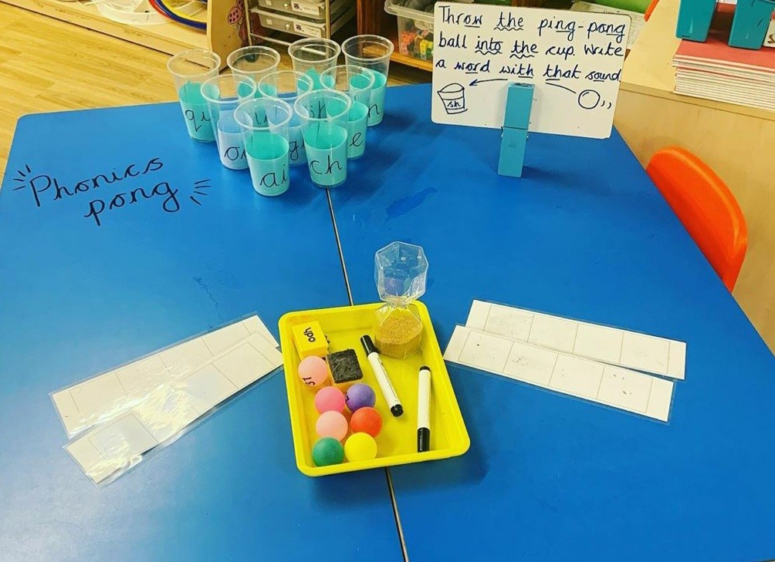
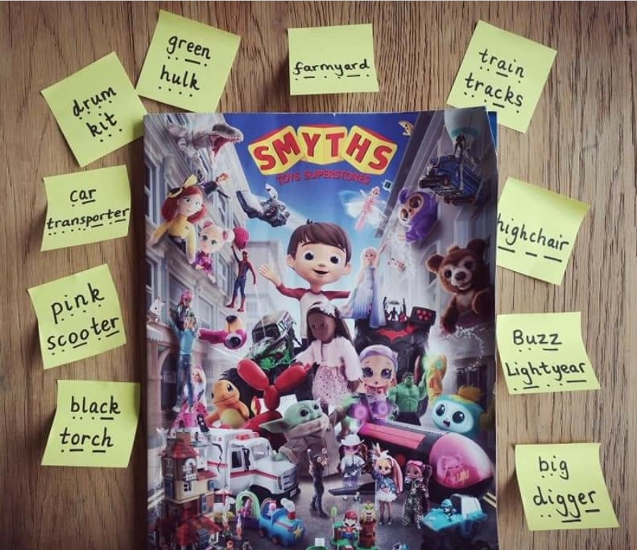
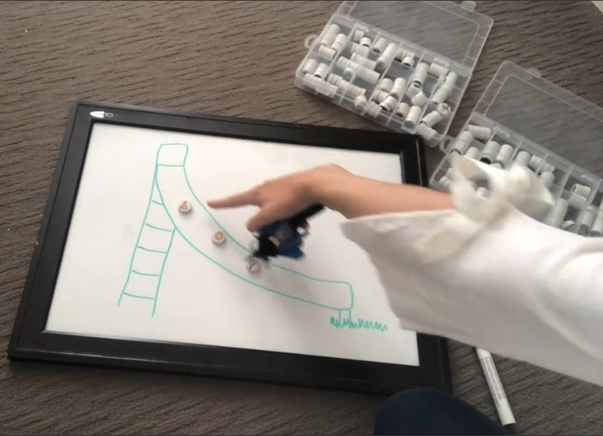
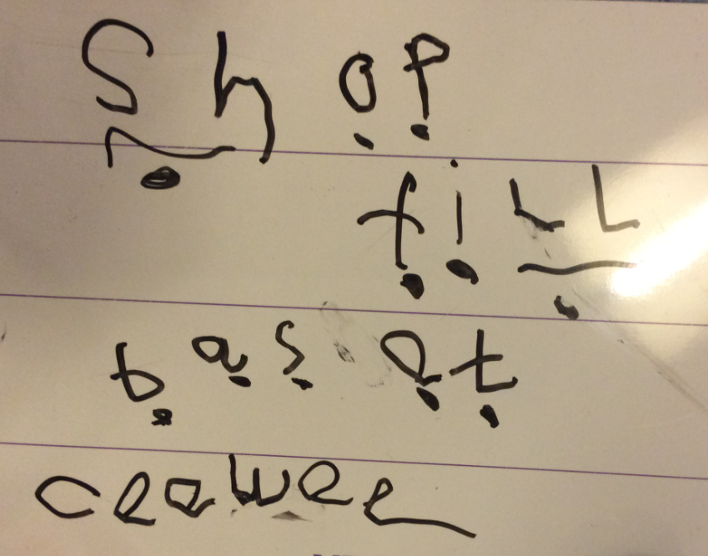

Slide 12
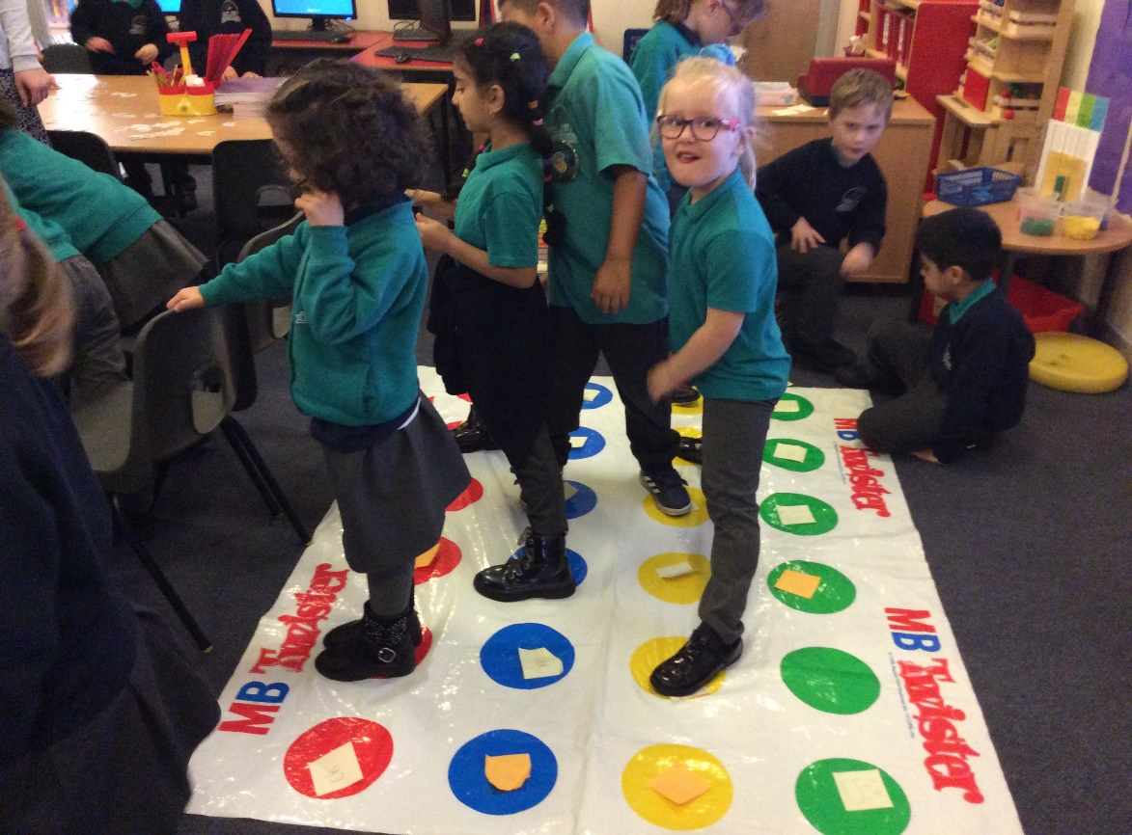
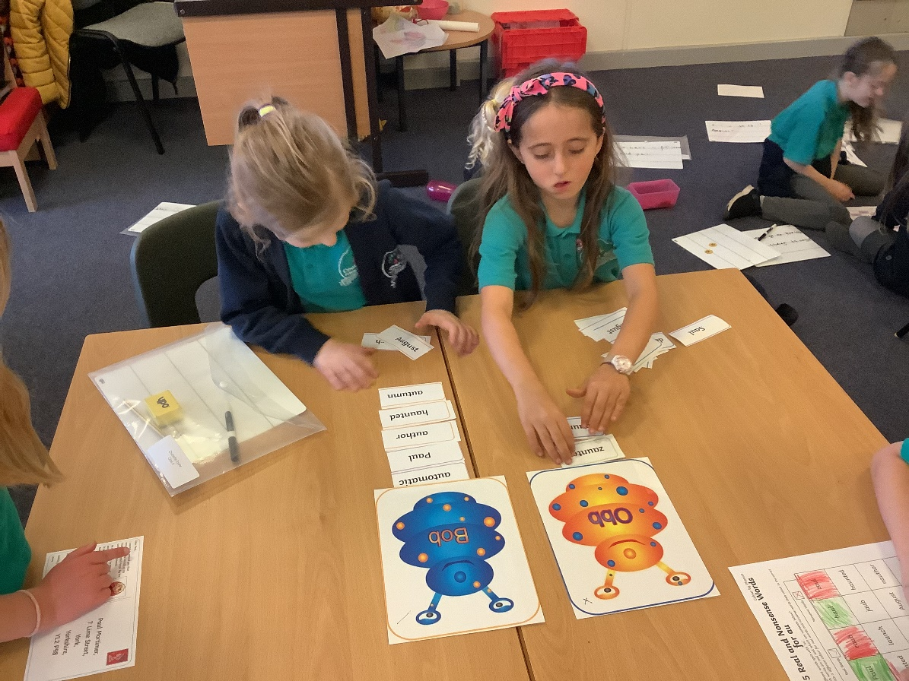
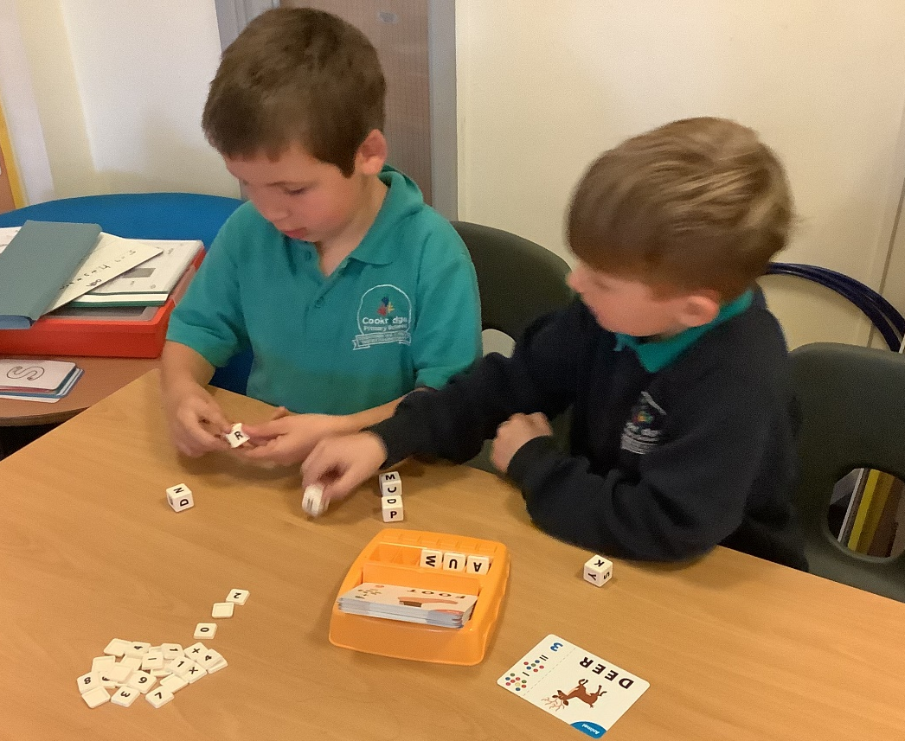
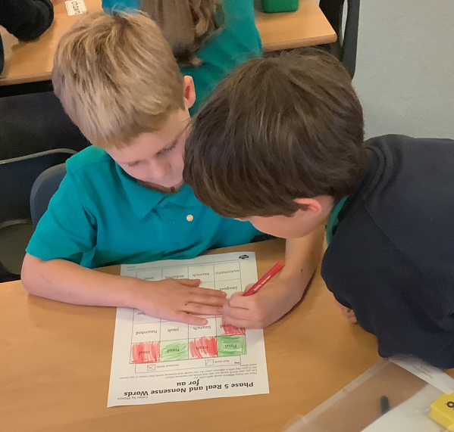

Slide 13
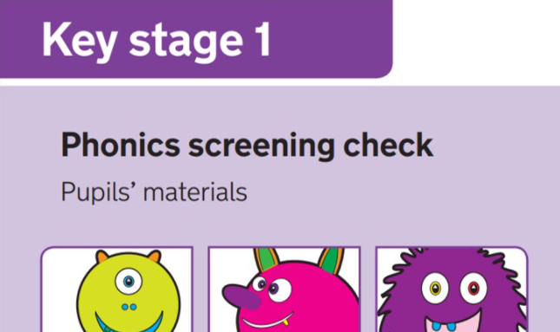
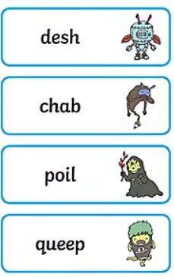
Phonics Screening test
Results from the check will be used by schools to analyse their own performance and for Ofsted to use in inspections.

Slide 14
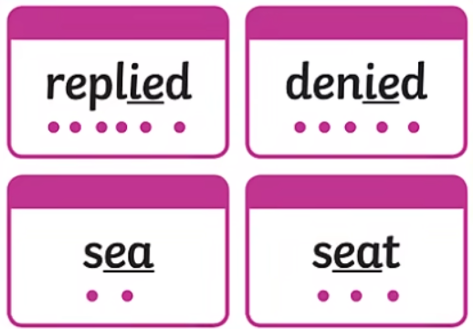
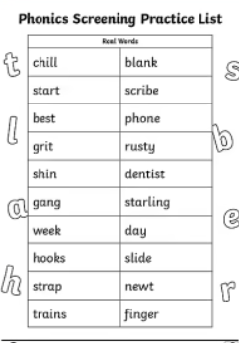
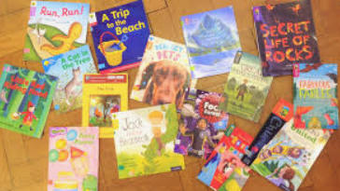
How you help your child to prepare for the phonics screening test
Read at least 3 times a week
https://www.phonicsplay.co.uk/parents

Slide 15
Useful websites/reading
Phonics Play – Planning, resources and online games
Oxford Owl –Ebooks to read and resources
https://www.twinkl.co.uk/resource/t-l-526364-phonics-screening-check-parents-information-pack-and-home-learning-tasks
https://www.twinkl.co.uk/resource/t-l-2409-parents-phonics-screening-check-resource-pack
What is Synthetic Phonics?- A summary

