Slide 1
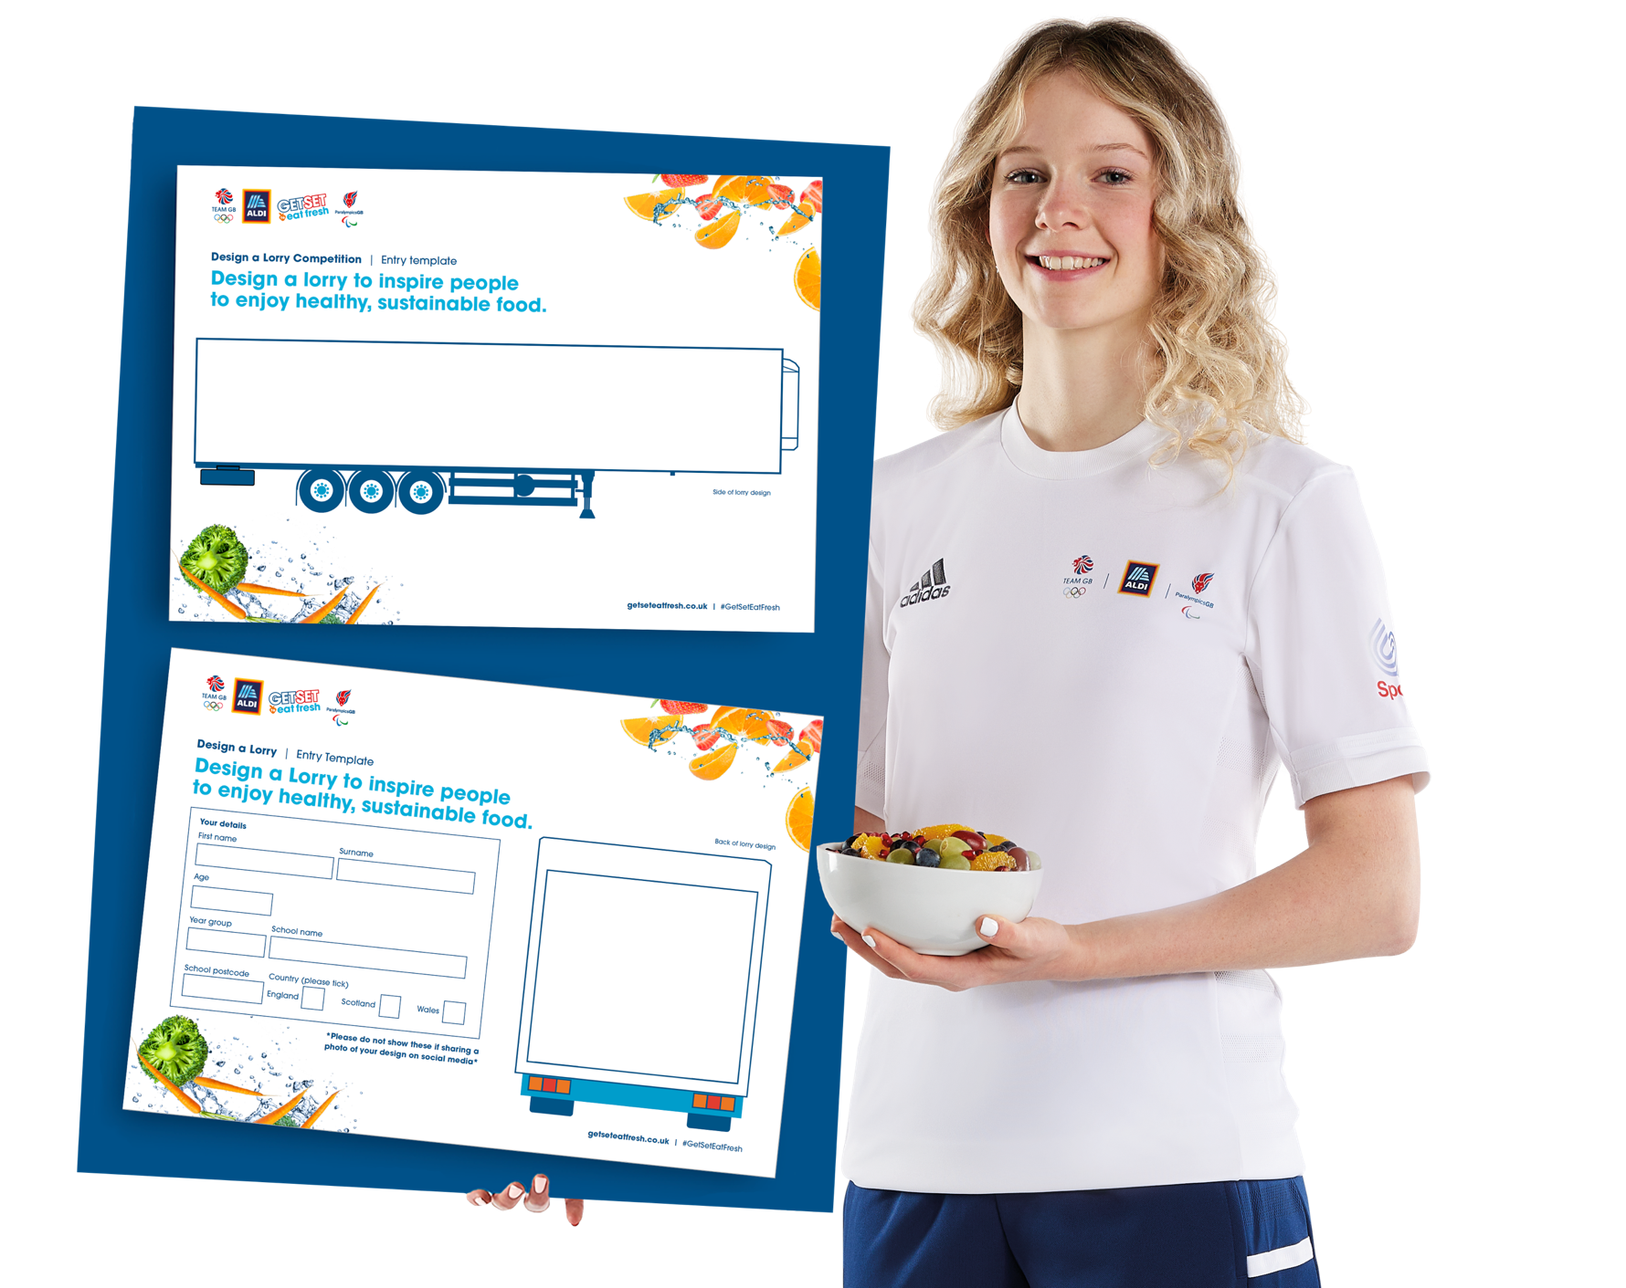
Design a Lorry
Competition

Slide 2
Design a Lorry
Competition
Design a lorry that inspires people to enjoy healthy, sustainable food!
  About the competition
        To celebrate the countdown to Paris 2024, Aldi, Team GB and ParalympicsGB are challenging young people aged 5–14 to get creative and design a lorry that inspires people to enjoy healthy, sustainable food. The three winners will see their designs featured on an Aldi lorry! Entries must be received by Friday 23rd June 2023.
        For resources and more information, including T&Cs, please visit: getseteatfresh.co.uk/designalorry
        Entering the competition
        Students should each complete an entry template with their design and personal details. Teachers/parents/carers should complete a cover sheet for entries and email or post students’ completed entry templates and cover sheet to the address on the cover sheet.
  Using this presentation
        Use this PowerPoint to introduce the competition. It also includes optional activities to explore what healthy, sustainable food means and how to create a great design. You can select and adapt the activities as required to suit your students.
        Simple delivery notes, including support and challenge ideas are included in the ‘Notes’ section underneath each slide.
  Presentation contents
        What do you know about healthy, sustainable food? (Slides 4 to 9) recap and recall key healthy eating facts and discuss what young people think about healthy, sustainable food.
        How can we inspire people to enjoy healthy, fresh food? (Slides 10 to 13) discuss who might see the Aldi lorries and how to use athletes to inspire them to enjoy healthy, sustainable food.
        How can we create an eye-catching design? (Slides 14 to 17) Review sample designs, generate quick ideas and discuss the judging criteria.
        Slide 18 contains a printable word bank to help students develop their ideas.
        Curriculum links
        Art & Design
        Design & Technology/Technology and Design/Technologies
        PSHE/PSE/PD&MU/Health and wellbeing (healthy eating,
        respect and sustainability)
Notes:
Background information
This slide provides background information on the competition for teachers and parents/carers. The rest of the presentation is student-facing.
The competition is open to all UK students aged 5–14 and in Years 1–9 (UK and Wales), P1–S2 (Scotland).

Slide 3

The Competition
Design a lorry that inspires people to enjoy healthy, sustainable food.
Your design could be selected by a panel of judges from Aldi, Team GB and ParalympicsGB to be used on an Aldi lorry!
Notes:
Introduction – The Competition
Explain to students that they are going to explore what healthy, sustainable food means and then create a design that inspires other people to enjoy it. These designs will be entered into a competition and the prize is having their design used on a real Aldi lorry!
Watch the video as a class to find out more!
Further information:
The three winners (one from England, one from Wales, and one from Scotland) will also win a £100 Aldi voucher and an exclusive goody bag of Team GB and ParalympicGB items. The winners’ schools (or a youth groups/community organisation to be agreed with Aldi, Team GB and ParalympicsGB, if the winner is home schooled) will also receive £1,000 in Aldi vouchers to spend on kitchen equipment and produce!
For further information on the competition, including entry materials and Terms and Conditions, please visit: getseteatfresh.co.uk/designalorry

Slide 4
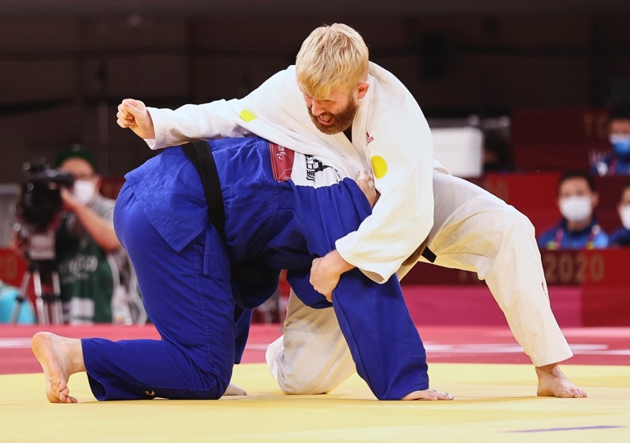
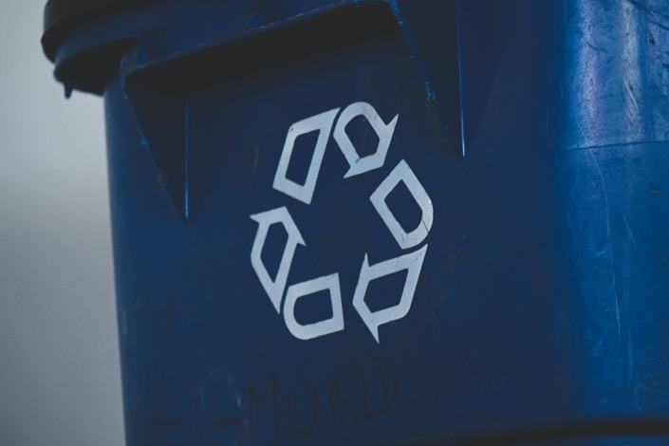
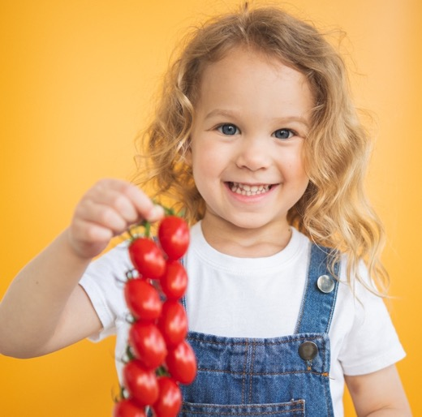
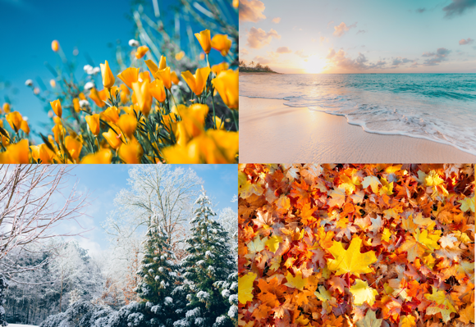




















Write down as many words as you can think of in 60 seconds! Use these images to help guide your thinking.
What does healthy, sustainable food mean to you?
60
59
58
57
56
55
54
53
52
51
50
49
48
47
46
45
44
43
42
41
40
39
38
37
36
35
34
33
32
33
32
31
30
29
28
27
26
25
24
23
22
21
20
19
18
17
16
15
14
13
12
11
10
09
08
07
06
05
04
03
02
01
00
Notes:
Starter activity – 60 Second definitions
Help students understand that this activity is to help them think about all the good things about healthy, sustainable food, which they can use to inspire people with their designs.
Divide the class into pairs or small groups. Set a timer for 60 seconds and ask them to write down all the things they think of and feel when they hear the word ‘healthy’. Do the same for ‘sustainable’. This is a quick fire activity to get them thinking, they don’t need perfectly phrased answers!
What kinds of things did students think of? How did the words make them feel? Take some examples from the class and invite students to write popular responses/key ideas on the board, to generate their own word bank to refer to throughout the lesson. You could also use sticky notes on the wall, which allows ideas to be grouped into themes.
Support: Discuss the images on the board as a class and gather ideas for the word bank as you go through them. For example:
Athletes – Healthy food is good for your body because it gives you energy to perform your best.
Eatwell guide – Having a healthy, balanced diet is important to make sure you get the full range of nutrients.
Fruit and vegetables – Think about a healthy food that you like. What does it taste, look and feel like? Why do you like it?
Reduce, Reuse, Recycle – Being sustainable means doing little or no harm to the environment. Reducing the amount of single use items we use, reusing them for another purpose and then recycling the material at the end of its life can help.
Eating seasonal food – Food doesn’t have to travel as far and can grow more naturally, which is more sustainable.
Feelings – Healthy food makes us feel good. Recycling makes us feel like we are doing our bit.
Challenge: Ask students to complete the activity individually, then to swap their list with the person next to them. They should try to add detail to some of their partner’s ideas – adding connecting words or feelings, before swapping back and sharing with the class on the board.

Slide 5
True or false?
Test your knowledge of healthy, sustainable food.
We should eat as many different types of fruit
and vegetables a day as possible.
Protein is only found in meat and fish.
True
True
False
True
False
False
True! To make sure we get all the vitamins and minerals we need, we should eat at least five portions of fresh, frozen, canned, dried or juiced fruit and vegetables a day.
False! Beans, pulses, nuts, eggs and dairy products are also great sources of protein – and they’re vegetarian!
Notes:
Activity 1 – Quiz: What do you know about healthy, sustainable food?
Take the class quiz to help students understand or review key facts about healthy, sustainable food. To make the game more active, ask students to perform an action, such as star jumps for true, and lunges for false.
True or False: We should eat as many different types of fruit and vegetables a day as possible.
True: To make sure we get all the vitamins and minerals we need, we should eat at least five portions of fresh, frozen, canned, dried or juiced fruit and vegetables a day.
2. True or False: Protein is only found in meat and fish. False.
False: Beans, pulses, nuts, eggs and dairy products are also great sources of protein – and they’re vegetarian!
Support: Give students hints from the answer or visual clues to help them figure out the correct answer.
Challenge: Ask pupils to explain why they have selected true or false. Explain that other pupils can change their mind if a student makes a compelling argument.
Extension: Use our Eat well with Team GB resource to have a go at putting together a healthy meal for a Team GB athlete as an additional activity: getseteatfresh.co.uk/resources/eat-well-with-team-gb
SOURCES
Eatwell guide: assets.publishing.service.gov.uk/government/uploads/system/uploads/attachment_data/file/742750/Eatwell_Guide_booklet_2018v4.pdf
What counts as a portion of fruit and vegetables?
The exact portion changes for each fruit and vegetable, but it is roughly the same as what fits in the palm of your hand.
To explore portion size more fully, trying measuring out some portions using the rules below:
80g or any of these: one apple, banana, pear, orange or other similar-size fruit; three heaped tablespoons of vegetables; a dessert bowl of salad; 30g of dried fruit (which should be kept to mealtimes) or a 150ml glass of fruit juice or smoothie (counts as a maximum of one portion a day).
Ensure students understand that fruit and vegetables should be eaten as part of a balanced diet, making up a third of what we eat every day.

Slide 6
True or false?
Test your knowledge of healthy, sustainable food.
White pasta can help you feel fuller for longer
than wholewheat pasta.
Eating some fat is an important part
of a balanced diet.
True
False
False
True
False
True
False! Wholegrain carbohydrates like wholewheat pasta, potatoes with the skins on, or brown rice have more fibre and can help you stay fuller for longer.
True! Stick to healthier, unsaturated fats from plant sources like vegetable oil, rapeseed oil and olive oil.
Notes:
Activity 1 – Quiz: What do you know about healthy, sustainable food?
Take the class quiz to help students understand or review key facts about healthy, sustainable food. To make the game more active, ask students to perform an action, such as star jumps for true, and lunges for false.
1. True or False: White pasta can help you feel fuller for longer than wholewheat pasta.
False: Wholegrain carbohydrates like wholewheat pasta, potatoes with the skins on, or brown rice have more fibre and can help you stay fuller for longer.
2. True or False: Eating some fat is an important part of a balanced diet.
True: Stick to healthier, unsaturated fats from plant sources like vegetable oil, rapeseed oil and olive oil.
Support: Give students hints from the answer or visual clues to help them figure out the correct answer.
Challenge: Ask pupils to explain why they have selected true or false. Explain that other pupils can change their mind if a student makes a compelling argument.
Extension: Use our Eat well with Team GB resource to have a go at putting together a healthy meal for a Team GB athlete as an additional activity: getseteatfresh.co.uk/resources/eat-well-with-team-gb
SOURCES
Eatwell guide: assets.publishing.service.gov.uk/government/uploads/system/uploads/attachment_data/file/742750/Eatwell_Guide_booklet_2018v4.pdf

Slide 7


True or false?
Test your knowledge of healthy, sustainable food.
Local fruits and vegetables that are in season are more sustainable.
These symbols mean food has come from a more sustainable source.
True
False
True
False
True
True
True! Buying seasonal fresh fruit and vegetables reduces the amount of greenhouse gases used to get your food
to you.
True! The red tractor means a food has been produced entirely in the UK with minimal pesticides. The blue MSC label means fish has come from a sustainable source.
Notes:
Activity 1 – Quiz: What do you know about healthy, sustainable food?
Take the class quiz to help students understand or review key facts about healthy, sustainable food. To make the game more active, ask students to perform an action, such as star jumps for true, and lunges for false.
True or False: Local fruits and vegetables that are in season are more sustainable.
True: Buying seasonal fresh fruit and vegetables reduces the amount of greenhouse gases used to get your food to you.
2. True or False: These symbols mean food has some from a more sustainable source.
True: The red tractor means a food has been produced entirely in the UK with minimal pesticides. The blue MSC label means fish has come from a sustainable source.
Support: Give students hints from the answer or visual clues to help them figure out the correct answer.
Challenge: Ask pupils to explain why they have selected true or false. Explain that other pupils can change their mind if a student makes a compelling argument.
Extension: Use our Eat well with Team GB resource to have a go at putting together a healthy meal for a Team GB athlete as an additional activity: getseteatfresh.co.uk/resources/eat-well-with-team-gb
SOURCES
BDA: https://www.bda.uk.com/resource/what-is-a-sustainable-diet.html
Red Tractor: https://redtractor.org.uk/
MSC Fish: https://www.msc.org/

Slide 8
True or false?
Test your knowledge of healthy, sustainable food.
Eating a balanced diet can help us
cut greenhouse gases.
All plastic packaging is recyclable.
True
False
True
False
True
False
True! UK adults could reduce the greenhouse gas emissions of their diets by 30% if they more closely followed the Eatwell Guide’s recommendations, especially eating less meat and more plant-based food.
False! Not all types of plastic can be recycled. Try to buy loose fruit and vegetables where possible and research how to properly recycle any packaging.
Notes:
Activity 1 – Quiz: What do you know about healthy, sustainable food?
Take the class quiz to help students understand or review key facts about healthy, sustainable food. To make the game more active, ask students to perform an action, such as star jumps for true, and lunges for false.
True or False: Eating a balanced diet can help us cut greenhouse gases.
True: UK adults could reduce the greenhouse gas emissions of their diets by 30% (and reduce water use by 4%) if they more closely followed the Eatwell Guide’s recommendations, especially eating less meat and higher amounts of plant-based foods (e.g. mixing beans, pulses, nuts and seeds into your protein). Research from the British Nutrition Foundation notes that vegetarian or vegan diets may have larger environmental benefits, but are unlikely to be adopted by all and may reduce intakes and/or bioavailability of some essential nutrients (e.g. iron and zinc) in some people's diets – whereas reducing meat intake to follow the Eatwell Guide is a more realistic goal with the potential for big impact (30% reduction in emissions). In other words, exploring a range of proteins not only allows people to find new, exciting recipes but can benefit both personal and environmental health.
2. True or False: All plastic packaging is recyclable.
False: Not all types of plastic can be recycled. Try to buy loose fruit and vegetables where possible and research how to properly recycle any packaging.
Support: Give students hints from the answer or visual clues to help them figure out the correct answer
Challenge: Ask pupils to explain why they have selected true or false. Explain that other pupils can change their mind if a student makes a compelling argument.
Extension: Use our Eat well with Team GB resource to have a go at putting together a healthy meal for a Team GB athlete as an additional activity: getseteatfresh.co.uk/resources/eat-well-with-team-gb
SOURCES
Plastic: https://wrap.org.uk/taking-action/plastic-packaging
Aldi packaging: https://www.aldi.co.uk/about-aldi/corporate-responsibility/resources-for-our-products/product-packaging-and-waste
BMJ: https://bmjopen.bmj.com/content/10/8/e037554
British Nutrition Bulletin: https://onlinelibrary.wiley.com/doi/full/10.1111/nbu.12518

Slide 9
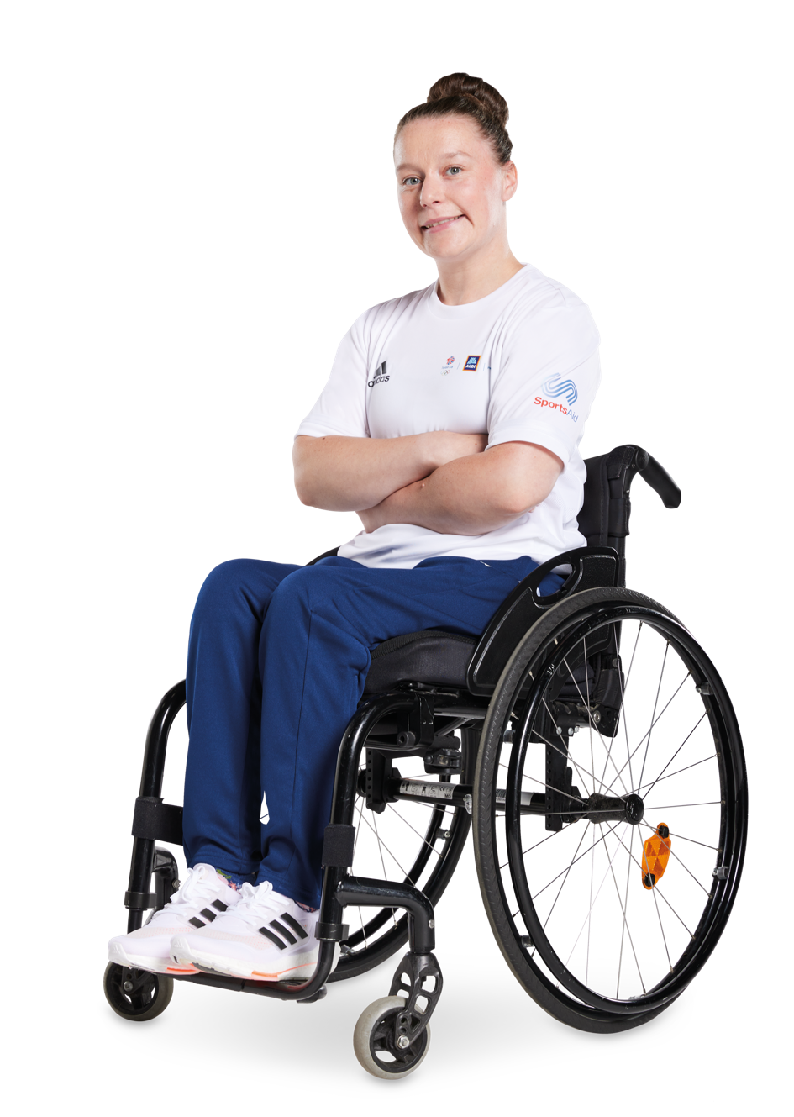
Reflection
If healthy, sustainable food is good for us and the planet, why isn’t everyone already enjoying it?
Discuss in small groups.
    How would you define a healthy, balanced diet?
    What does eating sustainably mean?
    What might stop people from enjoying a healthy, sustainable diet?
    How could we inspire everyone to enjoy healthy,
    sustainable food?
Notes:
Activity 1 – Reflection: Barriers to enjoying healthy, sustainable food
Challenge students to reflect on everything they have learnt and discussed so far. If healthy, sustainable food is good for us and for the environment, why isn’t everyone already enjoying it?
Ask students to discuss these three questions in pairs or small groups, and give reasons for their responses.
How would you define a healthy, balanced diet?
What does eating sustainably mean?
What might stop people from enjoying a healthy, sustainable diet? (Students should think about different awareness levels, what ingredients are local, different cooking abilities, different amounts of time available to cook etc.)
Reveal the fourth question and explain that their reflections will help them to better understand the different and complex audiences for their design, and how they can be inspired.
Support: Discuss the questions as a class, adding key words or topic toplines to the word bank created at the start of the lesson. Provide students with printed copies of the word bank on slide 18 to help develop their ideas.

Slide 10


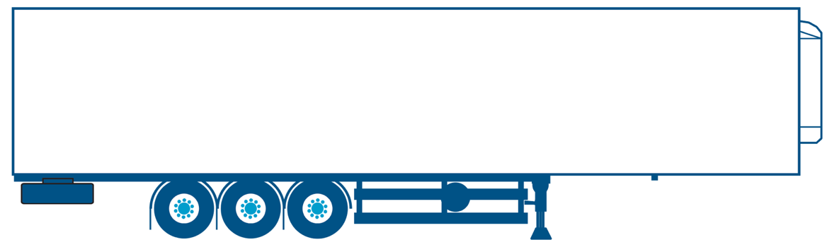
What are we designing?
Your challenge is to design a lorry to inspire people to enjoy healthy, sustainable food.
    Entries should include designs for both the side and back of the lorry.
    The winning designs will be featured on Aldi’s 13.6 metre long lorries. These lorries deliver fresh, healthy food from Aldi’s warehouses to shops around the country.
Did you know?
Aldi GB & IE are carbon neutral.
Aldi are working to develop new ways
to reduce CO2 emissions from lorries.
This includes:
    using lighter vehicles with improved aerodynamics and fuel-efficient tyres
    using double deck trailers for fewer trips
    training lorry drivers to drive
    more efficiently
    making sure new trucks are as efficient
    as possible.
Notes:
Activity 2 – Introduction: How can we inspire people to enjoy healthy, fresh food?
Recap the competition brief and take a closer look at the Aldi lorry. As a comparison, the average adult male in the UK is 1.75 metres – so the lorry will be almost as long as eight adult men lying head to toe! (Around 7.78 men.)
* Students should design the side and the back of the lorry (the same design will be used on both sides).
What do students think is the most interesting fact about the lorries?
Further information
Aldi have reduced their carbon footprint by 55% per metre squared since 2012.
Aldi GB & IE are 100% carbon neutral and are working to develop new ways to reduce CO2 emissions from lorries. This includes:
using lighter vehicles with improved aerodynamics and fuel-efficient tyres
using double deck trailers for fewer trips
training lorry drivers to drive more efficiently
making sure new trucks are as efficient as possible.
Sources
*Average UK Male height: Moody, Alison, ‘Adult anthropometric measures, overweight and obesity’: web.archive.org/web/20160702012345/http://www.hscic.gov.uk/catalogue/PUB13218/HSE2012-Ch10-Adult-BMI.pdf

Slide 11
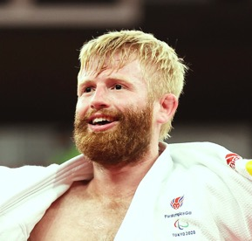
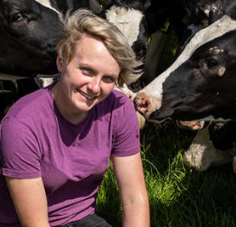
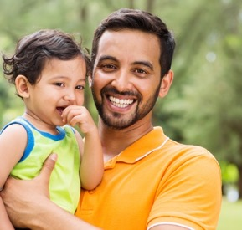
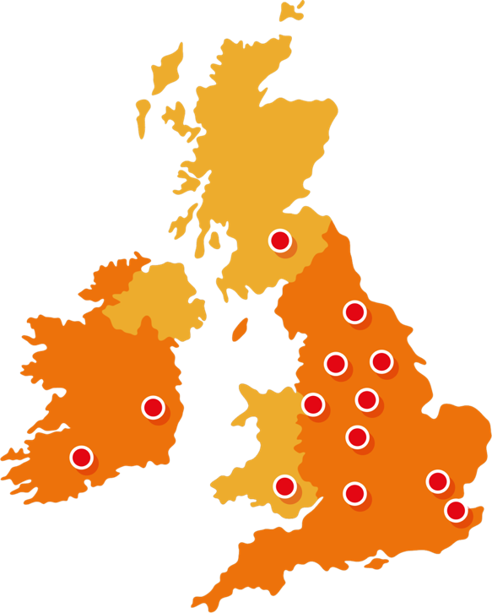
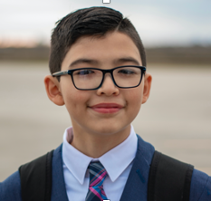
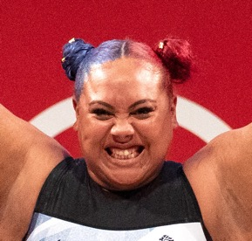
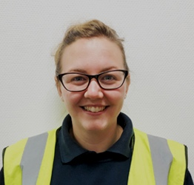
Who might see or hear
about your lorry?
Chris
ParalympicsGB judoka
Hull
    What do they like about healthy food?
    What do they know about being sustainable?
Sally
Dairy farmer and Aldi milk supplier West Yorkshire
Sahil
Nurse and Aldi customer
Cardiff
Did you know? There nearly 1000 Aldi stores across the UK!
Elliot
School pupil
Glasgow
Emily
Team GB weightlifter
Nottingham
Danielle
Aldi lorry driver
Atherstone
Notes:
Activity 2 – Discussion/matching: How can we inspire people to enjoy healthy, fresh food?
Explain that this activity will help students think more about the audience for their design. Show students the map of the UK. The dots mark Aldi’s 11 ‘Regional Distribution Centres’ (warehouses) where lorries collect produce to deliver to Aldi’s nearly 1000 stores across the country.
Ask students where they think people might see their lorry? Who/what kind of people might see it? Take some ideas from the class, then click to reveal the five examples. Divide students into small groups and give each one of the personas to discuss.
What do they like about healthy food?
What do they know about being sustainable?
Ask students to note down their answers and feedback to the class, explaining why their persona might enjoy healthy, sustainable food. Add any new words or ideas to the collective word bank on the board.
Support: Provide students with printed copies of the word bank on slide 18 to help develop their ideas. Choose one of the people to discuss as a class, or run as a matching exercise – asking students to match the following responses to the question ‘what do you like about fresh, healthy food?’ There isn’t necessarily a right or wrong answer for these – if students can justify their opinions – although they may find some responses seem best suited to certain people! U
I like locally grown, seasonal fruits and vegetables.
I like healthy food that’s quick to prepare for my family.
I like healthy foods that help me stay strong and perform at my best.
I like healthy foods I can take with me on long drives.
I like healthy foods I can share with my friends.
Challenge: Encourage students to pick two people to compare and contrast. Encourage them to find about their age, job, location, possible other interests/factors (e.g. hobbies, the environment, religion/culture, dietary requirements etc.) in their answers, if they can, or imagine what they might be like if they can’t find out about them. Give students an additional question to start discussing: How could your design combine what different people think is great about healthy, fresh food to celebrate it together?
Extension
Students may want to extend their background research. Ask students to create an informal survey for parents, teachers or their peers, and/or complete additional independent research to further explore the target audience for the lorry, and understand the motivations and attitudes of that audience and what might inspire them to enjoy healthy, sustainable food.
Further information
You can find out more information about Sally and Danielle on the following links.
Sally Hall, dairy farmer: aldi.co.uk/grocery/meet-our-suppliers/british-milk
Danielle, Aldi HGV driver: aldirecruitment.co.uk/warehouse-transport/transport

Slide 12
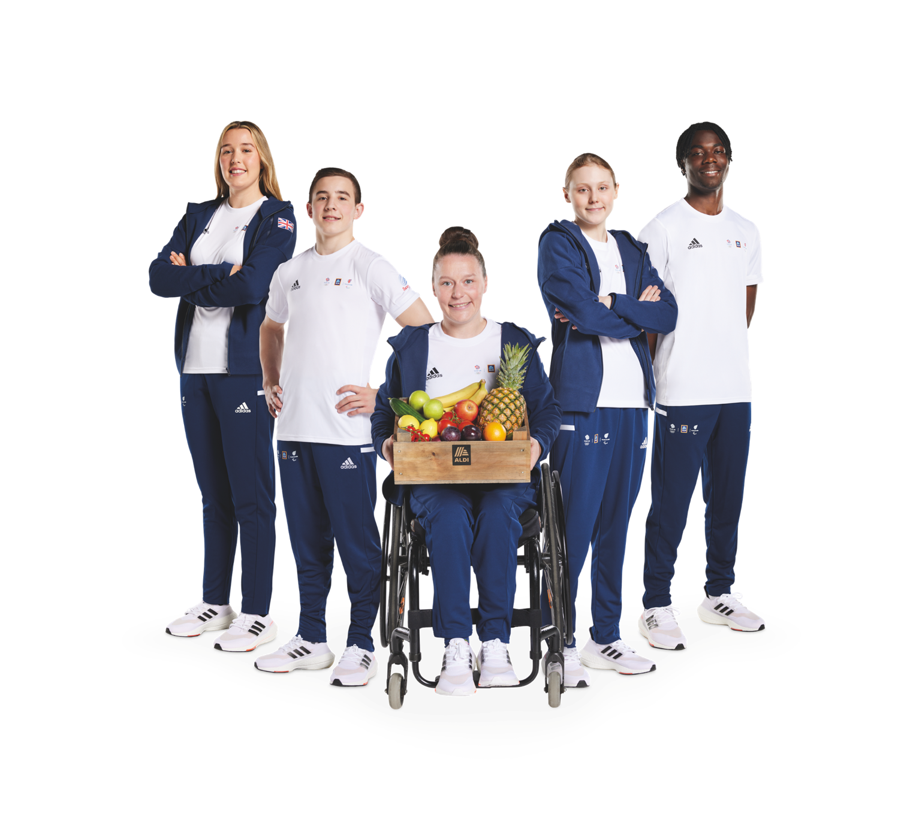
How can we inspire people to enjoy healthy, sustainable food?
    What do you want people to do?
    How will you inspire them to do it?
    How will you make them feel like
    they can do it?
Notes:
Activity 2 – Pair and share: How can we inspire people to enjoy healthy, fresh food?
Take some suggestions from the class on what it means to be ‘inspired’ to do something. Then ask students to pair and share to start thinking about their designs: what do they want people to do when they see it? How will the design inspire them to want to do this? How will it make them feel like they can do it?
Additional activity
Ask students to divide a page into two columns, labelling one ‘Want’ and the other ‘How’. They should fill in the columns with things they want with design to inspire people to do, think or feel and then give examples of how they could achieve it. Their ideas don’t all have to be practical at this stage – ask them to dream big and hone their ideas down later.
Prompt students to think about:
What do you want people to do, think and feel? E.g. Enjoy more fruits and vegetables, think about trying more plant-based foods, feel excited by healthy food, think about sustainable options etc.
How will you inspire them and make them feel like they can do it? E.g. How can your design help people feel positive and excited? How can you make healthy, sustainable food feel fun and/or easy?
How will this lead to them enjoying healthy, sustainable food?
Support: Choose some words from the collective word bank (see slide 18) to prompt their ideas. Think about the athletes mentioned on the previous slide – what healthy, sustainable food might they eat to perform at their medal winning best? How could they capture this in their design?
Challenge: Encourage students to reflect on their prior learning about healthy foods to inform the discussion. What key information might people need to know about healthy, sustainable food? What foods do we need as part of a balanced diet? How can students share this information in a way that celebrates what’s great about healthy, sustainable food? (E.g. A healthy diets needs a balance of carbohydrates, fruits and vegetables, protein, dairy/substitutes, and oils/spreads – but we can achieve this balance by exploring a huge variety of different foods. Eating a more balanced diet can encourage us to try new things.)

Slide 13
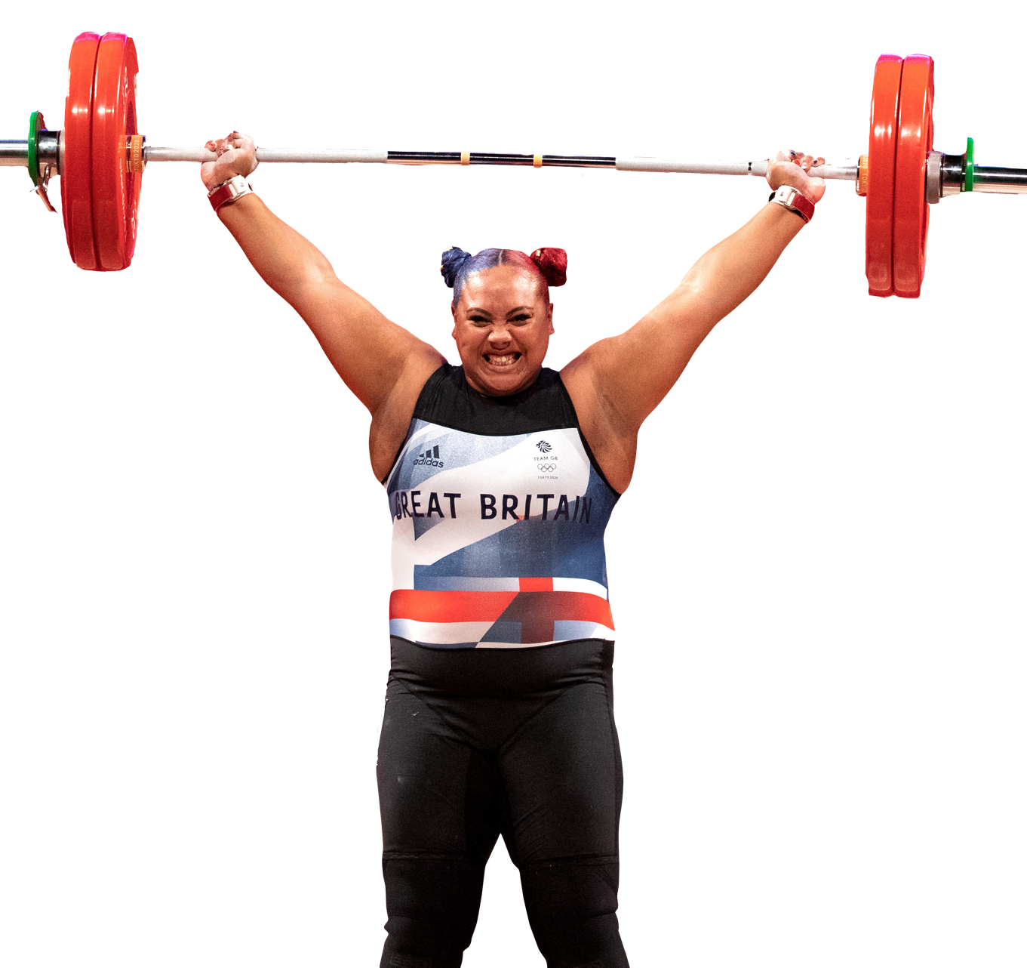
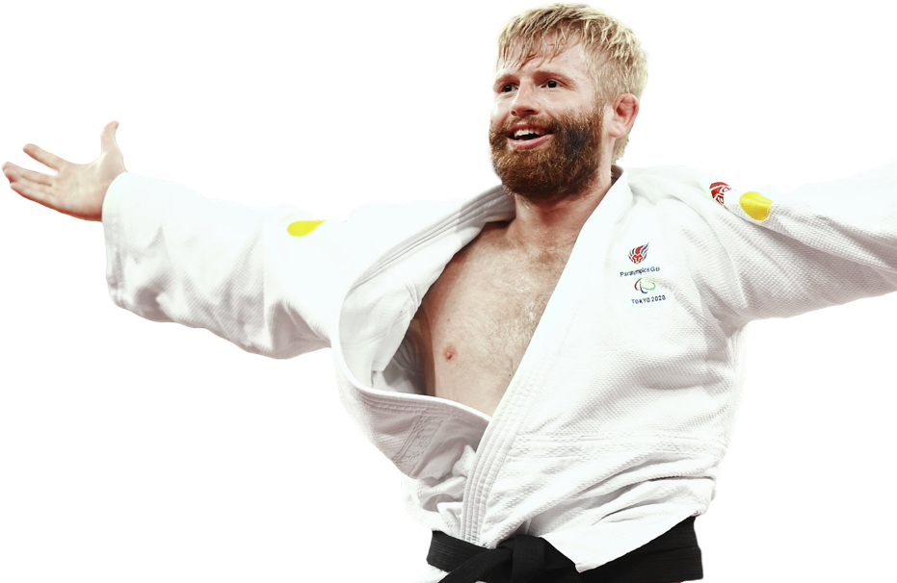
How could you use Team
GB and ParalympicsGB inspiration in your design?
    The winning lorry design will hit the roads in the run up to the Paris 2024 Olympic and Paralympic Games.
    How could people be inspired by athletes’
    actions and achievements?
    How does healthy, sustainable food help
    athletes perform at their best?
    How is Paris 2024 setting an inspiring
    example in sustainability?
Emily Campbell's silver medal winning lift at Tokyo 2020 weighed 161kg –
about the same as a bottlenose dolphin!
Chris Skelley winning his first Paralympic medal – gold at the Tokyo 2020 Paralympic Games.
Notes:
Activity 2 – Pair and share (challenge): How can the Olympic and Paralympic Games be used to inspire people to enjoy healthy, fresh food?
The winning lorries will hit the roads in the run up to Paris 2024. Ask pairs/small groups to discuss why people might find the Olympic and Paralympic Games inspiring. How could students use Team GB or ParalympicsGB inspiration in the designs?
Athlete examples – click to display:
Emily Campbell, Olympic silver medal in weightlifting: https://www.youtube.com/watch?v=WXGpSH9eo0k
At the Tokyo 2020 Olympic Games, weightlifter Emily Campbell, who we met in the film, won Team GB’s first weightlifting medal in 37 years – becoming only the sixth person in history to do so. Her medal winning lifts had a combined weighed 161kg, which is about the same as a bottlenose dolphin!
Chris Skelley, Paralympic gold medal in judo: https://www.youtube.com/watch?v=F4kvDz1ys9A
At the age of 17, Chris Skelley, who we also met in the film, had to stop training to become a mechanic, because he was losing his eyesight. To help him get through this difficult time, he threw himself into his Judo practice. He came 5th at the Rio 2016 Paralympic Games but then went on to win a gold medal at Tokyo 2020!
People have a strong reaction when they see people reaching achievements like this. How could you capture or use this in your design? In the competition film both athletes talk about being fuelled by eating great, healthy food! What foods did they mention? How could you show that great food powers great performances?
Paris 2024 examples:
The organisers of the Paris 2024 Olympic and Paralympic Games have ambitious sustainability plans. They are aiming to cut the carbon footprint of the games in half, compared to previous years, and will be offsetting unavoidable carbon emissions to make the event carbon neutral. They have also committed to offering athletes and visitors more healthy, sustainable food options, including more plant-based meals and 80% local, French produce, as well as cutting single use plastic waste in half.
Add support: Focus on the first question and discuss why the athlete examples are inspiring in more detail as a class.
Extension/Add challenge: Invite students to investigate Paris 2024’s sustainability plan further. How could they incorporate this into their design?
https://www.paris2024.org/en/delivering-carbon-neutral-games/
https://www.paris2024.org/en/food-vision/

Slide 14
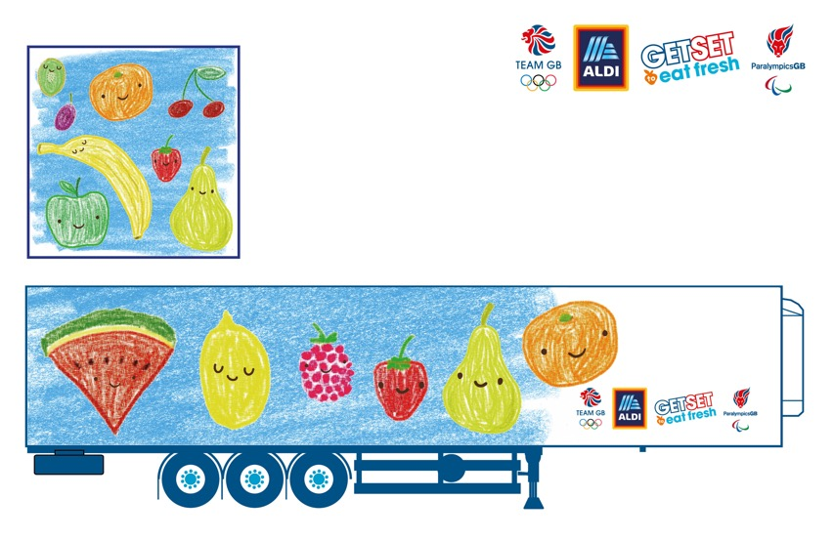
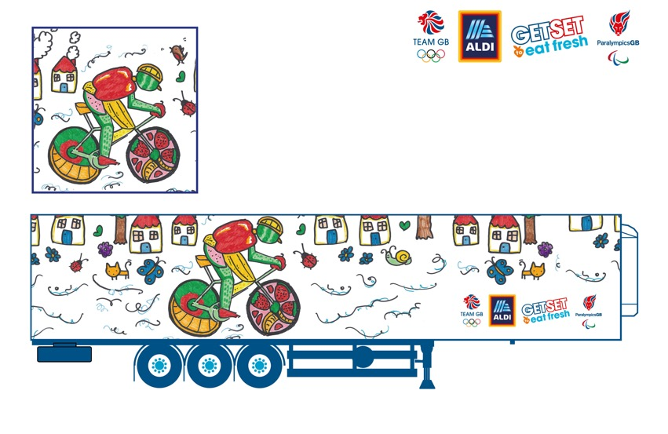
Example designs
How can we create an eye-catching design?
    What do you like about these designs?
    Do you think they would inspire people to enjoy healthy, sustainable food? Why/why not?
    What other designs/styles might you want to use when creating your lorry design?
Notes:
Activity 3 – Introduction and example designs: How can we create an eye-catching design?
These designs have been created to help young people start thinking about their designs and the different styles and approaches they might use. ​
​
What do you like about these designs? ​
Do you think they inspire people to enjoy healthy, sustainable food? Why/why not?​
What other designs or styles might you want to use when creating your lorry design? ​
​
Across these questions, ask students to comment on the colour, layout, wording, range of approaches, and to explain their views. ​You may want to discuss additional sources of inspiration, including links to artists or designers that students have studied previously.​
​
Support: Make a note of key ideas that students may want to use in answer to the third question to use on the next activity. ​
Challenge: Explore different approaches to healthy eating messaging. This Public Health England library of historic health messaging might be an interesting way to explore how messaging has changed over time, and what encourages people to adopt healthy behaviours today: publichealthengland.exposure.co/100-years-of-public-health-marketing

Slide 15
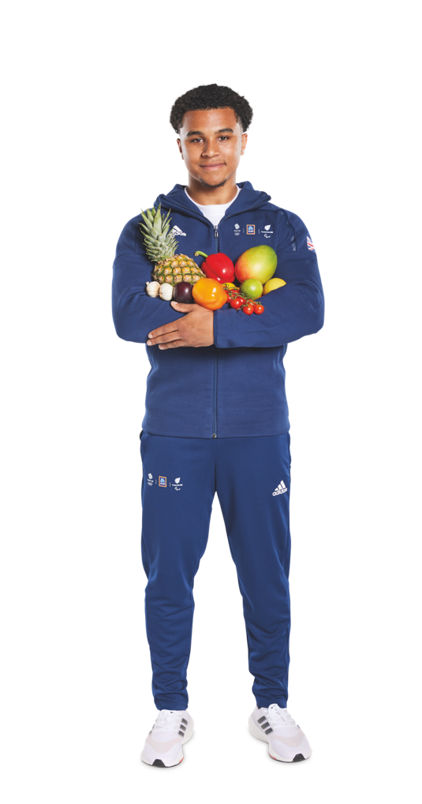
Creating your design – four ideas in five minutes
    Fold a piece of paper into four sections.
    In each section, draw simply (sketch) a different quick idea for your lorry design. You will be timed!
    Reviewing the quick ideas
    What was similar? What was different?
    Do we have any new ideas?
Your design must be created by hand, not on a computer, and cannot use the Olympic Rings
or the Paralympic Agitos!
Notes:
Activity 3 – Initial ideas: How can we create an eye-catching design?
Give each student a piece of paper and ask them to fold it into three sections. Ask students to write down or sketch out as many ideas as possible under each heading, using the collaborative word bank (see slide 18) as required for inspiration. Give them a time limit of five minutes (adjust as suitable).
The idea here is to get students to come up with as many ideas as possible in a short period of time. Ideas don’t need to be beautiful/finished and could include notes/key words as well as sketches. If students are struggling to get started, you may want to do a warm up where they all draw three things from their school day in three minutes so they get the idea – and you can do this too! If necessary, adjust the number of ideas/time for students but do try and keep this quick.
Support: If students get stuck they could explore these ideas:
My design will show my favourite fruit(s) or vegetable(s) – what makes it/them special?
My design will show the feeling(s) you get from healthy, sustainable food.
My design will inspire people to want eat more local fruit and vegetables like Team GB and ParalympicsGB athletes will at Paris 2024.
My design will inspire people to want to try new things.
My design will inspire people to feel great because they eat healthy, sustainable food.
My design will inspire people to want to make good food choices for the planet.
Challenge: Ask students to carry on to the other side with any remaining time.
Reviewing the ideas
Come back together as a class and discuss the themes that have emerged across the designs. What was similar? What was different? Think about: what was drawn, if words were written, the mood created by the ideas. How will they adjust their ideas based on the discussion? Older students may want to discuss the sketches with reference to styles or healthy eating messaging explored earlier in the session or in previous lessons.
Ensure that students feel they have developed an idea they are happy to progress in their final design.

Slide 16
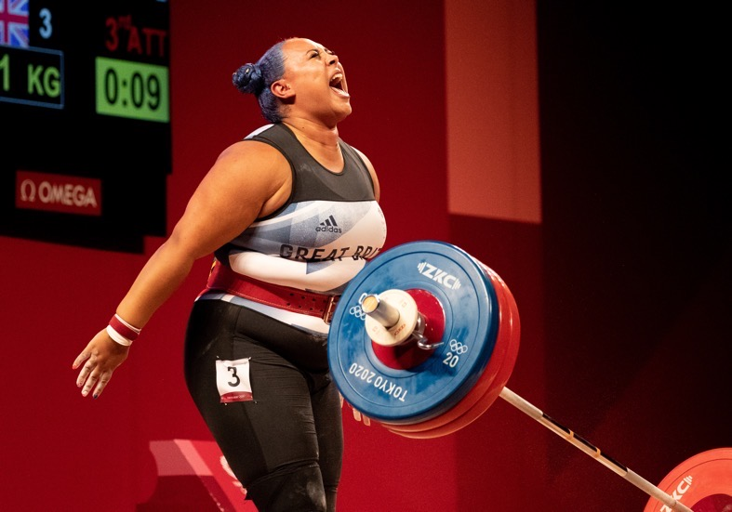
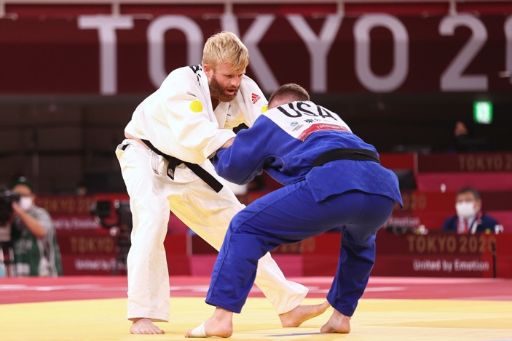
Judging criteria
    The judging panel are looking for designs that:
    are the most creative and exciting
    inspire people to not just eat healthy,
    sustainable food, but to enjoy it
    are eye-catching, and will stand out on an Aldi lorry.
    Think through your initial ideas and get ready to
    create your final design!
Your design must be created by hand, not on a computer, and cannot use the Olympic Rings or the Paralympic Agitos!
Notes:
Activity 3 – Judging criteria and final designs: How can we create an eye-catching design?
Share the competition judging criteria with the class. Think through your initial ideas and get ready to create your final design!
Ask students to create a list of things to bear in mind when creating their final design.
Examples:
practising their final design before putting it onto the template
spacing on the page
creating a clear design
using pens/materials clearly and making sure they make a clear mark on the page
using photos as reference to help draw foods
practising writing on other paper to check spelling first
remembering to take time.
Support: Create this list as a class. Take the opportunity to remind students of the stimulus they have seen across the session – such as the images of different foods, and the different example designs. You may want to share a library of fruit, vegetable and other healthy food images.
Challenge: Suggest students try out a chosen idea in a range of artistic styles.

Slide 17
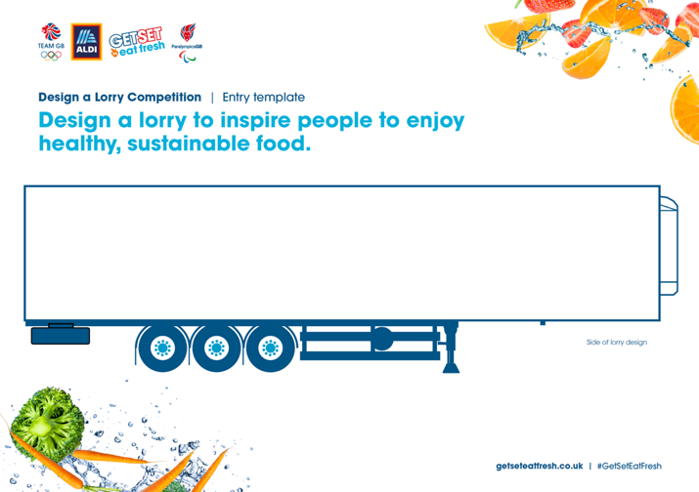
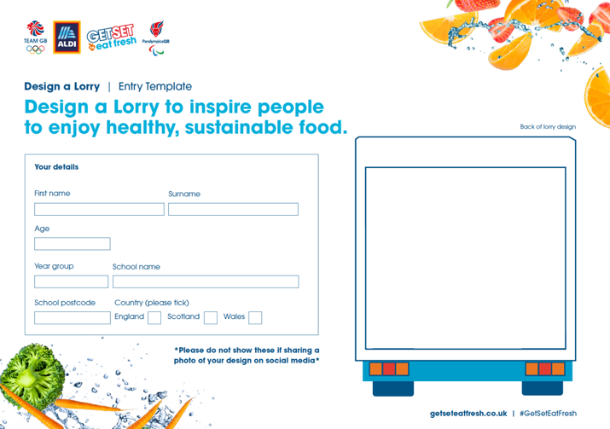
Entering the competition
    Once you have finalised your design:
    draw your design clearly and neatly on to the Entry template
    don't forget to design the back of the lorry on the second page
    enter your personal details on the second page
    return your completed entry to your teacher.
    Thanks for designing a lorry to celebrate healthy, sustainable food – and good luck!
Notes:
Entering the competition
If you are not completing the final designs within the class, you may wish to add a date to this slide by which students should return their entry to you.
If you are setting the design as homework, you may wish to download and complete the Parents letter document, to ensure entries are returned in time.
Please send all your students’ entries, together with the Cover sheet for entries, by Friday 23 June 2023. Entries received after this date will not be accepted. Submission of entries also requires acceptance of Terms and Conditions. For more information, and to download the Entry template and Cover sheet for entries, please visit: getseteatfresh.co.uk/designalorry
Why not share your classes designs to inspire other people to get involved with the competition? Submit a showcase on the GSTEF community page or tweet @AldiUK, @TeamGB and @ParalympicsGB using #GetSetEatFresh. Ensure all sharing is in line with your school’s safeguarding procedures (i.e. obscure student details from images) before posting.

Slide 18

How can we inspire people to enjoy healthy, sustainable food?
        What are your favourite healthy foods?
        How do they look, feel and taste?
        Foods
        fruit - vegetables - bread - rice - pasta - noodles - oats - meat - fish - beans eggs - milk - cheese - yoghurt - oil - water - juice
        Look
        beautiful - attractive - colourful - natural - shiny - multi-coloured - bright
        Taste
        sweet - salty - sour - bitter - spicy – savoury - cooling - fruity - fresh
        refreshing - rich - zesty - tasty - delicious - wonderful - unique
        Texture
        chewy - crumbly - creamy - crispy - crunchy - dry - gooey - juicy - light
        tender - smooth
        How do you feel when you eat your favourite healthy, sustainable foods?
        happy - excited - amazing - great - comfortable - warm - relaxed - strong healthy - energised
        How can healthy, sustainable food help you stay healthy and perform your best?
        stay healthy - build muscle - strong bones - have energy - feel awake concentrate - do sport/work - help the planet
        What are the top three things you think are great about healthy, sustainable food?
        choice - taste - look - feel - variety - traditions - culture - trying local foods
        - exploring new foods - favourite - it helps me perform my best - having fun with food - spending time with friends/family - sharing - coming together
        - learning new skills - better for the planet - less greenhouse gas - local food
        - seasonal fruit and vegetables - less plastic waste
Notes:
How can we inspire people to enjoy healthy, sustainable food?
Printable support slide. Provide this word bank to support students when discussing what’s great about healthy, fresh food - and how we can celebrate it.

