Slide 1
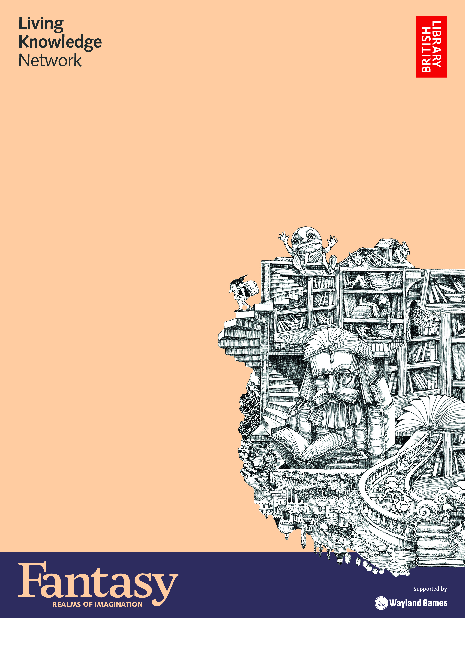
Fantasy:
Realms of Imagination Exhibition
21st February- 21st March at Holt Park
Community Hub and Library
Journey from fairy tales and folklore and all the way to Neverland. Venture into lands occupied by goblins and go down the rabbit hole. Gather your fellow adventurers and step through the portal into the realms of fantasy.
Who knows where the journey will lead…
With items from Leeds Libraries' Special Collections, transporting art installations and displays from the British Library.

