Slide 1
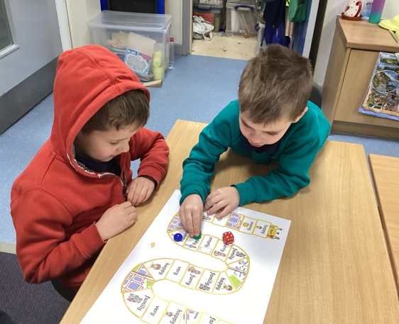
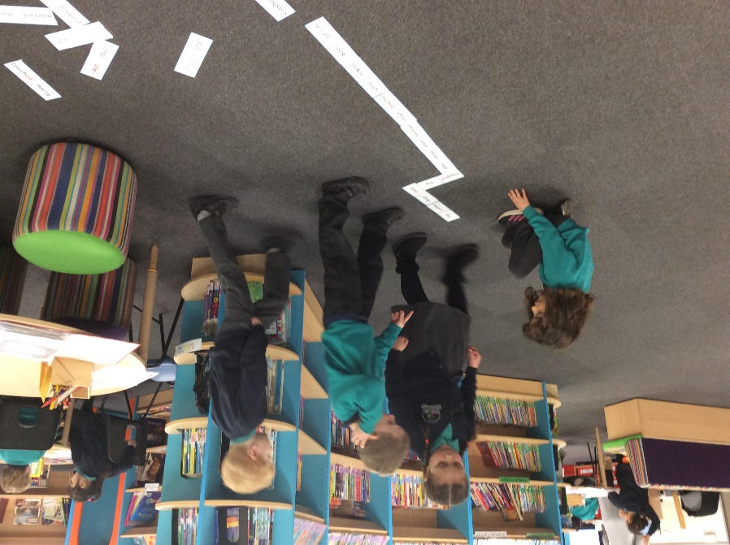

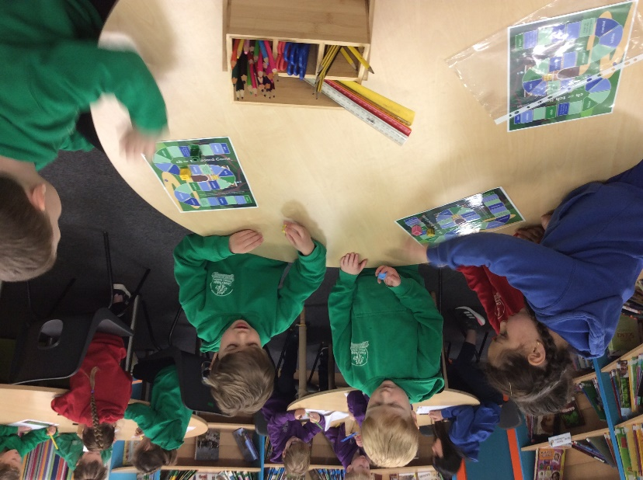
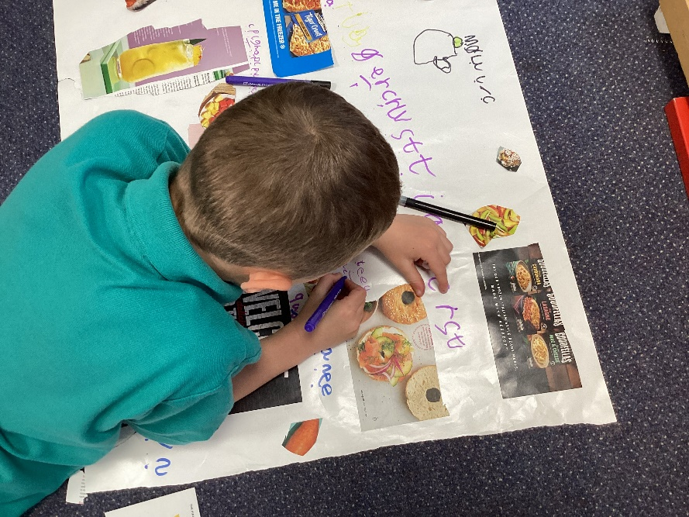
PHONICS

Slide 2

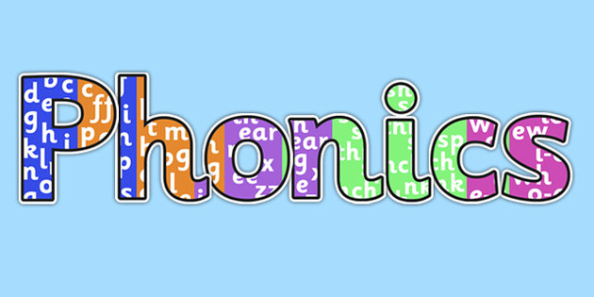
What is Phonics?
Why do we teach it?

Slide 3
Teaching phonics is all part of holistic literacy. It’s repetitive, which helps those that struggle with a short term memory. It can be fun and differentiated and over it all it will give the child the confidence to grow and develop a love of reading.

Slide 4
Phonics screening
Year 1 children to complete phonics screening wk commencing 10th June 2024
What is the Phonics Screening Check?
The Phonics Screening Check 2024 (or Phonics Screening Test) is a test to assess and show how well your child can use and apply the phonics skills that they've learnt up to the end of Year 1

Slide 5
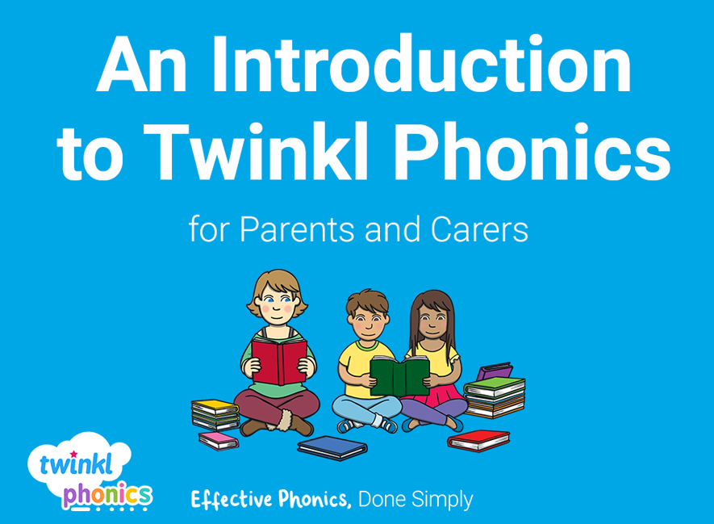
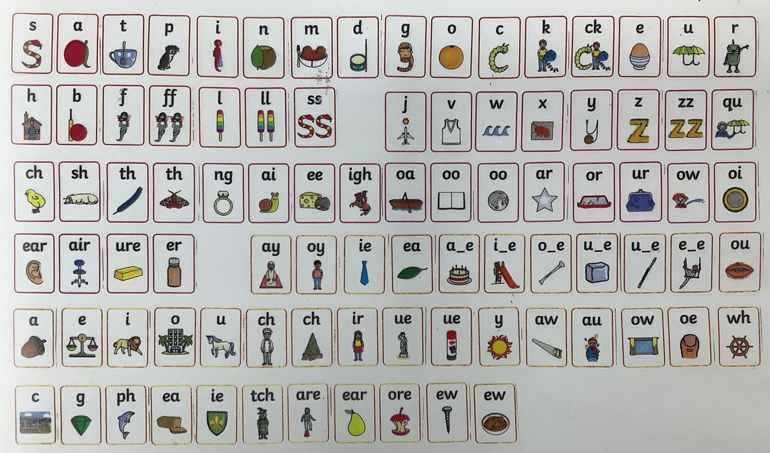

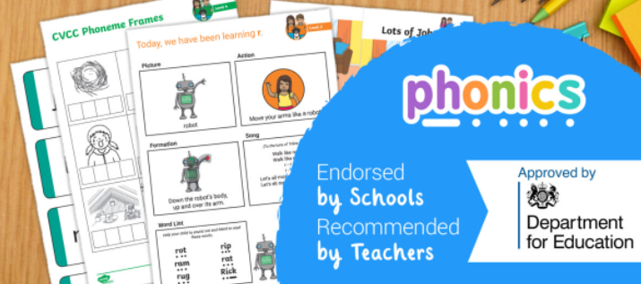
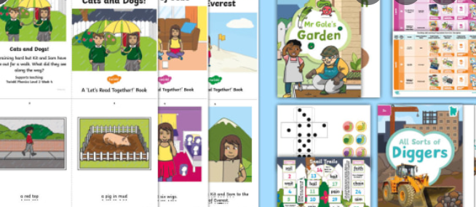

Slide 6
      Reading Scheme

Slide 7
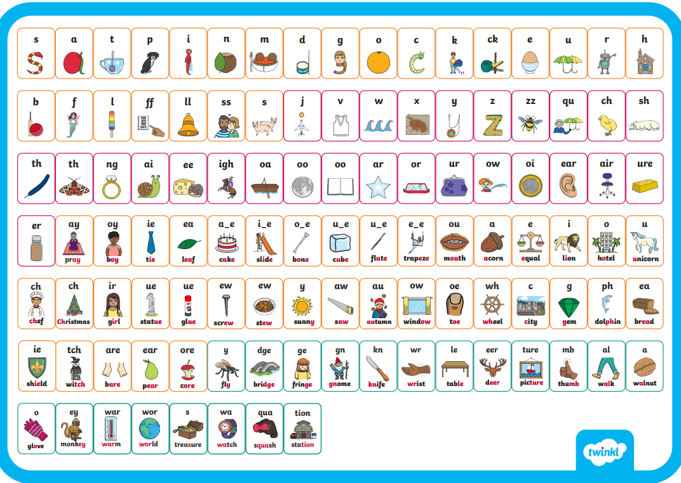
Which phonemes can you spot when you are reading?

Slide 8
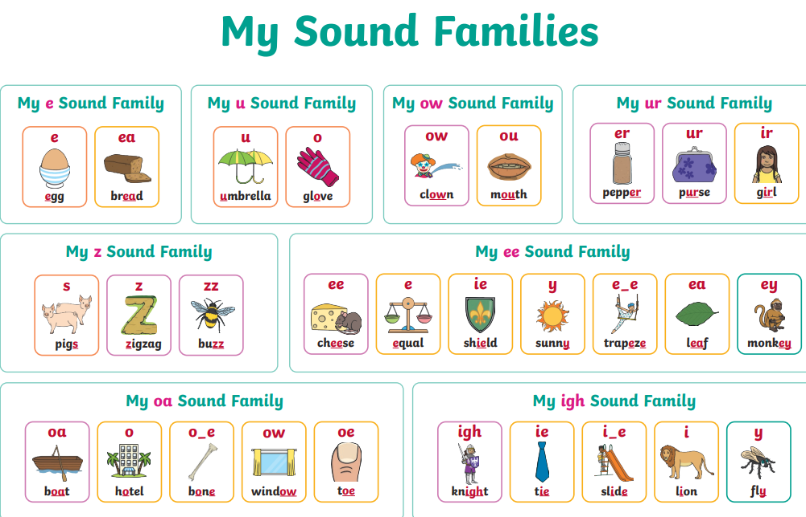

Slide 9
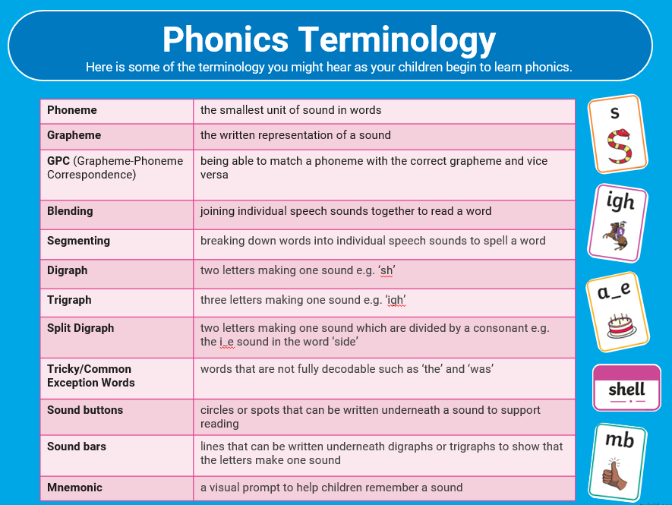

Slide 10
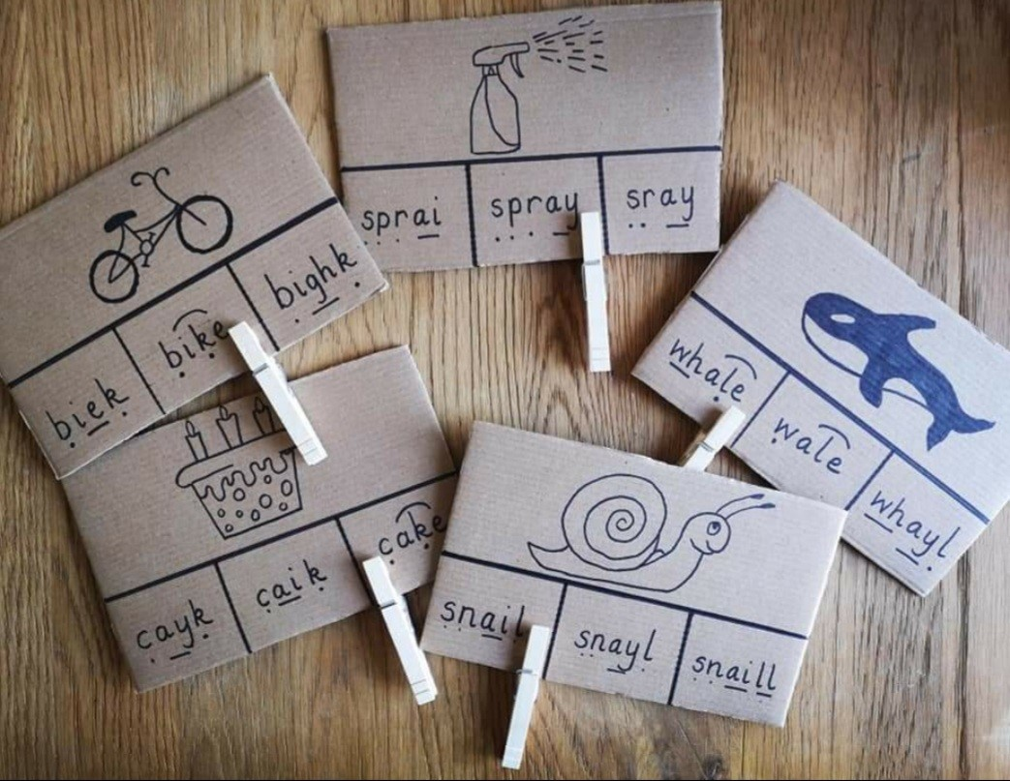
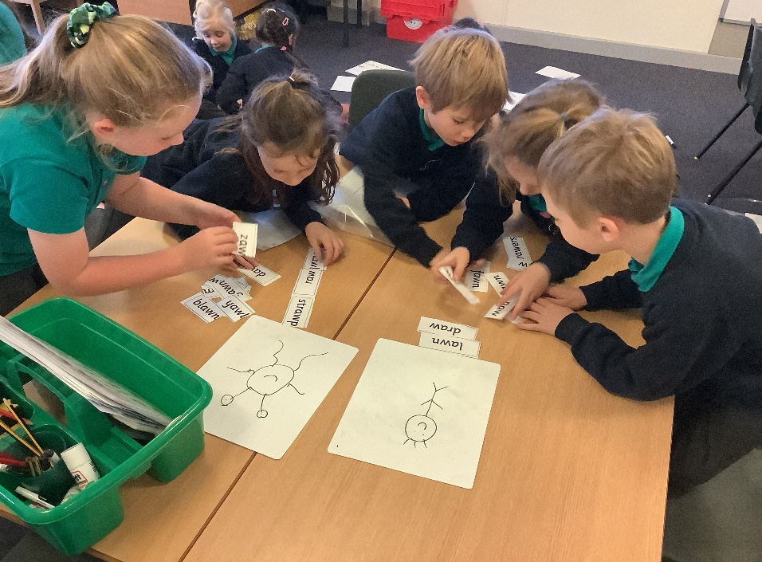
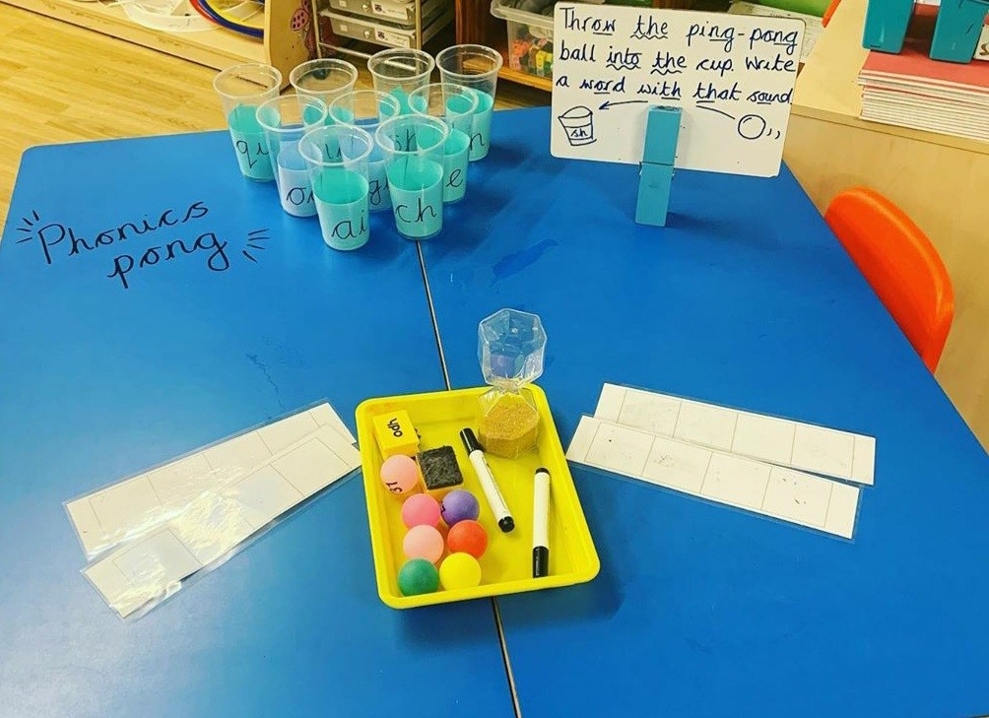
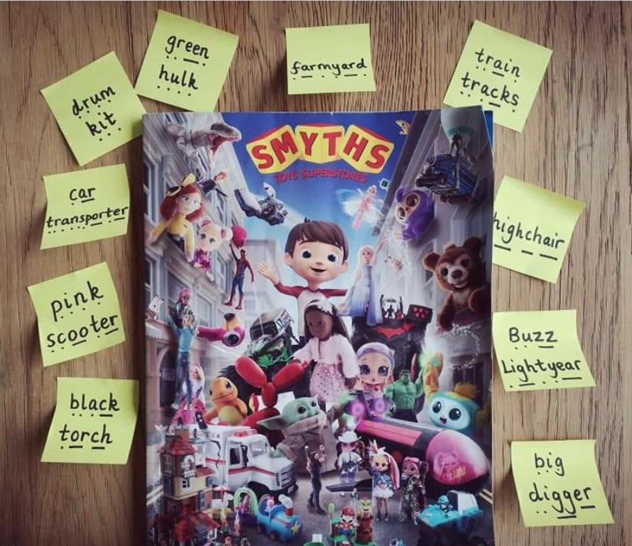
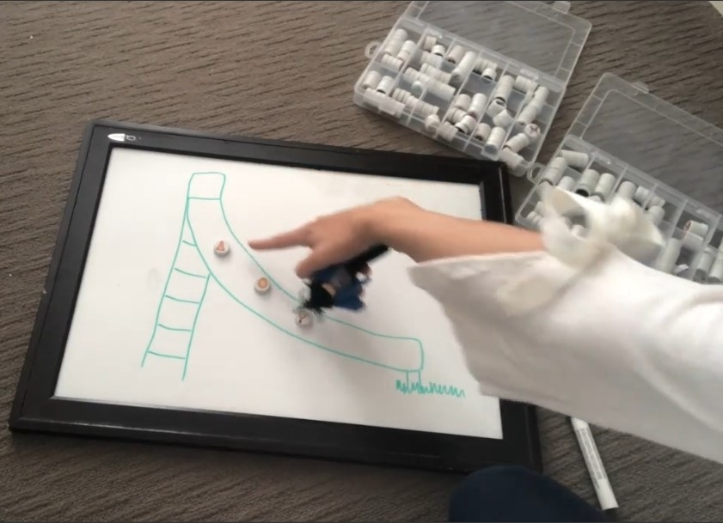
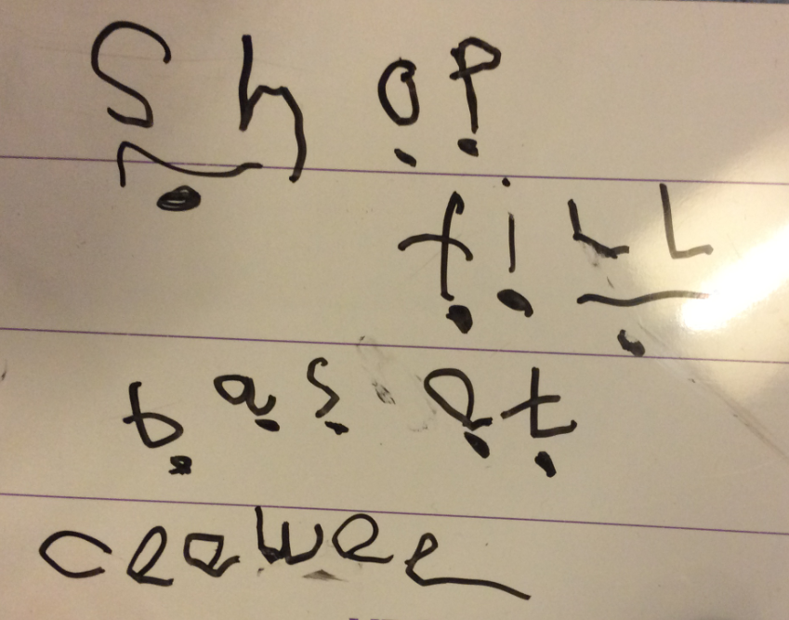

Slide 11
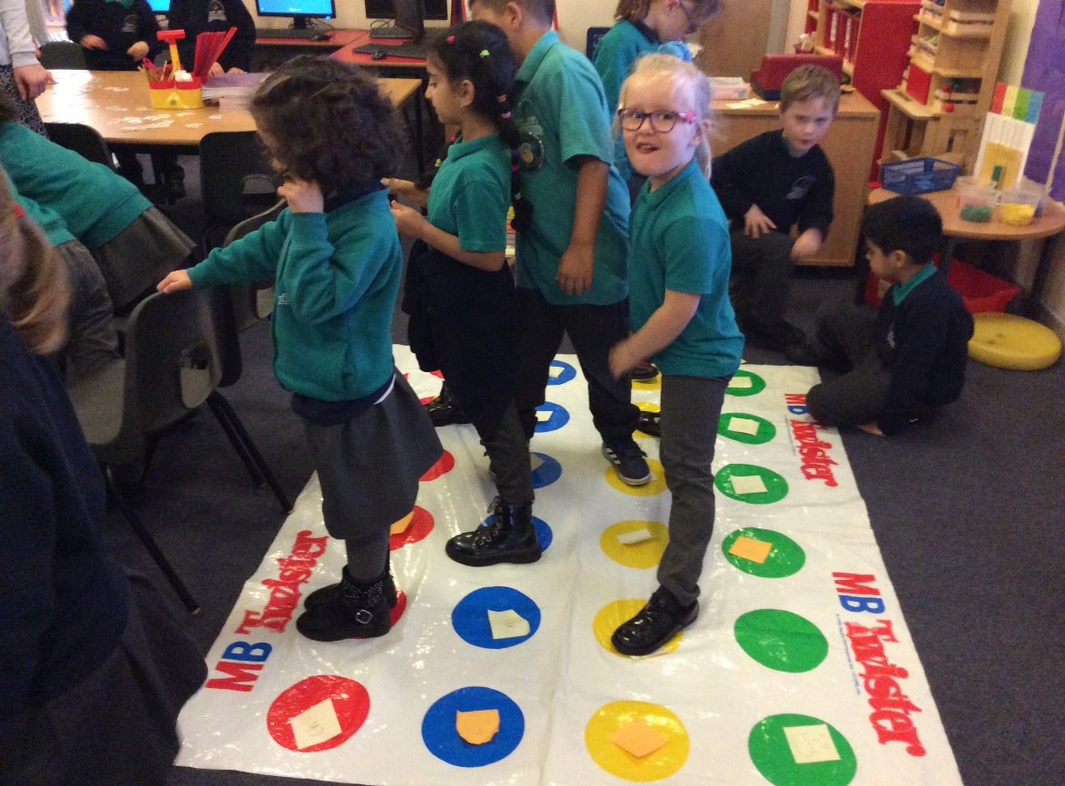
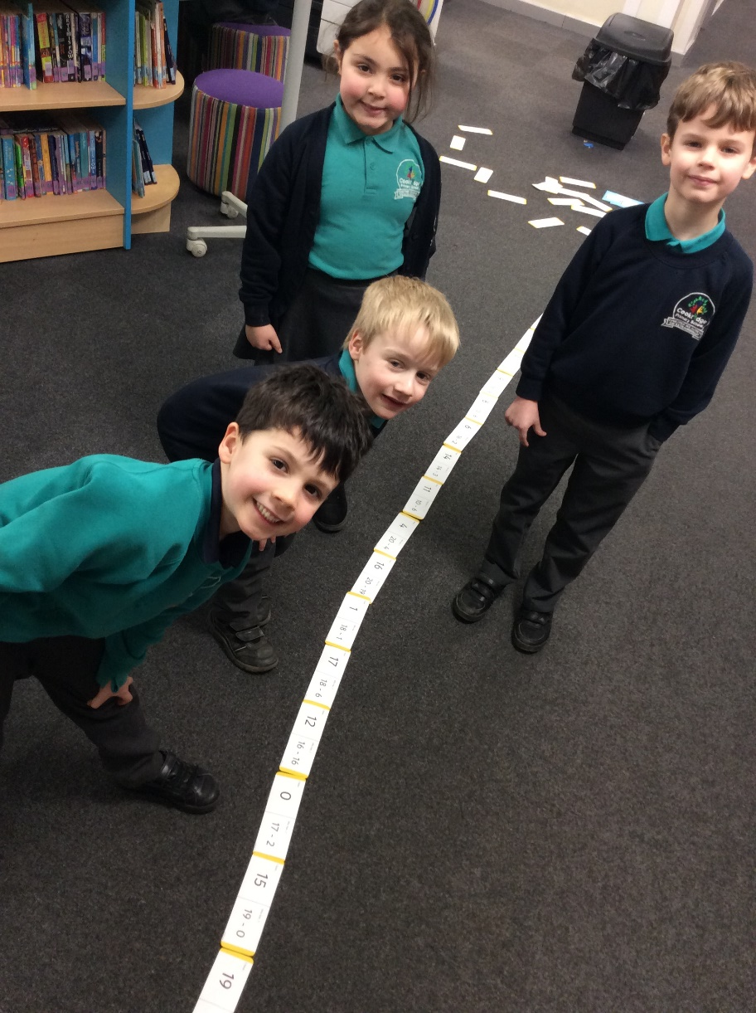
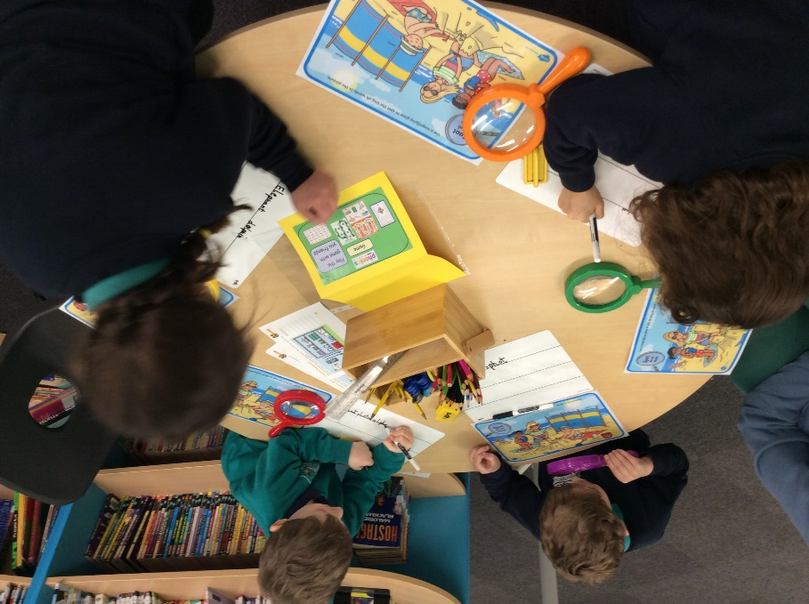
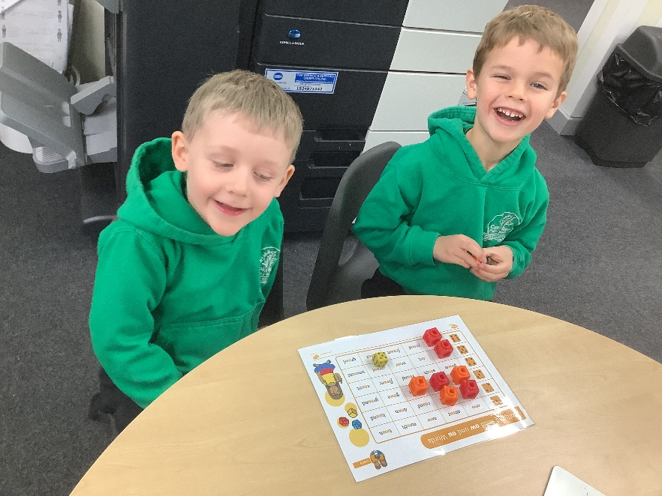

Slide 12
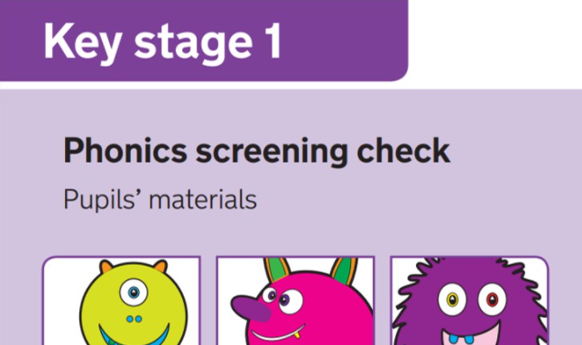
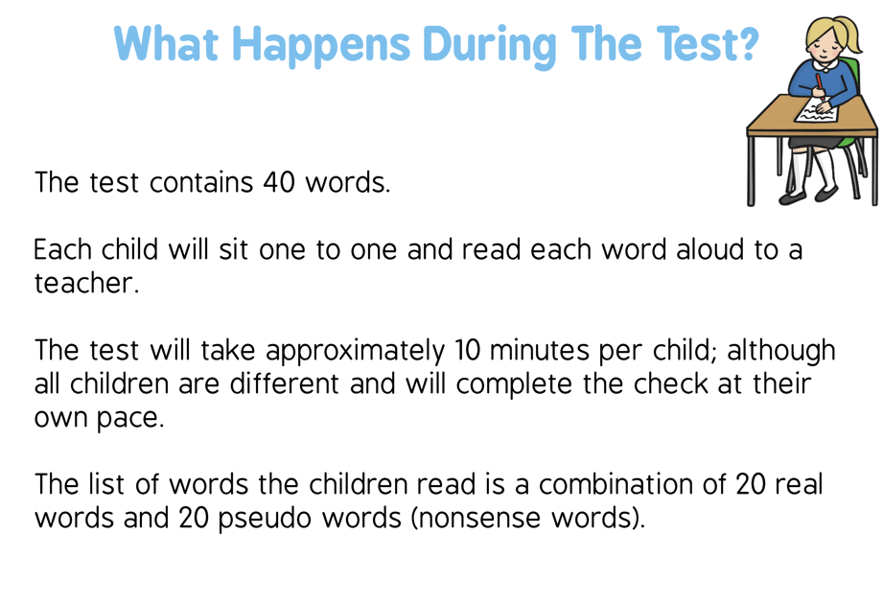
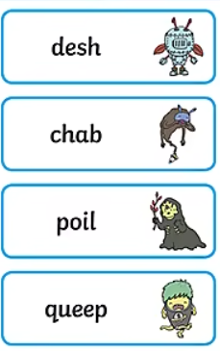
Phonics Screening test
Results from the check will be used by schools to analyse their own performance and for Ofsted to use in inspections.

Slide 13
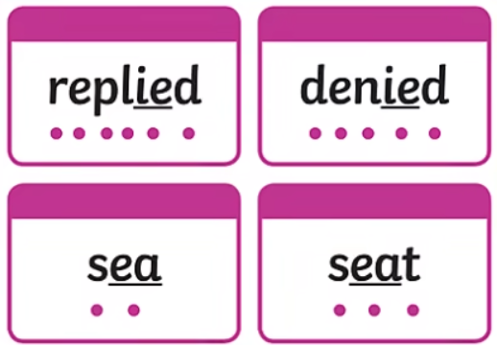
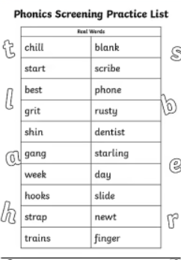
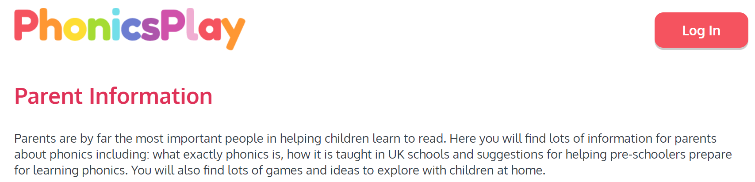
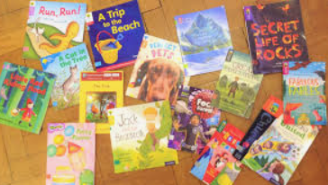
How you help your child to prepare for the phonics screening test
Read at least 3 times a week
https://www.phonicsplay.co.uk/parents

Slide 14

Useful websites/reading https://www.twinkl.co.uk/go
Phonics Play – Planning, resources and online games
Oxford Owl –Ebooks to read and resources
https://www.twinkl.co.uk/resource/t-l-526364-phonics-screening-check-parents-information-pack-and-home-learning-tasks
https://www.twinkl.co.uk/resource/t-l-2409-parents-phonics-screening-check-resource-pack
What is Synthetic Phonics?- A summary

Slide 15
Any questions?

